Slide 1
SCALP AND HAIR
Afable, Guaves, Ordonez, Pahuyo, Signey, Villanueva

Slide 2
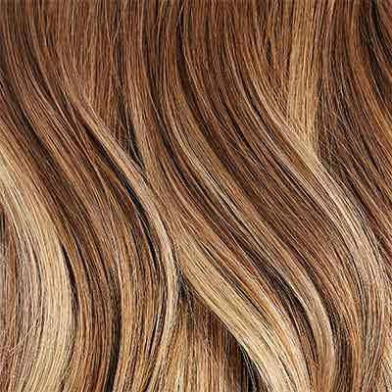
HAIR/SCALP CHARACTERISTICS
Hair is a derivative of the epidermis
Can vary in shape, length, diameter, texture, and color
Skin needs of the scalp are complex
Functions:
Protection
Regulation of body temperature
Facilitation of evaporation of perspiration

Slide 3
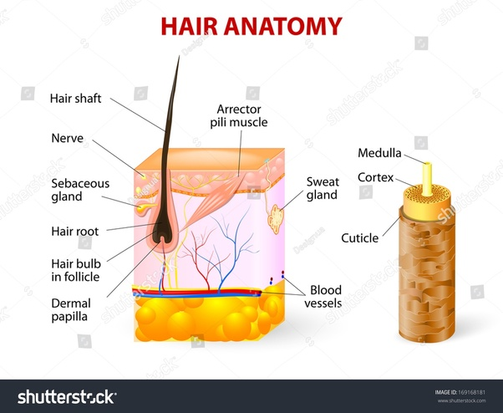
Characteristics of Skin Area
The hair shaft is formed of three layers:
Medulla
Deepest layer of the hair shaft
Cortex
Middle layer
Provides the strength, color and texture of the hair fiber
Cuticle
Outer layer
Thin and colorless
Notes:
Hair consists of two distinct parts, the hair follicle and hair shaft. The hair shaft is part of your hair that can be seen above scalp. It is composed of the protein keratin, which is produced in the skin. Keratin makes hair both strong and flexible

Slide 4
Characteristics of Skin Area
Hair follicles anchors each hair into the skin
Hair bulb forms the base of the hair follicle
Blood vessels nourish the cells in the hair bulb and deliver hormones that modify hair growth and structure

Slide 5
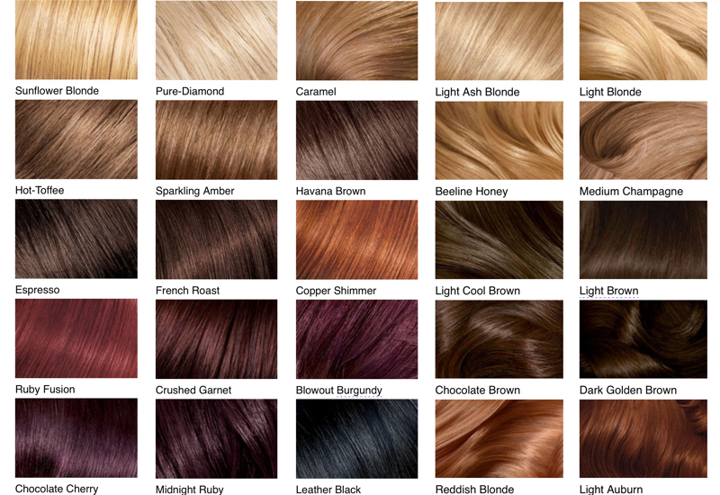
Characteristics of Skin Area
Hair Color: melanin pigments
Eumelanin: brown to black
Phaeomelanin: yellowish-blond, ginger and red colors
Absence of pigment white/gray hair
Notes:
With aging, pigment cells die, and hair turns gray.

Slide 6
Skin Care Needs
remove excess skin scale
key to scalp skin health
loosen shredding hair
maintain the biofilm of sweat, sebum, and organisms in balance
Notes:
Skin scale allows the accumulation of sebum and sweat, making it prone to microbial contamination

Slide 7
Hygiene Needs
Massaging your scalp regularly helps release the sebum. Oiling and deep conditioning the scalp after a shower is essential for long hair since the lengthier the hair, the more lifeless it becomes.
Not washing your hair often or washing your hair very often can both be harmful. So, washing your hair twice a week is the minimum advisable. Alternatively, use mild shampoos. Make sure you get rid of oily scalp completely.
Let your hair dry naturally and do not keep your hair tied up when they are still wet. You may end up breaking more hair follicles.
Towel dry your hair and then apply serum to your hair tips and not on your scalp or root.

Slide 8
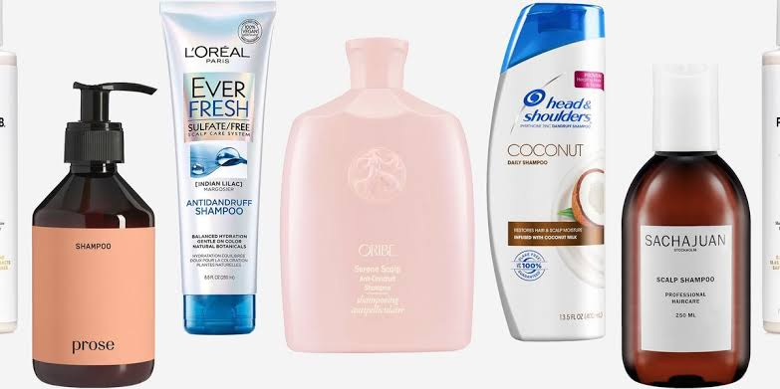
Basic Cosmetic Formulations
Shampoo
Liquid formulation for washing hair to remove dirt, used for removal of oils, dirt, skin particles, dandruff, environmental pollutants, and other contaminant particles, that gradually build up in the hair
Types: General Purpose Cleaning Shampoo, Conditioning Shampoo, Antidandruff Shampoo, Dry Shampoo
Notes:
Based on specific functional appeals
Johnson in Hair and Hair Care identified 4 types of Shampoos.

Slide 9
Basic Cosmetics Formulation
Conditioner
Make the hair easier to comb, frizz-free, soft feeling, reduce static charges, improve shine, and protect hair from future damage

Slide 10
Basic Cosmetics Formulation
Hair Gels
designed to help hold hair in a fixed shape. It is a clear product that is smoothed through the hair, coating it, and setting up a rigid film that inhibits movement.
Shaving foam
Hydration. Lubrication. Tracking. Soothing and refreshing.
Notes:
Light hold, firm hold, strong hold

Slide 11
Basic Cosmetic Formulation
Hair Dye
cosmetic products are used for colouring hair.
Types: temporary, permanent
Notes:
These products are mainly classified into two categories according to their duration in the hair, i.e., temporary and permanent. This classification is in line with the type of active ingredients involved in the dyeing process and with the dyeing process itself, commonly known as non-oxidative and oxidative hair dye products.

