Slide 1
Neck & Underarms
Aala, Ang, Bueno, Cuesta, Lazaro
Aala, Ang, Bueno, Cuesta, Lazaro

Slide 2
Neck

Slide 3
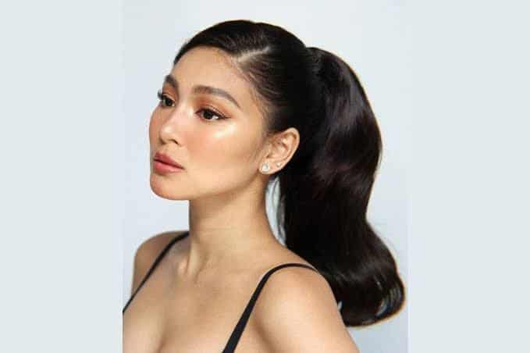
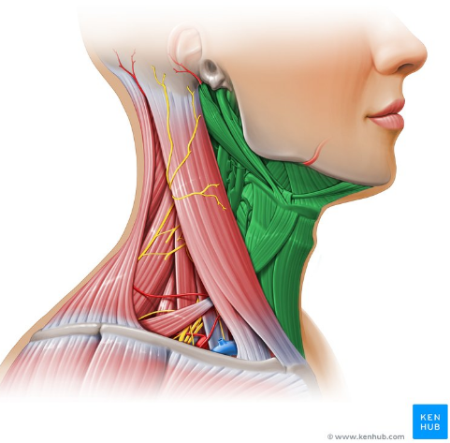
Anatomy and Physiology
Highly mobile skin
Contains fully mature hairs (males) and thin vellus hairs (females)
Covers important underlying structures
Does not heal well due to continuous movement
Notes:
Provides a transition between the thin skin of the neck and the thicker skin of the upper chest and back
Vellus - regulate body temperature
Important structures - blood and nerve supply to head, cervical spine, muscles that move head from side to side

Slide 4
Skin Care Needs
Good moisturization
Sun protection

Slide 5
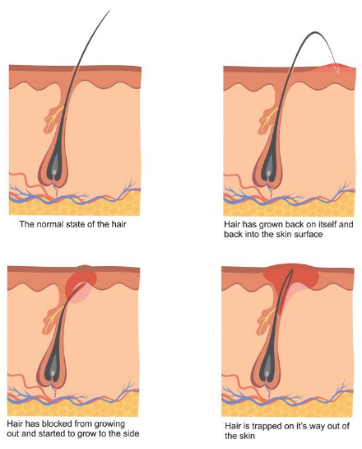
Hygiene Needs
Cleansing should be thorough but not over drying
Transition area for hair growth between the beard and the body hair of the chest
Shave frequently and keep hairs short to avoid ingrowth
Notes:
Hair exits the skin in many different directions
Predisposes to inflammation of hair follicular ostia (razor burn)
Pseudofolliculitis barbae - curved hair shaft reenter skin -> inflammation and infection

Slide 6
Basic cosmetic formulations applied to the Neck
Moisturizers (face and neck lotions/creams)
Exfoliators
Contouring creams
Sunscreens
Notes:
https://cosmeticsinfo.org/product/skin-care-products-creams-lotions-powders-and-sprays
https://www.makeup.com/tricks-for-younger-looking-neck

Slide 7
Common Dermatologic Disease Conditions
Fragrance allergy
Allergic contact dermatitis
Papules
Vesicles
Patch testing of fragrances
Severe razor burn
More common in curly-haired people

Slide 8
Underarms

Slide 9
Anatomy and Physiology
Intertrigenous site
Body area where 2 skin surfaces meet
Characterized by moisture retention, skin movement and warmth
Contains two types of sweat glands
Eccrine
Apocrine
Produce a yellowish scented sweat
Growth media for bacteria for odor producing bacteria

Slide 10
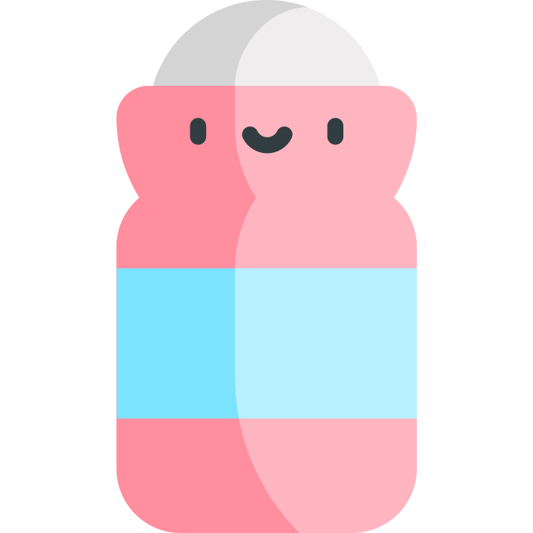
Skin Care Needs
Use of effective, non-irritating antiperspirant
Use of well-designed razor and shaving cream to both soften and reduce friction
Depilatories are typically too irritating for armpit hair removal
Hair removal is important in controlling armpit odor
Removal of hair limits amount of bacterial growth
Notes:
Topical antiperspirants may cause irritation
Hair removal can also cause irritation

Slide 11
Hygiene Needs
Elimination of eccrine and apocrine sweat
Control of sweat prevents body odor, skin barrier damage, infection, and emotionally disturbing wetness
Antiperspirants, oral medications, and chemodenervation (botulinum toxin) can be used

Slide 12
Basic cosmetic formulations applied to the underarms
Antiperspirants and Deodorants
Shaving creams
Exfoliators
Moisturizers
Notes:
https://www.makeup.com/underarm-care
https://beautymnl.com/bloom/articles/the-beginner-s-guide-to-starting-an-armpit-care-routine

