Slide 1
Hands and Feet
Huna, Malhabour, Querubin, Samson, Tiangco, Zorilla

Slide 2
Hands

Slide 3
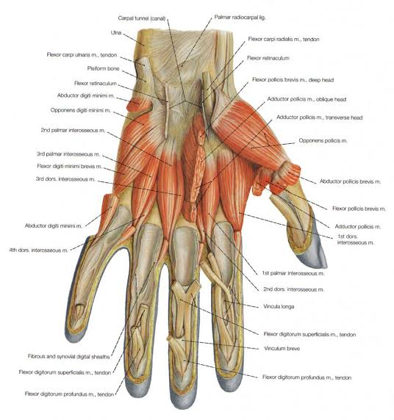
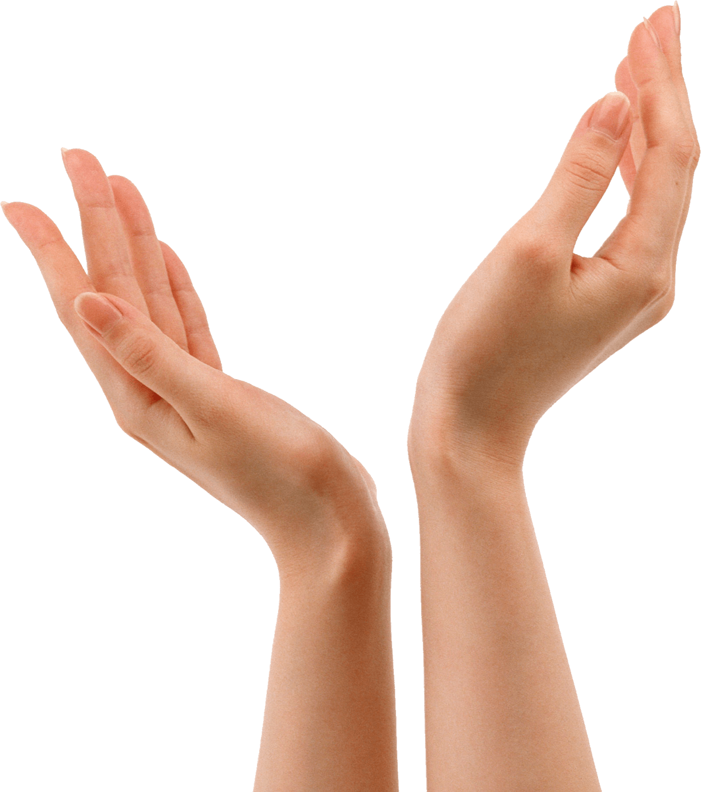
Characteristic of the skin area
Anatomy and Physiology
Formed of many tiny muscles and bones = agility
Vector for nose, eye, and mouth tissue infections
Eccrine glands - sweat glands; largely under emotional control (warm weather and stressful conditions)
Callus - thickened skin; retained keratin layers

Slide 4
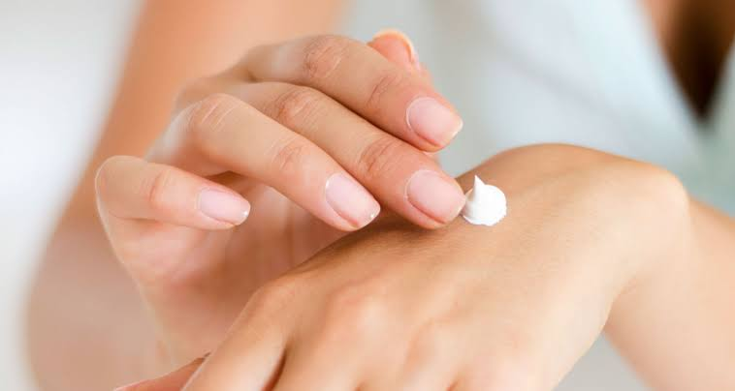
Skin Care Needs
Hand moisturization
Hand moisturizers should be designed to occlude the skin reducing trans-epidermal water loss, rehydrate the skin through the use of humectants, alleviate itch and pain, and smooth the skin surface with emollients.
Photoprotection
Photoaging UV A
Aggressive anti-aging therapy

Slide 5
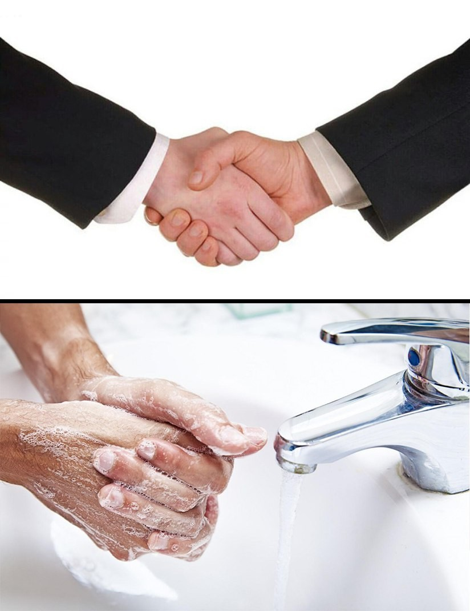
Hygiene needs
Excessive hand washing
Take toll physiologically (e.g. sebum lacking skin of the palms)
Can be considered as a medical disease (obsessive-compulsive disorder)

Slide 6
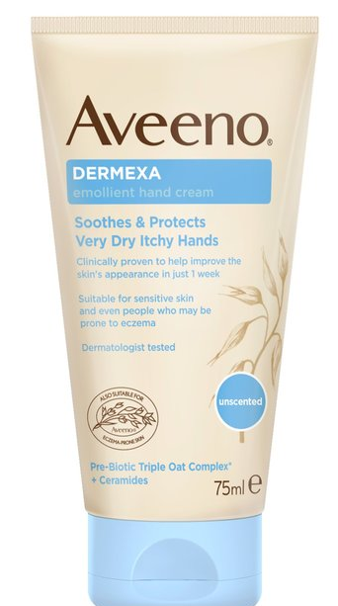
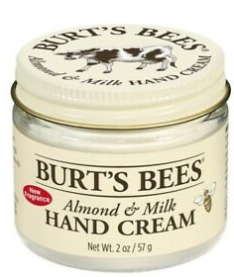
Formulation needs
Highly occlusive and emollient hand creams
Necessary to rehydrate damaged keratin and create an optimal environment for barrier repair
Usually contains petrolatum, mineral oil, or lanolin

Slide 7
Feet

Slide 8
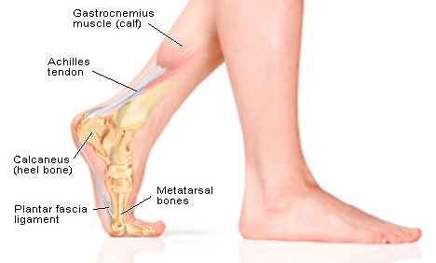
Characteristic of the skin area
Almost the same as hands
Different type of epithelium on the dorsal and plantar surface
Hair on dorsal surface, none on plantar surface
Few sebaceous glands and numerous sweat glands on the plantar surface
Anatomy
Sole of the foot - made up of tough keratin

Slide 9
Skin care needs
Use of moisturizer to minimize dryness and soften calluses
Urea, lactic acid
Foot moisturizers
Occlusive and humectant substances
Prevent hard skin
Moisturised skin has more elasticity and is better able to accommodate the movements of the foot
When skin is hydrated, it’s less likely to become cracked and damaged over time

Slide 10
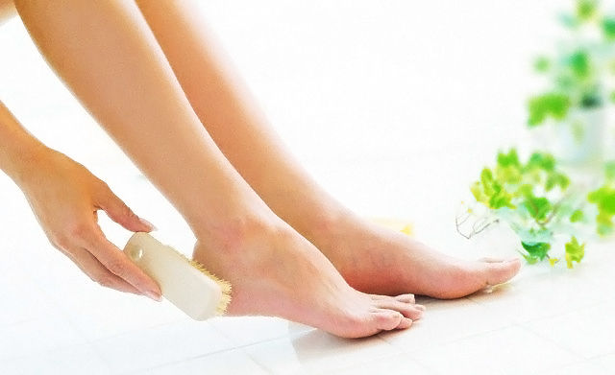
Hygiene needs
Aggressive hygiene is needed
Prevent infection
Control odor
Foot odor
Mixture of sweat with bacteria in a closed environment
Hyperhidrosis - excessive sweating

Slide 11
Formulation Needs
Foot moisturizers must be similar to hand moisturizers in that both occlusive and humectant substances must be incorporated
Used to prevent foot dryness and soften calluses
Physical act of rubbing a moisturizer on the feet can also help desquamate dead skin

