Slide 1
Approach to Hematologic Complaints (Sample Run)
Teresita E Dumagay, MD, FPCP, FPSHBT, FPCHTM, FPSBMT

Slide 2
q
Hematologic Disorders
A Diagnostic Approach
q
History
Physical Examination
Confirmatory Lab Tests
Red Flags to recognize

Slide 3
q
q
Anemia and Polycythemia
Bleeding and Thrombosis
Hematologic Disorders
A Diagnostic Approach
WBC Abnormalities
Lymphadenopathy and Splenomegaly

Slide 4
Sample Case

Slide 5
Pertinent Points
30/Male, previously well with no known co-morbids
Chief complaint of weight loss (unquantified)
5 month history of high grade fever, weight loss and night sweats initially treated as COVID initially with improvement of fever but with persistence of other symptoms
2 week history of bilateral lymphadenopathy and recurrence of high grade fever
With prolonged exposure to a patient treated for TB
PE: highly febrile at 39.8, (+) multiple matted palpable bilateral cervical lymph nodes the biggest at approximately 1cm in diameter, (+) 2cm palpable non-movable left axillary lymph node

Slide 6
Guide Questions
What additional points would you like to ask in the history and PE?
What are your differential diagnoses at this time? What is your basis for each?
What ancillary tests would you request to help you narrow down your diagnosis?

Slide 7
Additional Points
Quantify the weight loss
Functional Capacity of the patient
Work
Diet
Vices
Sexual History
Any other exposure?
Any other people in the household suffering the same symptoms?
ROS?
Any other palpable lymph nodes
Weight, Body morphology, BMI

Slide 8
Differential Diagnoses
Differential | Rule In | Rule Out
Tuberculosis | Fever Weight Loss Matted LAD Exposure to TB
Infectious Lymphangitis | Fever Weight Loss Matted LAD | Cannot account for the 5 month history
Malignancy (lymphoma) | Fever Weight Loss Matted LAD
COVID | Fever Weight Loss | Matted LAD

Slide 9
Diagnostics
Differential | Rule In
Tuberculosis | Sputum AFB Chest X-ray CBC Crea, BUN, AST, ALT **lymph node biopsy
Infectious Lymphangitis | CBC Crea, BUN, AST, ALT **lymph node biopsy
Malignancy (lymphoma) | CBC Crea, BUN, AST, ALT, calcium, phosphorous, Uric Acid, LDH **lymph node biopsy
COVID | CBC Crea, BUN, AST, ALT COVID swab

Slide 10
Sample Case

Slide 11
Summary of Labs
Mild normocytic Anemia but otherwise unremarkable CBC
Highly elevated LDH and Uric Acid, mildly decreased calcium but otherwise unremarkable electrolytes
Negative COVID swab
Unremarkable urinalysis
Unremarkable x-ray

Slide 12
Guide Questions
How do you interpret the labs?
Which differentials are ruled in or ruled out based on these labs?
What other ancillary tests would you request to help you narrow down your diagnosis?

Slide 13
Ruled Out
Differential | Rule In
Tuberculosis | Sputum AFB Chest X-ray CBC Crea, BUN, AST, ALT **lymph node biopsy
Infectious Lymphangitis | CBC Crea, BUN, AST, ALT **lymph node biopsy
Malignancy (lymphoma) | CBC Crea, BUN, AST, ALT, calcium, phosphorous, Uric Acid, LDH **lymph node biopsy
COVID | CBC Crea, BUN, AST, ALT COVID swab

Slide 14
Ruled Out
Differential | Rule In
Malignancy (lymphoma) | CBC Crea, BUN, AST, ALT, calcium, phosphorous, Uric Acid, LDH **lymph node biopsy
Tuberculosis | Sputum AFB Chest X-ray CBC Crea, BUN, AST, ALT **lymph node biopsy
Infectious Lymphangitis | CBC Crea, BUN, AST, ALT **lymph node biopsy
COVID | CBC Crea, BUN, AST, ALT COVID swab

Slide 15
Other Labs
Push for lymph node biopsy
Imaging of the rest of the body CT Scan at least – PET Scan ideally
ICC screen
Sputum AFB
PBS, reticulocyte count
**possible BMA

Slide 16
Sample Case

Slide 17
Guide Questions
How do you interpret the labs?
What is your final diagnosis?
How does the diagnosis explain the patient’s signs and symptoms?
How will you manage this patient?
What is the patient’s prognosis?

Slide 18
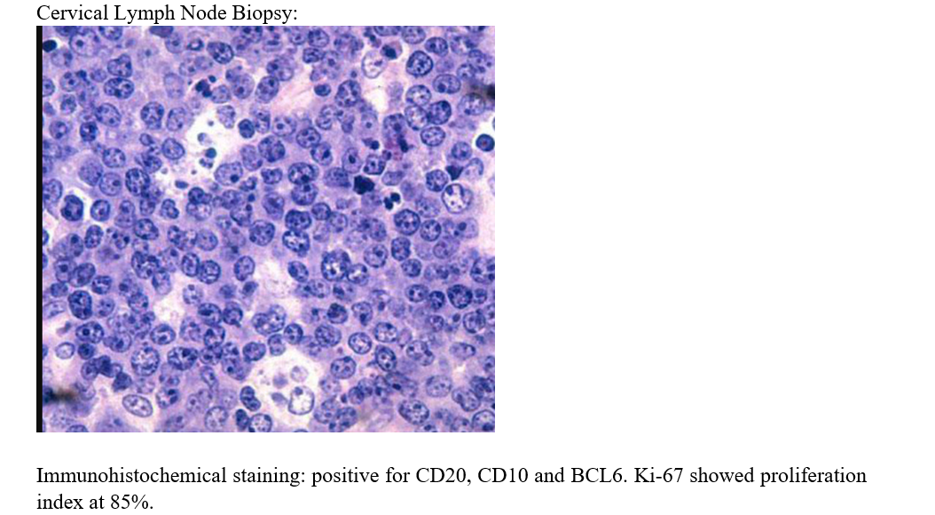

Slide 19
Final Diagnosis
Burkitt Lymphoma, Stage 3B

