Slide 1
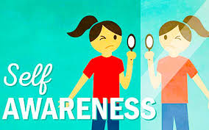
Notes:
Today, we embark on a journey of self-discovery and personal growth as we delve into the profound concept of self-awareness. In this lecture, we will explore what self-awareness is, why it matters, and how we can cultivate it to unlock our true potential.

Slide 2
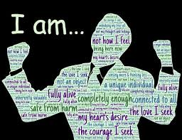
Self-awareness
ability to tune in to your feelings, thoughts, and actions
ability to perceive and understand the things that make you who you are as an individual, including your personality, actions, values, beliefs, emotions, and thought
recognizing and understanding our personalities, emotions, and skills. being able to recognize how other people see you
conscious knowledge of one's own character, feelings, motives, and desires."
Notes:
Self-awareness can be defined as the conscious knowledge of one's own character, feelings, motives, and desires. It involves having a clear understanding of who we are, what we value, and how we impact the world around us. Self-awareness is not merely about recognizing our strengths and weaknesses but also about being attuned to our emotions, thoughts, and behaviors.
Self-awareness can be defined as the conscious knowledge of one's own character, feelings, motives, and desires. It involves having a clear understanding of who we are, what we value, and how we impact the world around us. Self-awareness is not merely about recognizing our strengths and weaknesses but also about being attuned to our emotions, thoughts, and behaviors.
Self-awareness can be defined as the conscious knowledge of one's own character, feelings, motives, and desires. It involves having a clear understanding of who we are, what we value, and how we impact the world around us. Self-awareness is not merely about recognizing our strengths and weaknesses but also about being attuned to our emotions, thoughts, and behaviors.

Slide 3
4 stages /dimensions of self awareness
Self-awareness must account for:
Social – self :what others say/think about us
Self-knowledge : how we think and feel about ourselves,
Self- evaluation : who we really are
Self- expectation: who we want to become

Slide 4
Awareness of What Others Say and Think About You
first dimension of self-awareness - being aware of how you impact other people.
We tend to think that what other people say about us is a reflection of who we are. The truth is, what people say / think about us is their reaction to how we impact them. We cannot change people's reactions, only the impact we have on them.
NOTE: not everyone's reaction matters.

Slide 5
Awareness of the Thoughts and Feelings You Have About Yourself
The second dimension of self-awareness is understanding the root causes of the thoughts and emotions we have toward ourselves. Look back over the course of your young life, what memories come to mind?
.

Slide 6
Awareness of Who You Really Are
The third dimension of self-awareness is viewing who we actually are as reflected by our actions, motivations and emotions.
In his book The Speed of Trust, author Stephen M.R. Covey said "We judge ourselves by our intentions and others by their behavior."
believing we're one person but acting like we're another- that's the result of only being aware of our intentions and not our actions.

Slide 7
Awareness of Who You Want to Become
The fourth dimension of self-awareness is understanding who you want to be in the future; an awareness of your future self.
Do you know who it is you desire to be? Have you written your own eulogy? What kinds of things do you want people to say about you when you're not around?
We should regularly take time to reflect on who we want to become over time, as we grow older and more mature. This requires us to 1) let go of what other people think about us, 2) let go of what we think about ourselves, and 3) let go of the norms, behaviors, and habits we have today.
We must take our mind's eye off of the past, away from the present, and into the future.

Slide 8
Benefits of Self-Awareness:
Improved Emotional Intelligence:
Enhanced Decision-Making
Greater Resilience
Increased Self-Confidence
Authenticity and Fulfillment

Slide 9
Cultivating Self-Awareness:
Reflection
Seek Feedback
Embrace Vulnerability
Practice Empathy
Continuous Learning

Slide 10
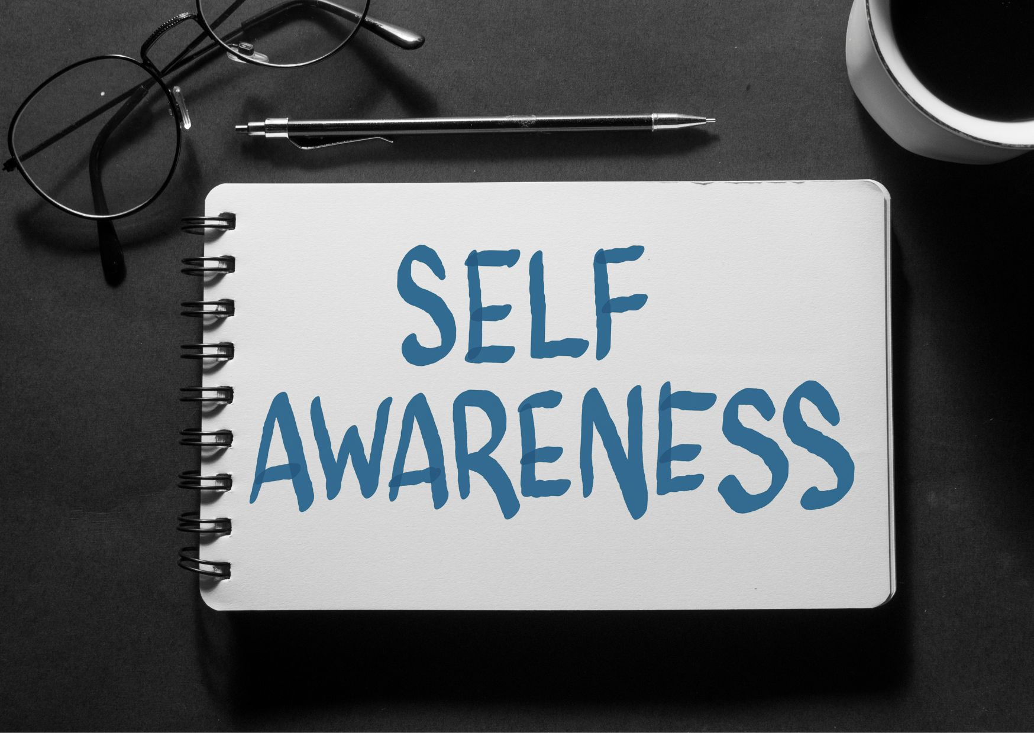
\

Slide 11
How do I know I am actually becoming more self-aware? How do I know I’m sufficiently self-aware? How do I compare my self-awareness to others self-awareness?

Slide 13
ACTIVITY: SELF-COMPLIMENT LIST
Who am I ?
Describe yourself in three words.
WHAT DO YOU LIKE MOST IN YOURSELF
WHAT ARE YOUR TOP SKILLS
What do you think are your weaknesses/faults
How do you see yourself 5 years from now?
Submission will be on Friday, via on -line submission bin

