Slide 1
MANDIBULAR MOVEMENTS
Michelle Sunico-Segarra

Slide 2
OUTLINE
Positions/ postures of the mandible
Basic movements
Functional movements
Border Movements

Slide 3
POSITIONS OF THE MANDIBLE
Centric Relation
the mandibular jaw position in which the head of the condyle is situated as far superior and posterior as it possibly can within the mandibular or glenoid fossa.
- condyle position

Slide 4
2. Centric Occlusion
maximum intercuspation
Interocclusal dental position

Slide 5
BASIC MOVEMENTS
Glinding – upper compartment
Hinge – lower compartment

Slide 6
FUNCTIONAL MOVEMENTS
Opening – downward forward movement
(EPM)
Closing – upward backward movement
(T, I, M)
Protrusive - EPM
Retrusive – posterior T
Lateral Movement (Bennet Shift)

Slide 7
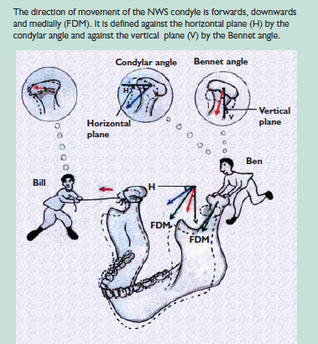

Slide 9
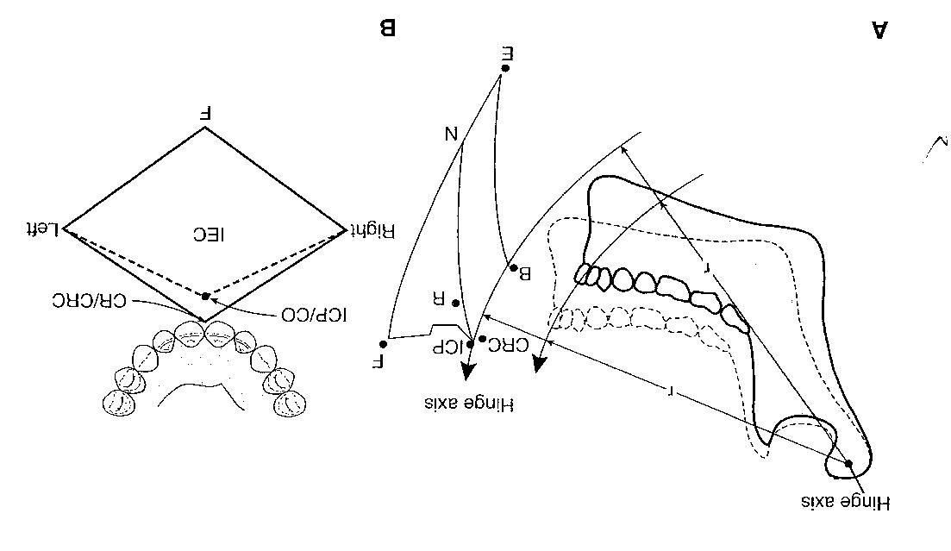
BORDER MOVEMENTS

