Slide 1
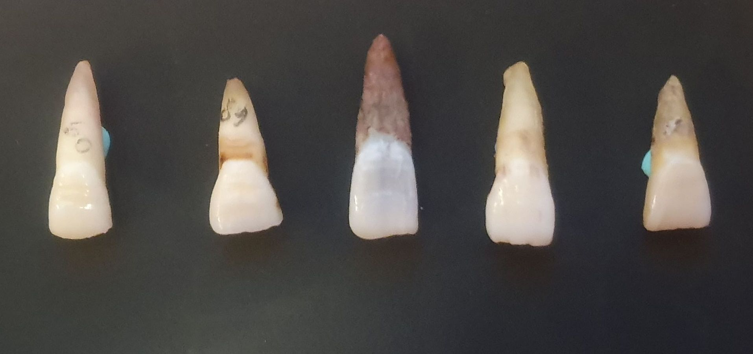
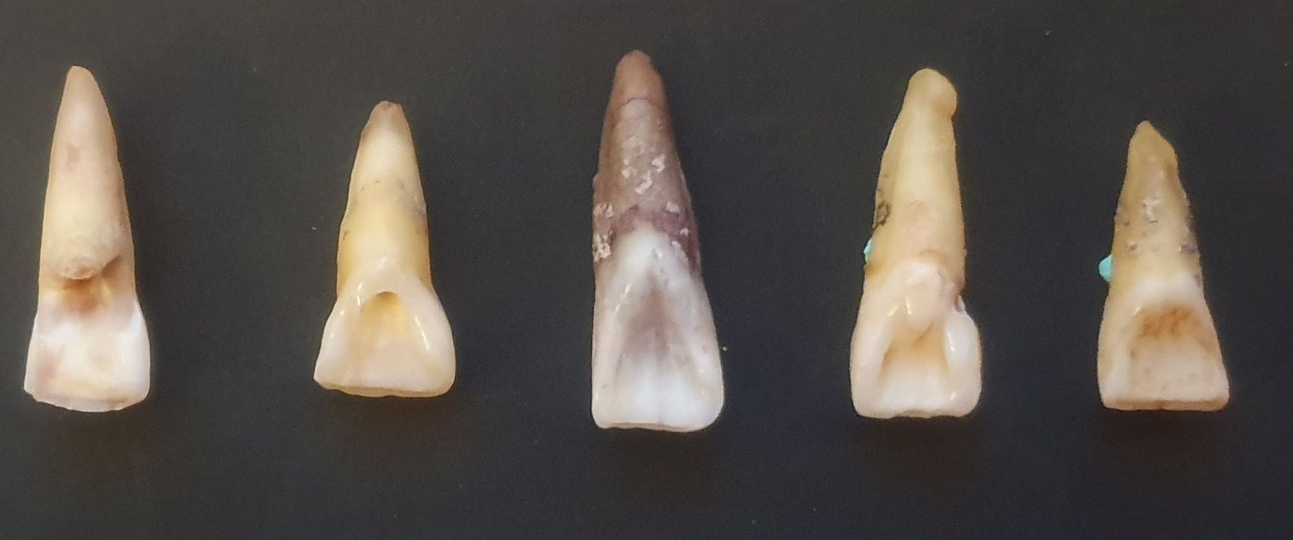
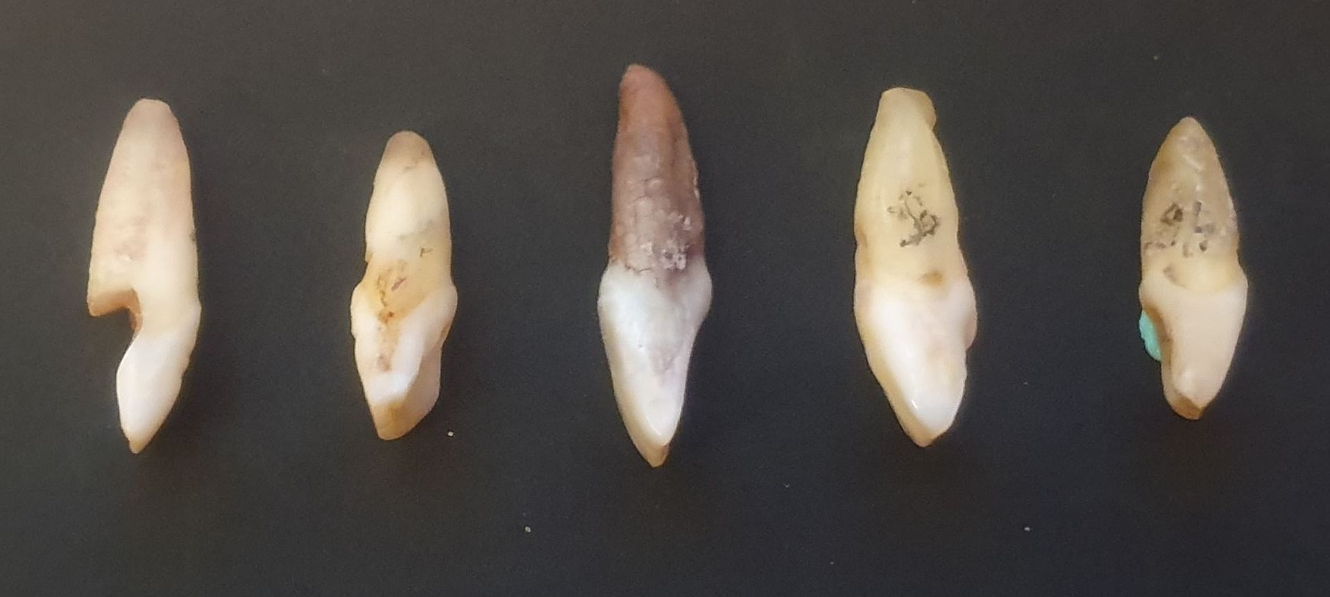
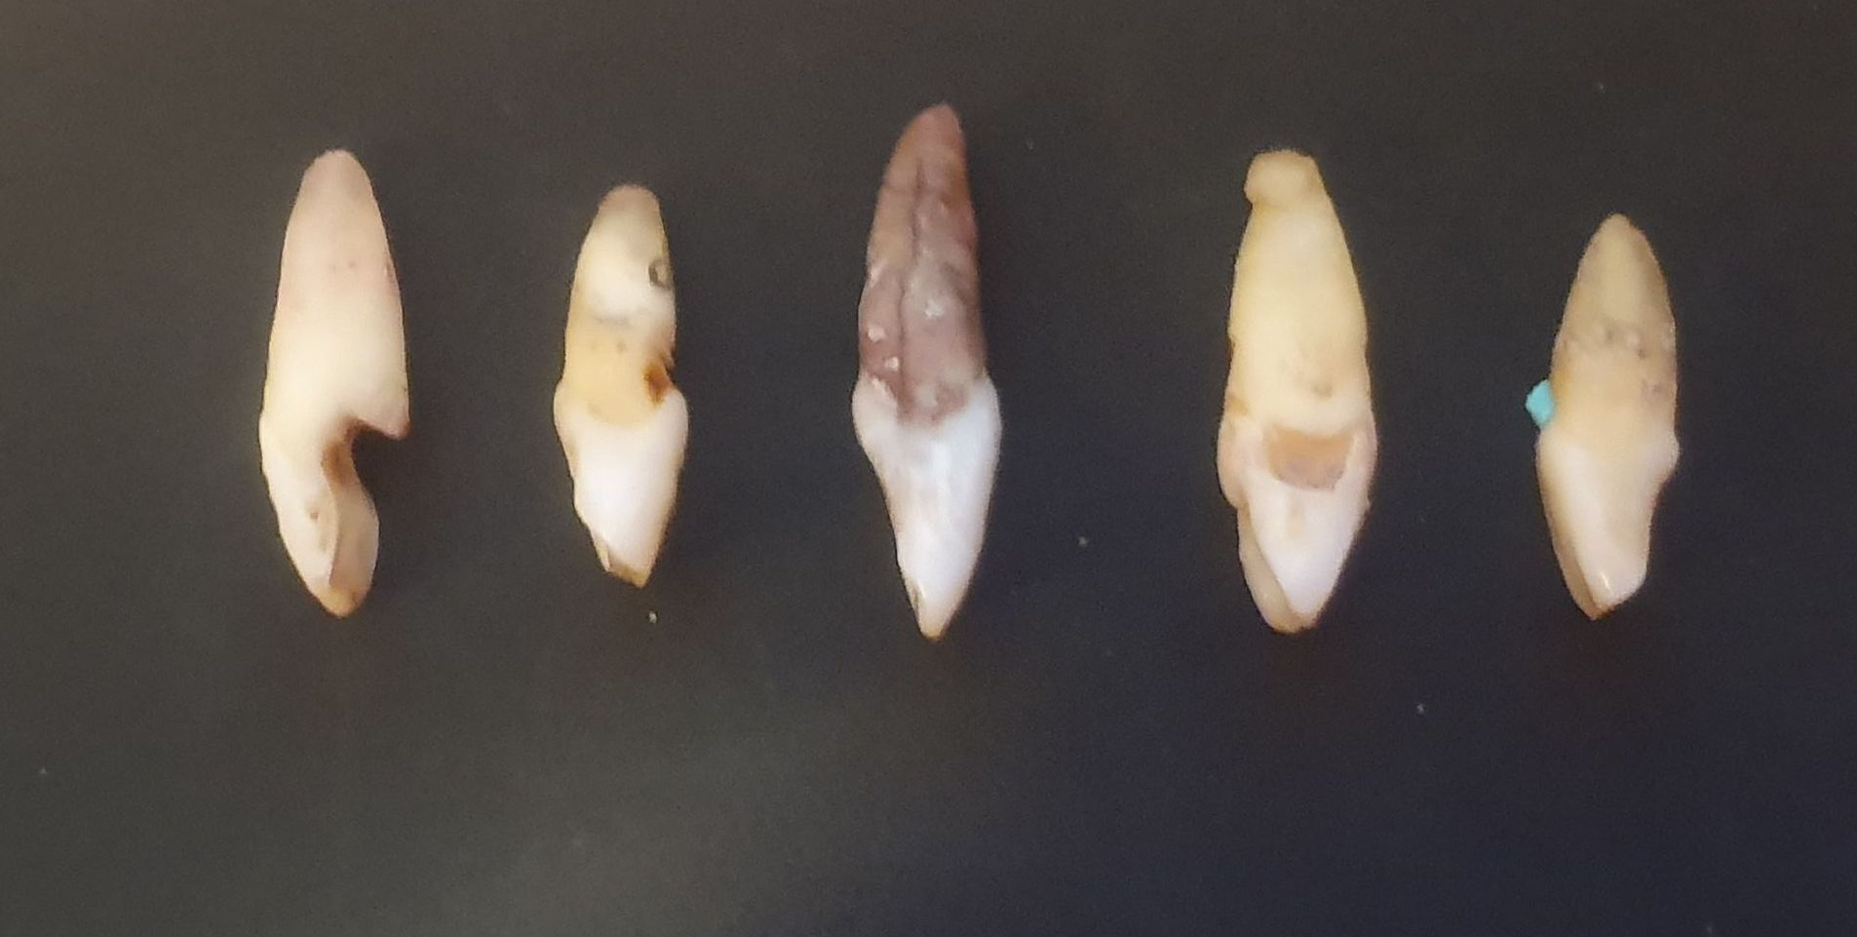
LABIAL
LINGUAL
1
2
3
4
5
1
2
3
4
5
DISTAL
MESIAL
1
5
1
2
3
4
5
2
3
4
SET 1
INCISAL
1
2
3
4
5

Slide 2
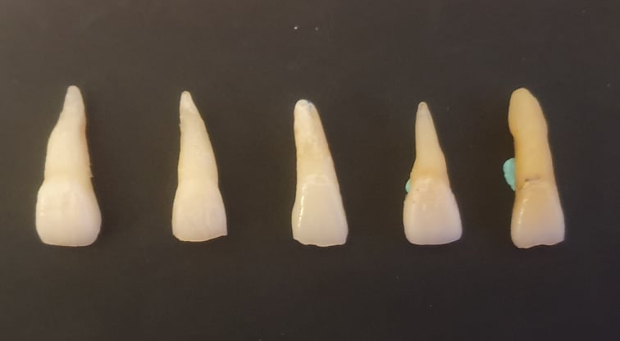
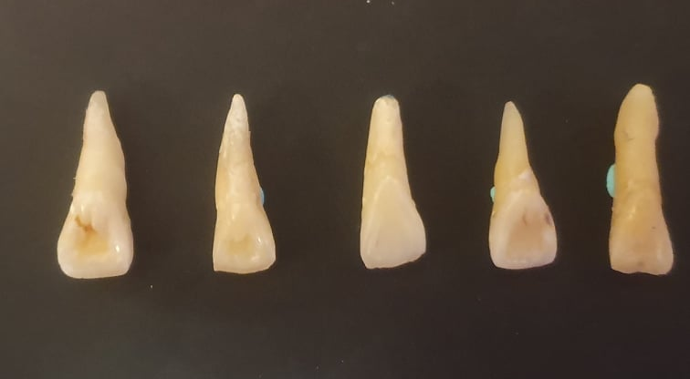
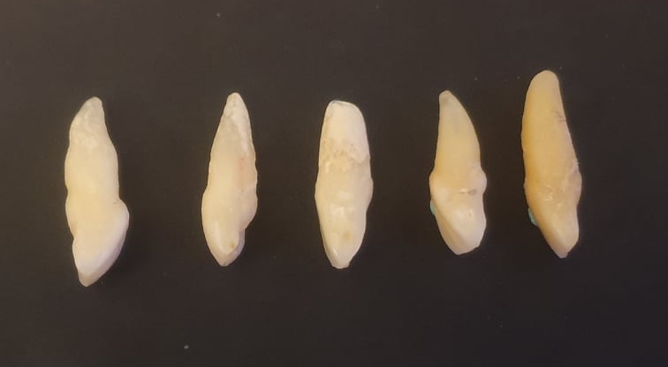
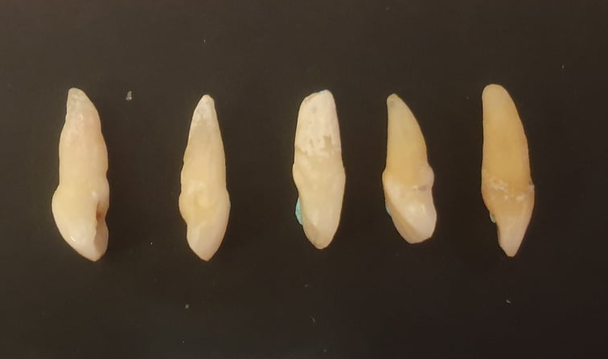
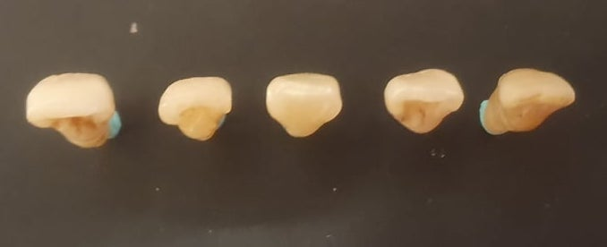
LABIAL
LINGUAL
1
2
3
4
5
1
3
5
2
4
MESIAL
DISTAL
1
2
3
4
5
1
2
3
4
5
INCISAL
SET 2
1
2
5
3
4

Slide 3
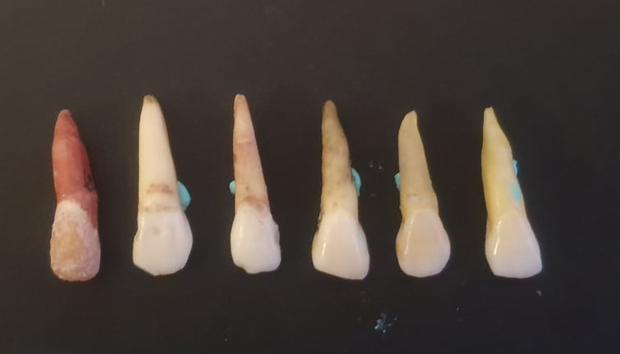
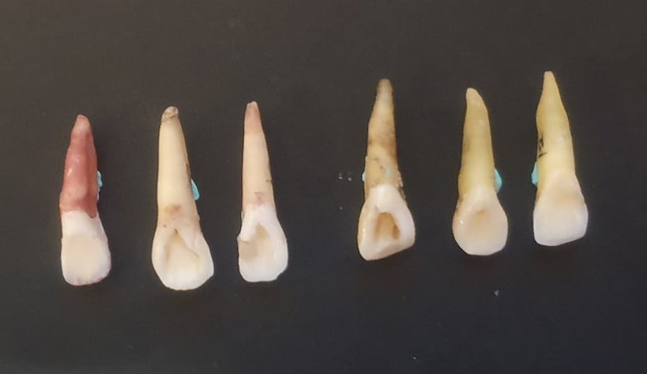
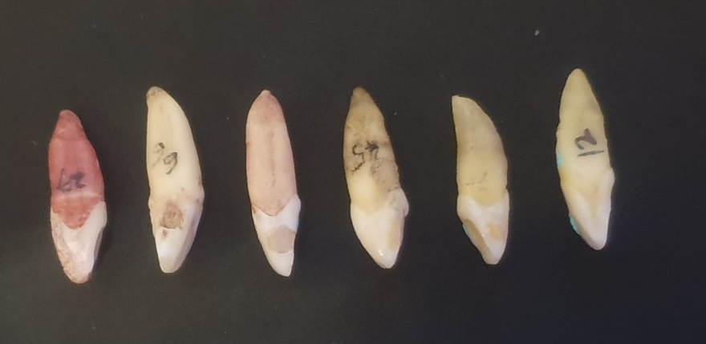
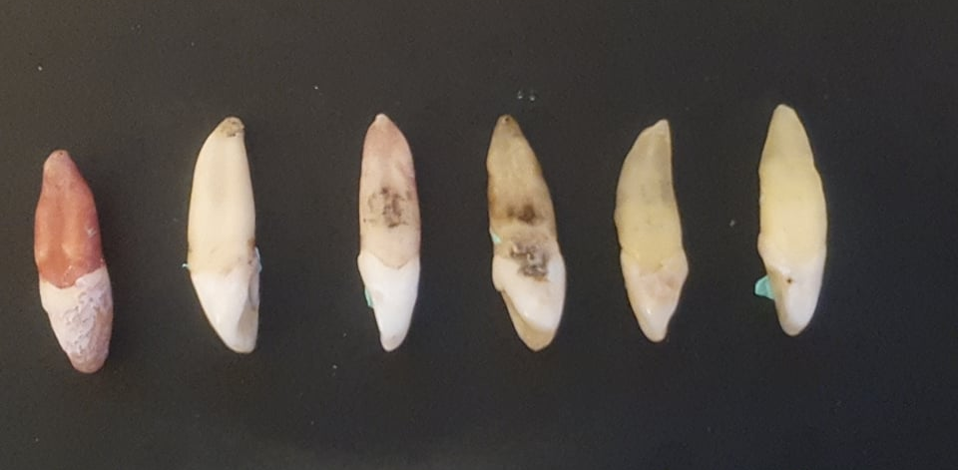
LABIAL
LINGUAL
1
2
3
4
5
6
1
3
5
6
2
4
MESIAL
DISTAL
5
6
1
2
3
4
5
6
1
2
3
4
INCISAL
SET 3
2
3
4
6
1
5

Slide 4
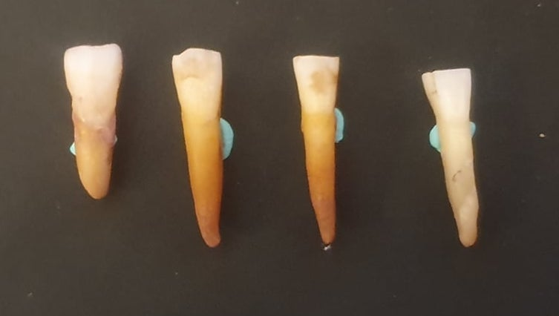
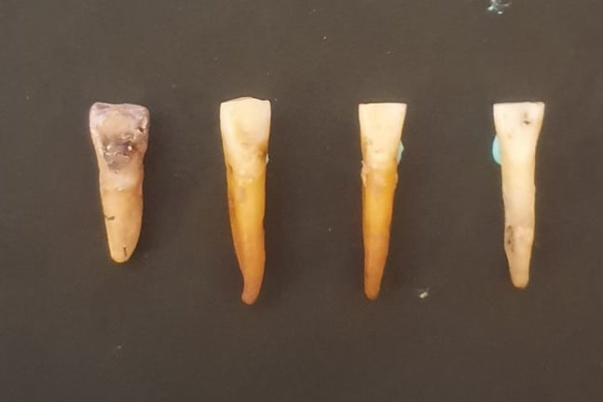
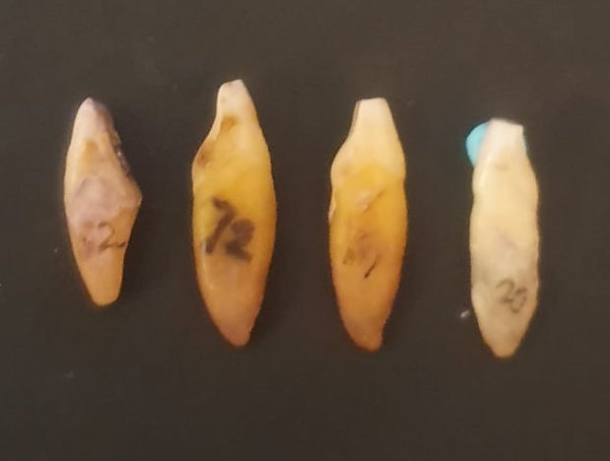
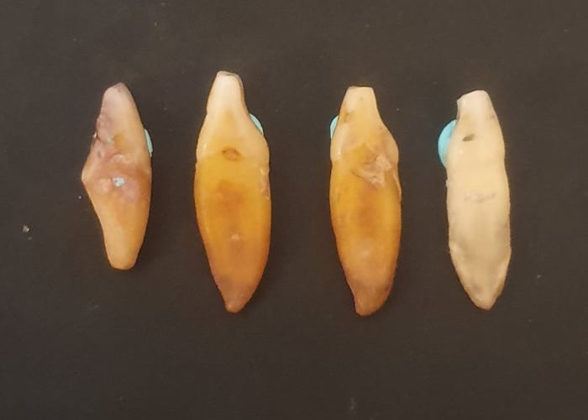
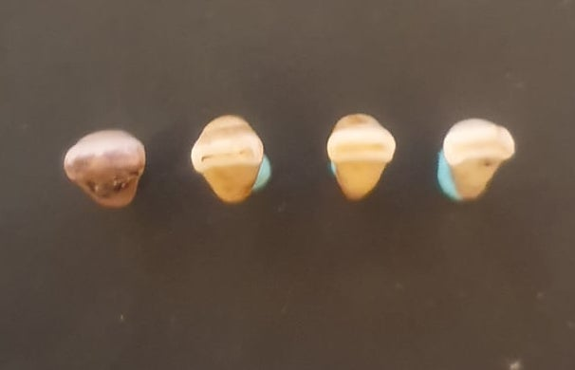
LABIAL
LINGUAL
1
2
3
4
1
4
2
3
MESIAL
DISTAL
INCISAL
1
2
3
1
4
2
3
4
1
2
3
4
SET 4

Slide 5
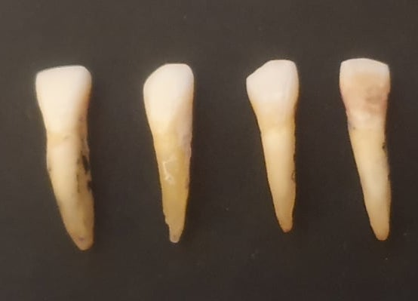
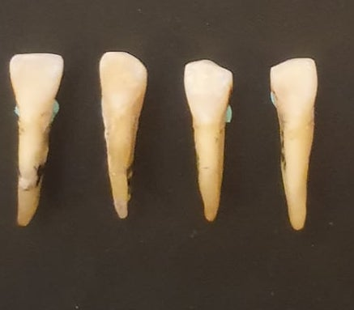
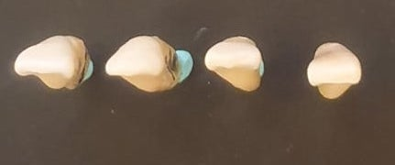
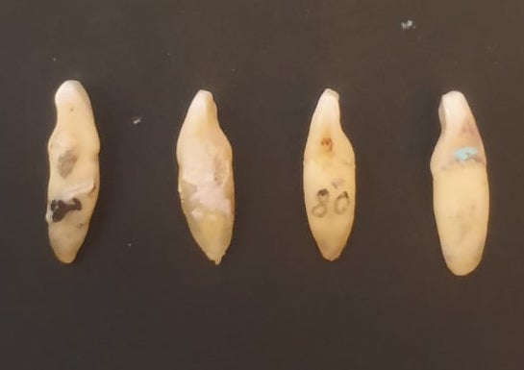
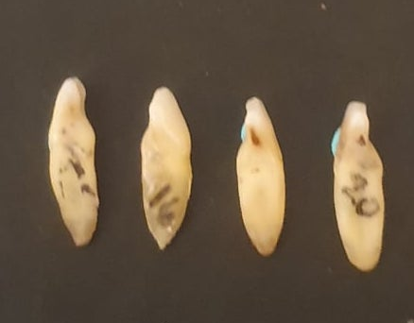
LABIAL
LINGUAL
1
2
3
4
1
2
3
INCISAL
4
MESIAL
DISTAL
1
2
3
4
1
2
3
4
1
2
3
4
SET 5

