Slide 1
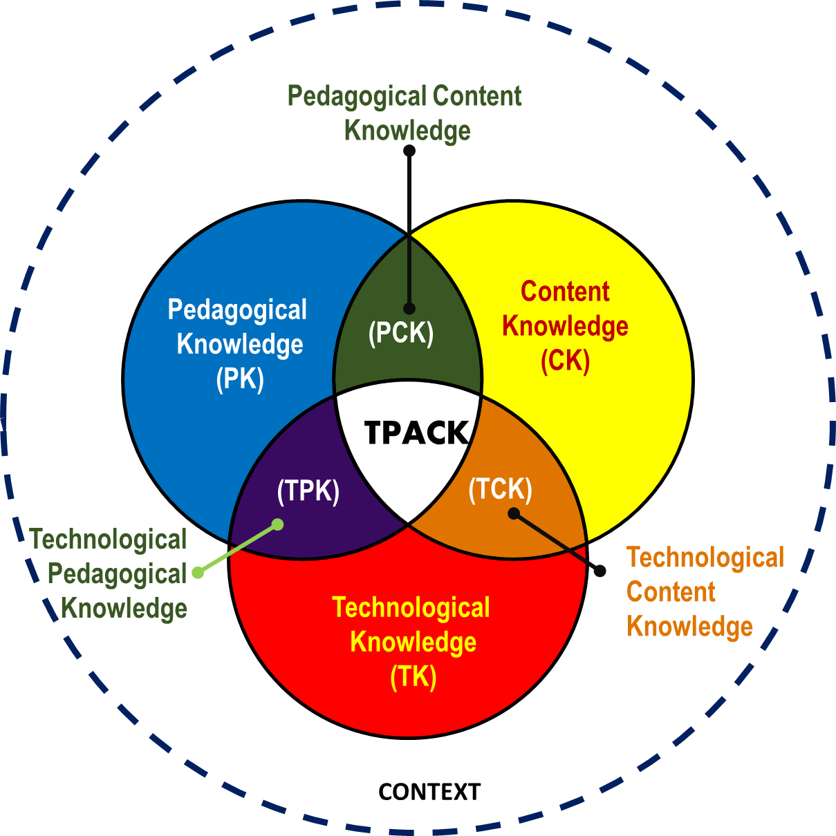
Add your text
Add your text
This is your summary page:
Please add the required PEDAGOGICAL knowledge, TECHNOLOGICAL knowledge, and CONTENT Knowledge for your TET session.
Add your text
TECHNOLOGICAL PEDAGOGICAL CONTENT KNOWLEDGE (FRAMEWORK)
(Graphics by NSF, based on original from TPACK.org)

