Slide 1
PREPARING A tailored PHE package for a PGH employee
JOSEFINA S. ISIDRO- LAPENA MD, MFM, FPAFP
PROFESSOR , UPCM

Slide 2
objectives
Provide a framework to use when preparing a tailored periodic health exam package
Discuss each component of the framework
Use the framework on a sample case

Slide 3
REVIEW
COPC
PERIODIC HEALTH EXAM

Slide 4
EVERY CONSULTATION
Is an OPPORTUNITY FOR PREVENTION and the PROMOTION OF HEALTH

Slide 5
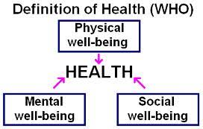

Slide 6
PHYSICAL WELL BEING
GENETIC MAKE UP
LIFESTYLE

Slide 7
MENTAL HEALTH DEFINED
Mental health has been defined variously by scholars from different cultures. Concepts of mental health include
subjective well-being
perceived self-efficacy
autonomy
competence
Inter-generational dependence
self-actualization of one’s intellectual and emotional potential
World Health Report 2001
Mental health: New Understanding, New Hope

Slide 8
SOCIAL WELL BEING
Social health is defined as: how a person gets along with other people
a person's level of support from people and institutions around them
how well a society does at offering every citizen the equal opportunity to obtain access to the goods and services critical to being able to function as a contributing member of society
Read more at http://www.yourdictionary.com/social-health#Y0pBjiuPSwxTaF0t.99

Slide 9
PUTTING WELLNESS
INTO ACTION…
IN YOUR
CLINICAL PRACTICE

Slide 10
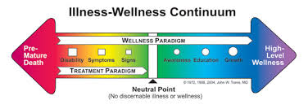
HEALTH IS A CHOICE

Slide 11
SELF CARE
Self-care is the practice of consciously doing things that preserve or improve your mental or physical health
BMI Health Care
We have long known that some 80 percent of health is determined by factors outside of the doctor’s office
Jonas W. [2019] The Importance of Self Care in Chronic Illness Management

Slide 12
the key to preventive medicine
is the identification
of risk factors

Slide 13
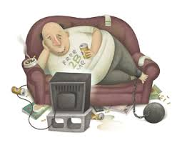
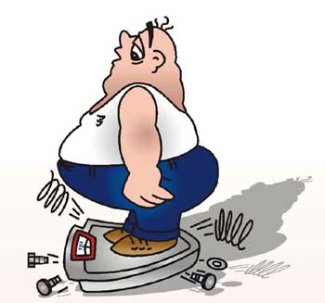
Risk Assessment

Slide 14
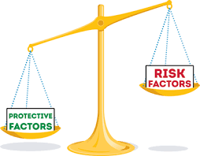
Risk assessment should include a range of protective as well as hazardous risk factors.

Slide 15
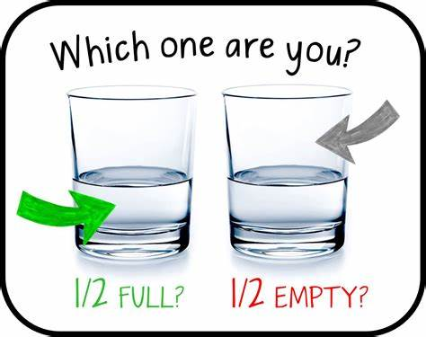
Psychosocial Protective Factors [adolescents and Adults]
Optimistic outlook in life with a sense of purpose and direction
Effective strategies for coping with challenges
Perceived control over life outcomes
Expressions of positive emotions
Social integration and emotionally rewarding relationships
quality of relationships in the home ( parent child and spousal ties) and the workplace (employer-employee and coworker relations)

Slide 16
PREVENTIVE HEALTH HISTORY
GENERAL DATA [ age, sex, gender, marital status, occupation, living arrangements]
CURRENT MORBIDITIES AND STATUS including MEDICATIONS
FAMILY HISTORY [ 3 generation genogram]
LIFESTYLE [ focus on 10 behaviors]
IMMUNIZATION HISTORY

Slide 17
LIFESTYLE
DIET (fat, fiber, sugar, salt, caffeine, water )
PHYSICAL ACTIVITY inclusive of exercise
SLEEP (quantity/ quality )
TOBACCO (active, passive) [never, ever, current]
ALCOHOL (quantity/quality/ frequency)
SEXUAL ACTIVITIES – Gender orientation
STRESS and COPING BEHAVIOR
PERSONAL HYGIENE – hand washing , Covid precautions
ENVIRONMENTAL exposure : home and work
OCCUPATION

Slide 18
PHE is…
A group of tasks designed either to determine the risk of subsequent disease or to identify disease in its early symptomless state.
- Feightner et al., 1995

Slide 19
The IDEA OF A SINGLE ANNUAL EXAM APPROPRIATE FOR EVERYONE WAS DISCARDED IN FAVOR OF INDIVIDUALIZED EXAMS TAILORED TO EACH PERSON’S UNIQUE RISK FOR DISEASE.

Slide 20
PERIODIC HEALTH EXAM
LIFESTYLE
SCREENING FOR EARLY DETECTION
VACCINATION
CHEMOPREVENTION

Slide 21
LIFESTYLE
PHYSICAL | MENTAL | SOCIAL
Food and nutrition | Perceived self efficacy | Family
TOBACCO & ALCOHOL | Knowledge & skills = competence | Friends
Physical activity & sleep | Subjective well being – sense of “happiness” | Other relationships and significant others
Personal hygiene | Coping mechanisms whether adaptive or mal adaptaive | Access to health resources
Sexual activities
Work hazards/environment

Slide 22
SCREENING
“If a patient asks a medical practitioner for help, the doctor does the best he can. He is not responsible for defects in medical knowledge.
If, however, the practitioner initiates screening procedures, he is in a very different situation. He should have conclusive evidence that screening can alter the natural history of disease in a significant proportion of those screened.”
Archie Cochrane and Walter Holland, 1971

Slide 23
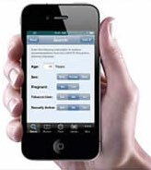
SCREENING
IDENTIFICATION OF RISK FACTORS - RISK ASSESSMENT
PREVENTIVE HEALTH HISTORY
GENERAL DATA: AGE/ SEX/ GENDER/ M STATUS / ETHNICITY
CURRENT CHRONIC MORBIDITIES
FAMILY HISTORY
LIFESTYLE
EVIDENCE BASED RECOMMENDATIONS
Clinical practice guidelines

Slide 24
Screening criteria
The condition should be an important health problem.
There should be a treatment for the condition.
Facilities for diagnosis and treatment should be available.
There should be a latent stage of the disease.
There should be a test or examination for the condition.
The test should be acceptable to the population.
The natural history of the disease should be adequately understood.
There should be an agreed policy on whom to treat.
The total cost of finding a case should be economically balanced in relation to medical expenditure as a whole.
Case-finding should be a continuous process, not just a "once and for all" project

Slide 25
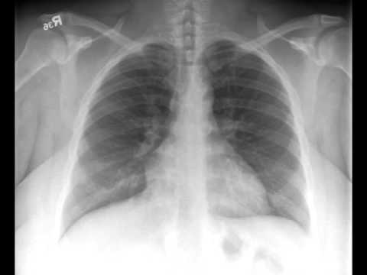
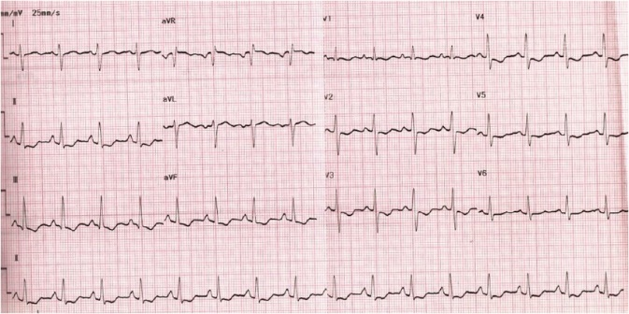
Screening Tests
Cost effective

Slide 26
VACCINATION
Childhood immunization
Vaccine titers : hepatitis B/ Chickenpox
Recommendations by Philippine Foundation for Vaccination or CDC

Slide 27
CHEMOPREVENTION
On going treatment for current morbidities
Supplementations
ChemoProphylaxis

Slide 28
Design a tailored package based on risk assessment . Include cost of exams

Slide 29
SAMPLE CASE
53 /F accountant with known hypertension currently controlled with Losartan 50 and Amlodipine 5 mg with good adherence
One previous hospitalization for uncontrolled BP 10 years ago when diagnosis was made/ No surgeries
G2P2 [2002] menopause at age 48
Family history of hypertension both parents , no other heredo familial conditions
Complete childhood immunization/ adult – 2 Covid vaccines 2021 booster 2021
Diet follows Pinggang Pinoy and DASH
Non smoker , occasional alcoholic beverage drinker
Lives with husband in a house in suburbs with youngest adolescent daughter. Older son married living with own family . Good family relations
BMI = 24 normal physical examination since last check up three months ago

Slide 30
FORMAT OF THE PRESENTATION
The employee general data
Preventive Clinical History
Lifestyle include recommendations if changes are needed
Screening tests based on Risks identified
Recommended vaccines cognizant of immunization history
Chemoprevention in light of current risks and morbidities
Cost of the package based on prevailing pay prices

Slide 31
THE TASK
You will be given the name and contact detail of the employee
Call and make an appointment with said employee
Do the interview and inform the said employee that you will need to present the recommendations to a UPHS consultant.
After confirmation with the consultant, inform the employee of the recommendations and ask employee have the tests done then to set up an appointment at the UPHS for the results of the screening tests

Slide 32
THE PRESENTATION
Schedule the session with your assigned UPHS consultant
The schedule could either be a Friday or Saturday of the first week. You may have to follow the preferred time of the consultant . You are otherwise free for that whole day
Fill up the google form of the employee and submit. You must know if employee is permanent or temporary

Slide 34
Submit a word document of the clinical history and PE of your employee patient to your preceptor for encoding to RADISH

Slide 35
Any QUESTIONS ?

Slide 36
STAY SAFE !
Be WeLL

