Slide 1
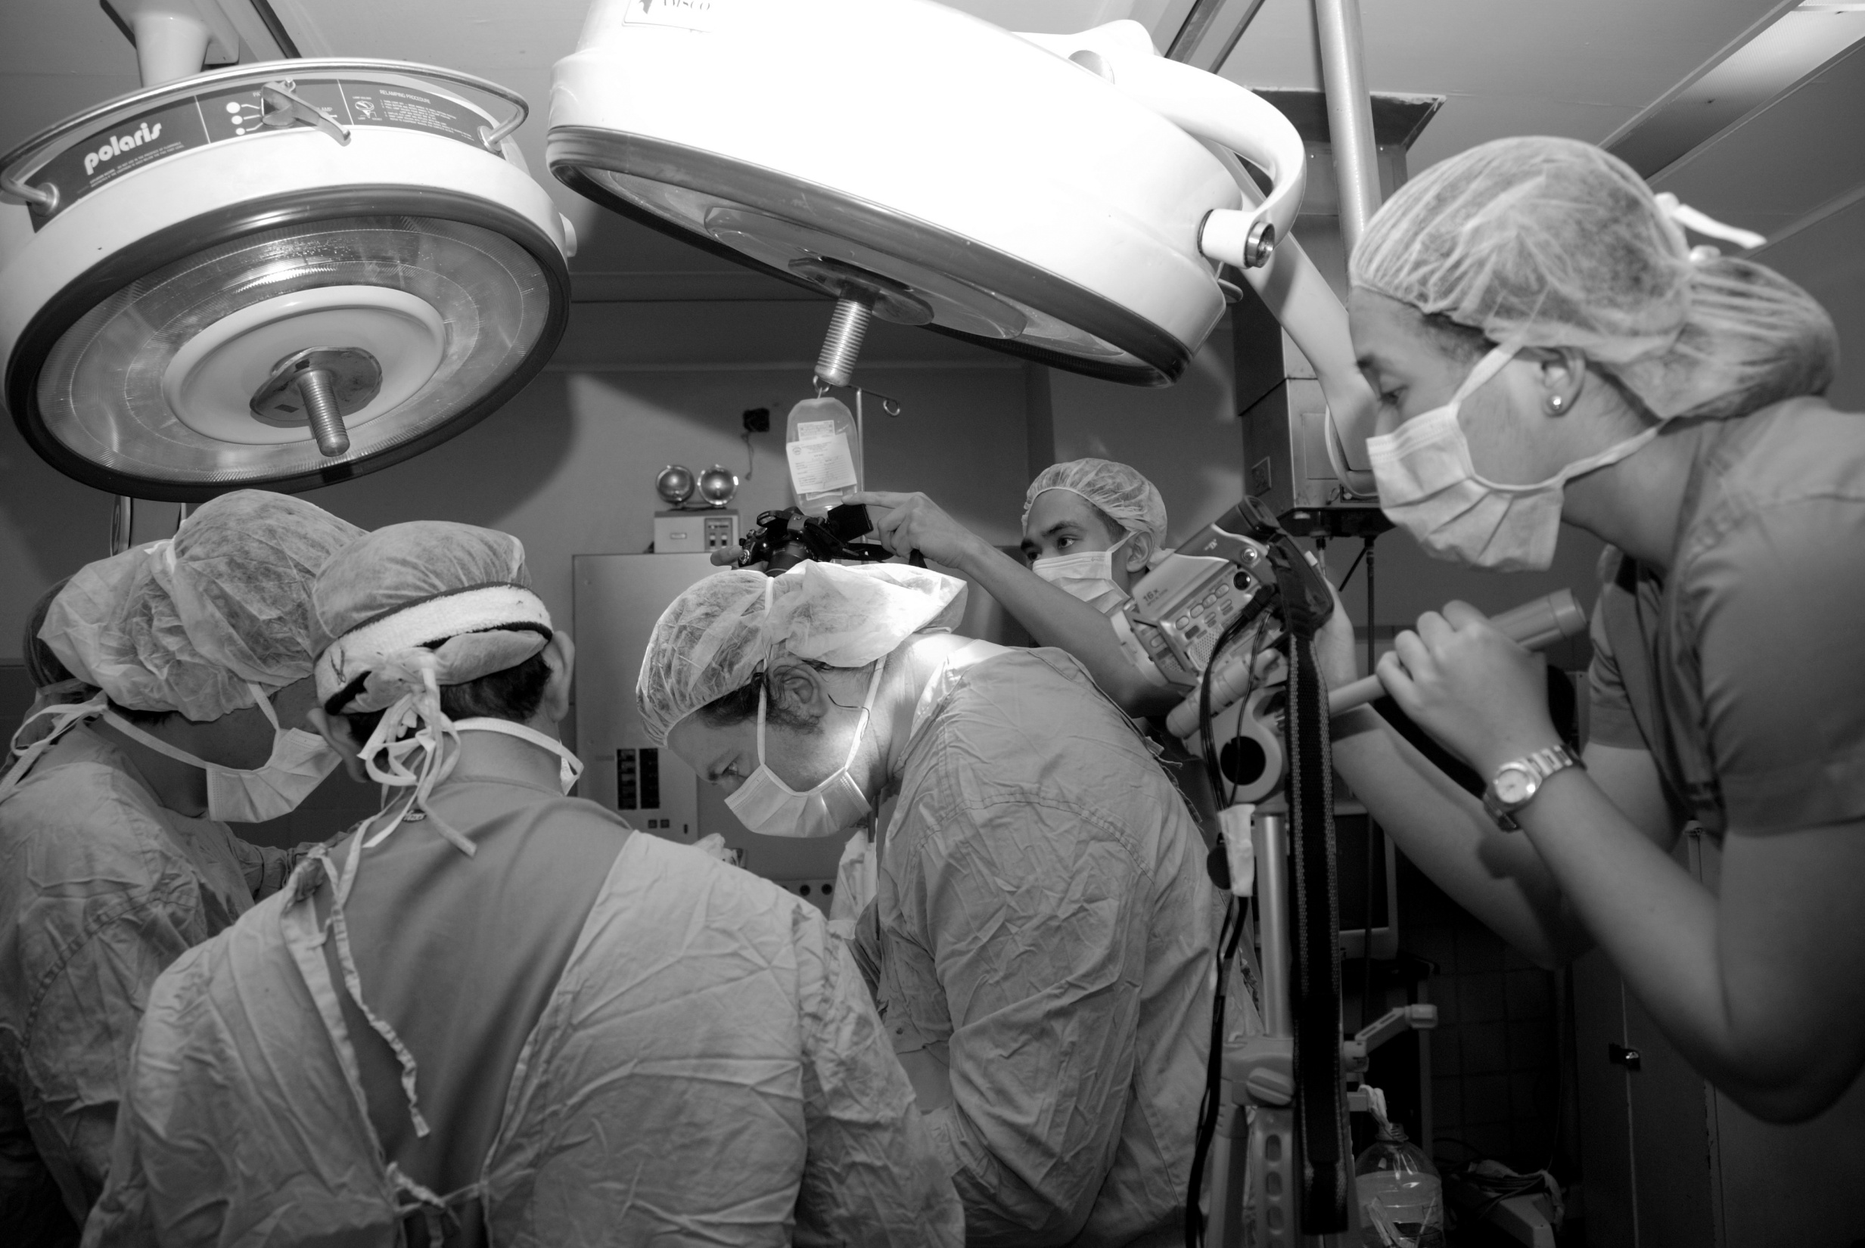
Common Postoperative Complications

Slide 2
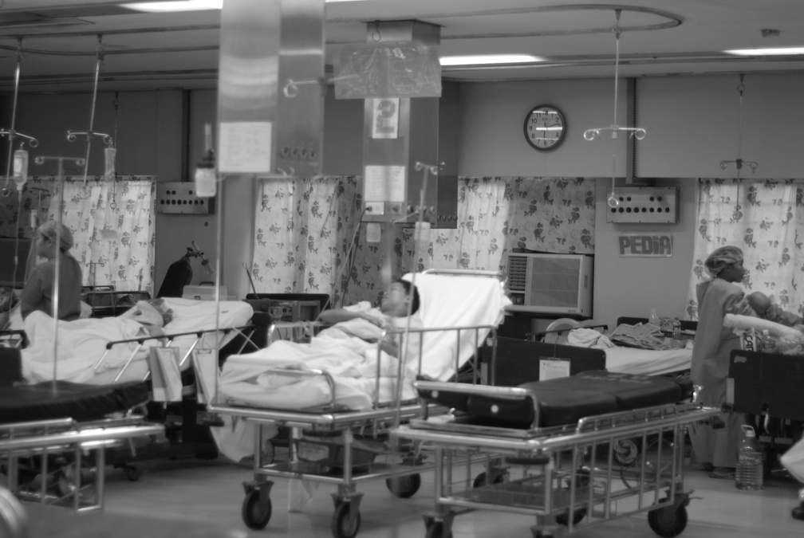
Objectives
To enumerate the common postoperative complications in the PACU
To discuss the diagnosis and initial management of postoperative complications in the PACU

Slide 3
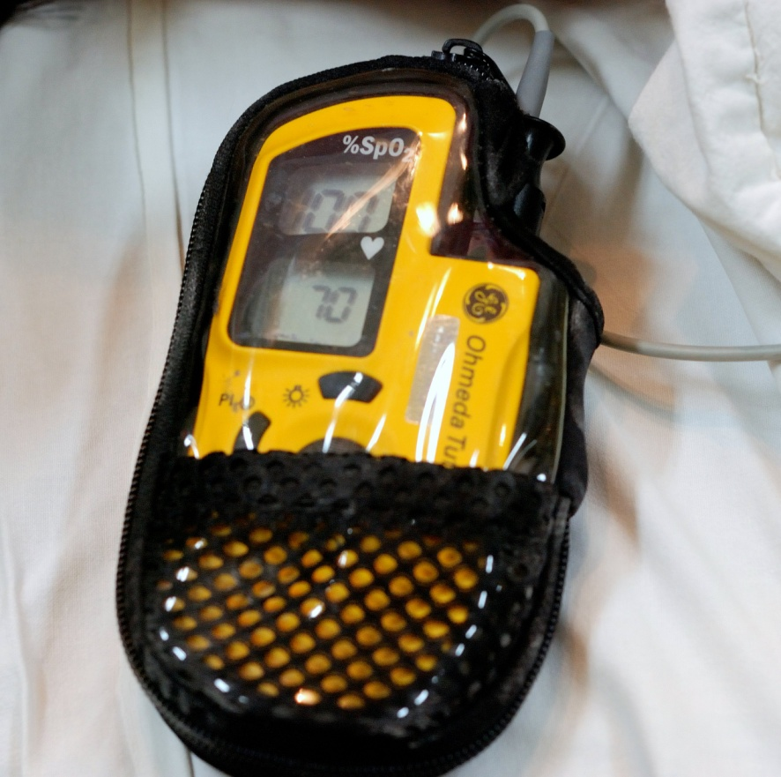
Hypoxemia
Incidence is high in postoperative patients
hemoglobin saturations fall below 90%
  30% of patients younger than 1 year of age
  20% ages 1 to 3 years
  14% ages 3 to 14 years
  7.8% of adults
Patients with lung disease or obesity, those recovering from thoracic or upper abdominal procedures are at an increased risk

Slide 4
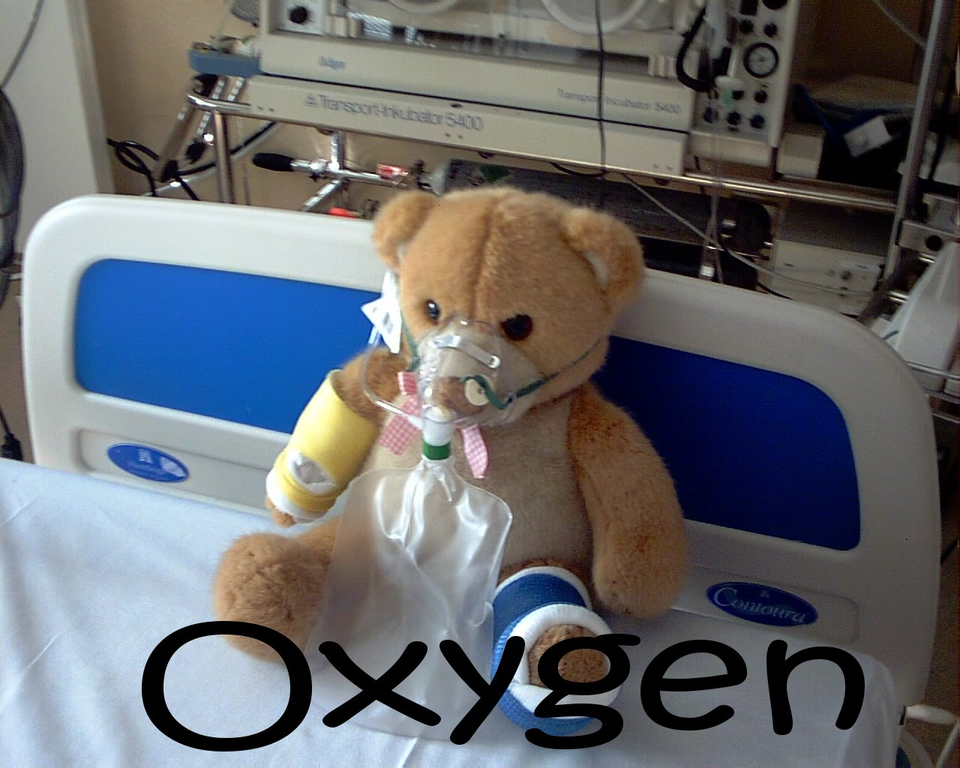
Supplemental Oxygen
Administered to the patient upon arrival at the PACU
Improves oxygen saturation
May help prevent or treat hypoxemia
However this does not treat the underlying causes of hypoxemia.

Slide 5
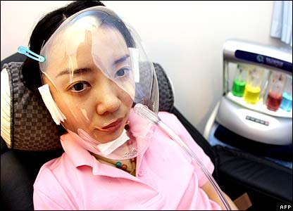
Hypoventilation
In PACU patients mild respiratory acidemia is expected
Inadequate ventilation should be suspected when inspiratory acidemia occurs coincident with tachypnea, anxiety, dyspnea, labored ventilation, or increased sympathetic activity

Slide 6
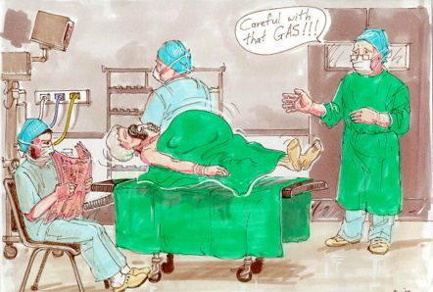
Possible Causes of Hypoventilation
Residual effects of intravenous or inhalational anesthetics blunt the ventilatory responses to hypercarbia and hypoxemia
Sedatives augment depression from opioids or anesthetics
Effects of residual neuromuscular blockade
Intracranial hemorrhage or edema sometimes presents as hypoventilation,
Treat the underlying cause

Slide 7
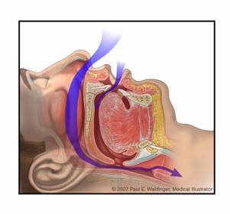
Upper Airway Obstruction
Anatomic - tongue falling back
  Chin-lift manuever
  Jaw thrust
  Insert an oral airway
Laryngospasm
  Positive pressure ventilation
Expanding hematoma e.g. in post-thyroidectomy patients
  Relieve compression

Slide 8
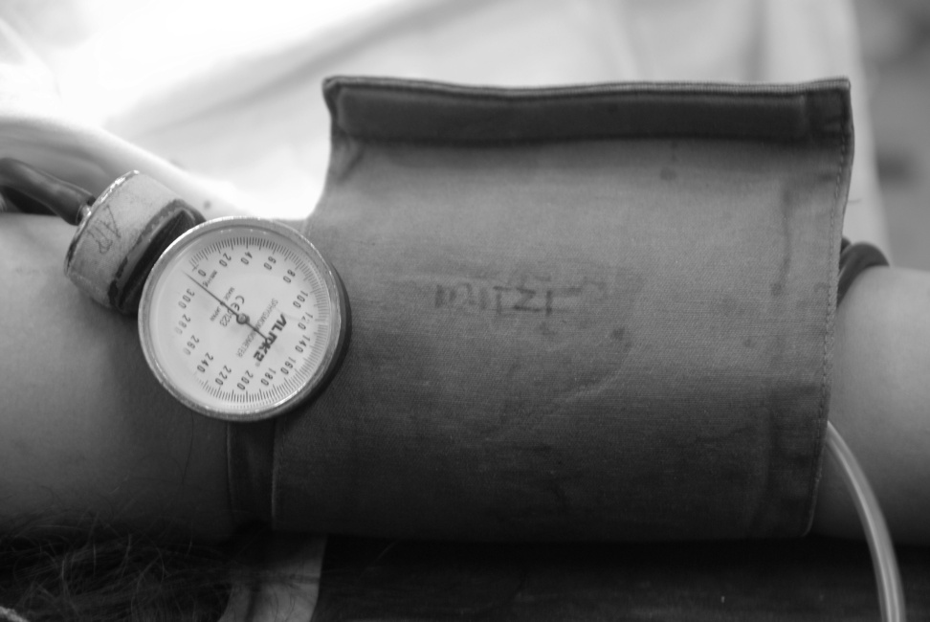
Hypotension
Defined as 20 to 30% reduction from pre-operative systolic pressure
Assess the underlying cause
Hypovolemia is the most common etiology
May start fluid challenge (300-500cc of saline)
Trendelenburg position
Consider vasopressors

Slide 9
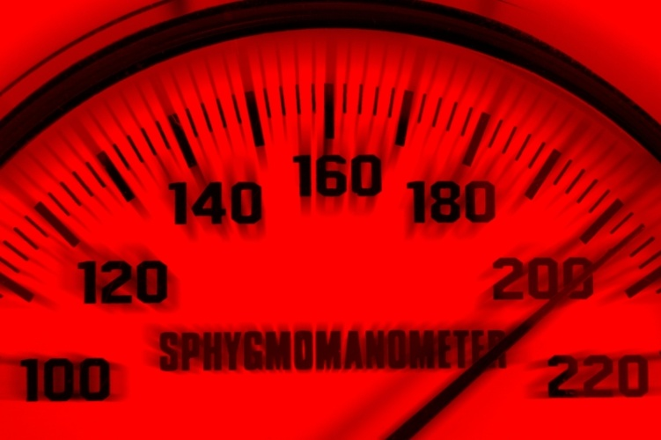
Hypertension
Acceptable in well-hydrated postoperative patients
Treatment is indicated if systolic or diastolic pressure is above 20 to 30% of baseline or with symptoms of complications
  Headache
  Bleeding
  Angina
  ST segment depression
Beta-blockers, calcium –channel antagonists, ace inhibitors may be used

Slide 10
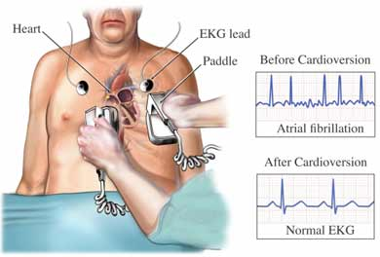
Cardiac Dysrhythmias
General Anesthesia causes ECG changes in axis, intraventricular conduction, P-wave and T-wave morphology and ST segments that are not related to cardiac abnormality
These changes reflect electrophysiologic effects of hypothermia, inhalational anesthetics, autonomic nervous system imbalance and mild electrolyte abnormalities.
Changes usually resolve withing 3 to 6 hours

Slide 11
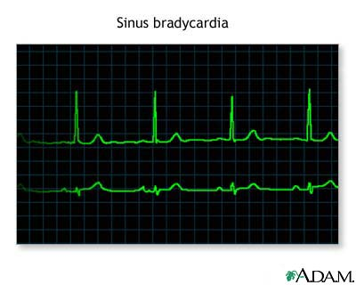
Bradycardia
Can be caused by increased parasympathetic activity or decreased sympathetic activity
Sinus bradycardia is benign unless it causes hypotension (usually below 40 to 45 beats/min)
Consider giving atropine or ephedrine

Slide 12
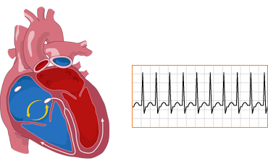
Tachycardia
Usually harmless but may precipitate ischemia in patients with coronary artery disease
Treat underlying cause
  Analgesics for pain
  Intravenous fluids for hypovolemia
  Sedatives for anxiety
If ischemic
  Optimize myocardial oxygen supply and demand
  Serial ECG
  Enzyme determinations

Slide 13
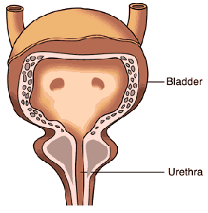
Inability to Void
Should be assessed since opioids and autonomic blockade via regional anesthesia interferes with sphincter relaxation and promote urinary retention
Frequent after urologic, inguinal and genital surgery

Slide 14
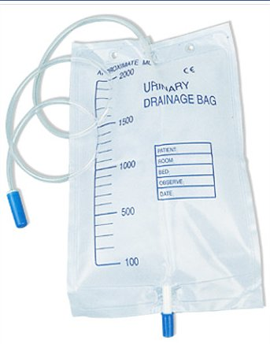
Oliguria
<0.5 mL/kg/h
Occurs frequently during recovery
Reflects an appropriate renal response to hypovolemia
Check indwelling catheters
  Kinking
  Obstruction by blood or debris
  Catheter tip positioned above urinary level in bladder

Slide 15
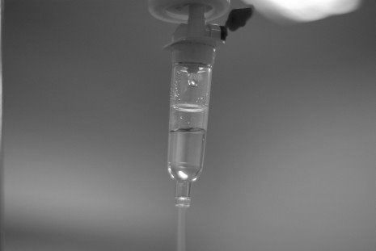
Oliguria
Systemic blood pressure must be adequate for renal perfusion (based on baseline levels)
Check for urine osmolarity and electrolytes
May give a 300-500mL crystalloid bolus
Consider giving furosemide

Slide 16
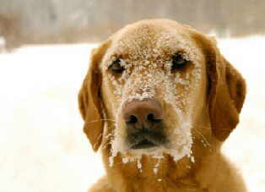
Hypothermia
Complicates care in the PACU
Average PACU stay is increased by 40-90 minutes
Oxygen consumption and Carbondioxide production is increased by 200%
Associated increase in minute ventilation and cardiac output

Slide 17
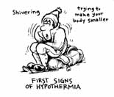
Hypothermia
Shivering
  increases risks of incidental trauma
  disrupts medical devices
  Interferes with ECG
  Interferes with pulse oximetry readings
Goal is restoration of normothermia (heating lamps/blanket)
Consider giving meperidine to lessen shivering

Slide 18

Emergence Delirium
A stormy emergence reaction can have significant medical consequences
  Incidental trauma
  Contusions or fractures
  Corneal abrasions
  Jeopardizes suture lines, intravenous access, orthopedic fixations, vascular grafts, drains and catheters

Slide 19
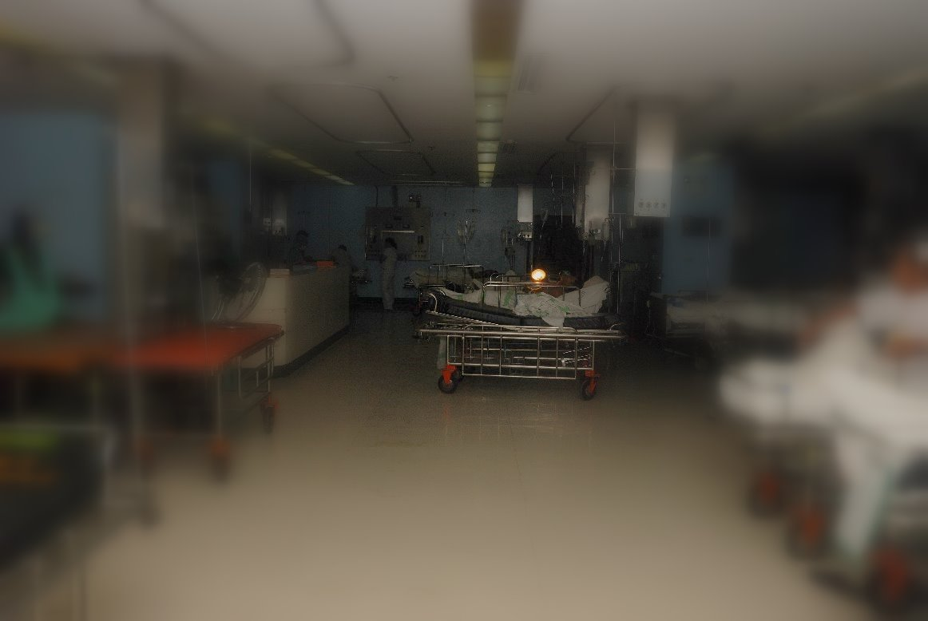
Emergence Delirium
Incidence is higher after procedures with high emotional significance
Intraoperative recall can generate panic
Pain amplifies agitation
Rule out hypoxia
Urinary retention causes discomfort
Check for tight dressings

Slide 20
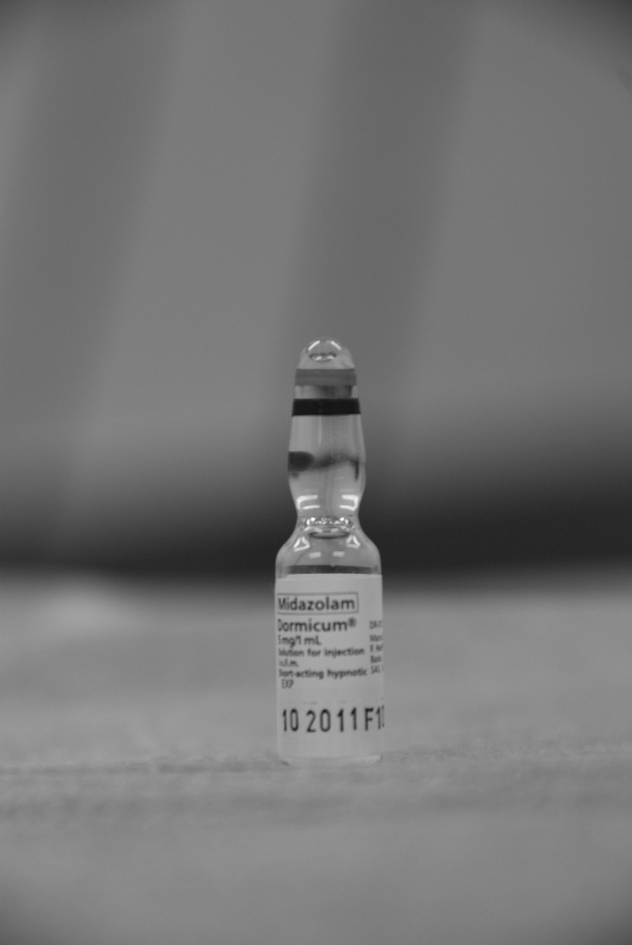
Emergence Delirium
Do not administer sedatives if altered mental status may reflect a physiologic abnormality
Use restraints only if patient’s safety is compromised

Slide 21
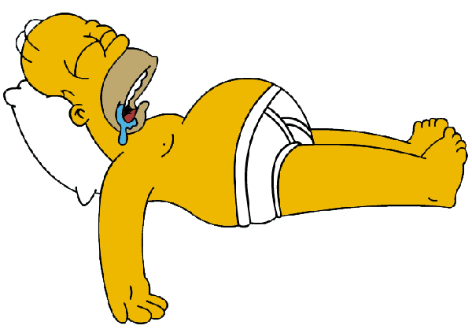
Delayed Awakening
90% of patients regain consciousness within 15 minutes of admission into the PACU
Unconsciousness persisting for a greater period is considered prolonged
Physical assessment should include a tactile stimulus such as a light skin pinch (better than verbal stimuli)

Slide 22
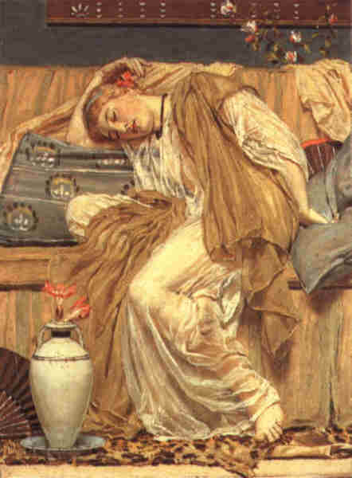
Delayed Awakening
Can be caused by residual inhalational anesthetics
If opioid overdose, consider giving Naloxone
If benzodiazepine overdose, consider giving Flumazenil
If recurarization is considered, consider giving a reversal agent
Check for hypothermia, hypoglycemia
If still unresponsive, consider referral to a neurologist for a nuerologic evaluation

Slide 23
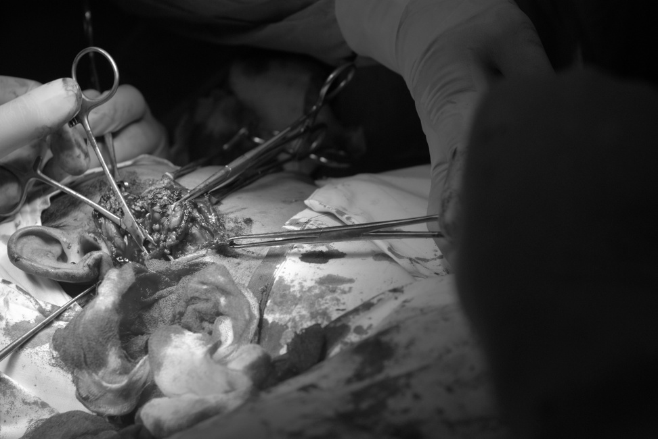
Bleeding
Check bandages for signs of bleeding
Check drains for excessive amounts of blood
Look at urine bag for assessment of hematuria
If excessive, refer back to primary service for possible re-operation

Slide 24
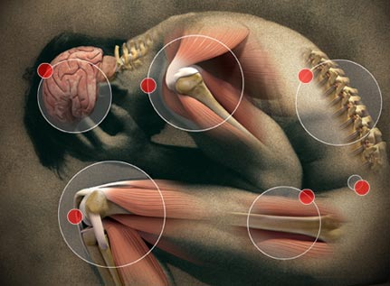
Pain
Increases sympathetic nervous system activity
Can cause agitation
Can cause splinting/difficulty in breathing
Make sure analgesics are given
If persistent, consider giving additional or step-up analgesics

Slide 25

Postoperative Nausea and Vomiting (PONV)
A common complication
Higher incidence in women
Higher incidence in ear-nose-throat,dental procedures
Higher incidence in procedures involving extra-ocular muscle traction, peritoneal or intestinal irritation
Swallowed blood, or air from esophageal intubation/ventilation increases PONV
Increases risk for aspiration
Serotonin blockers, dexamethasone and droperidol are equal in efficacy

Slide 26
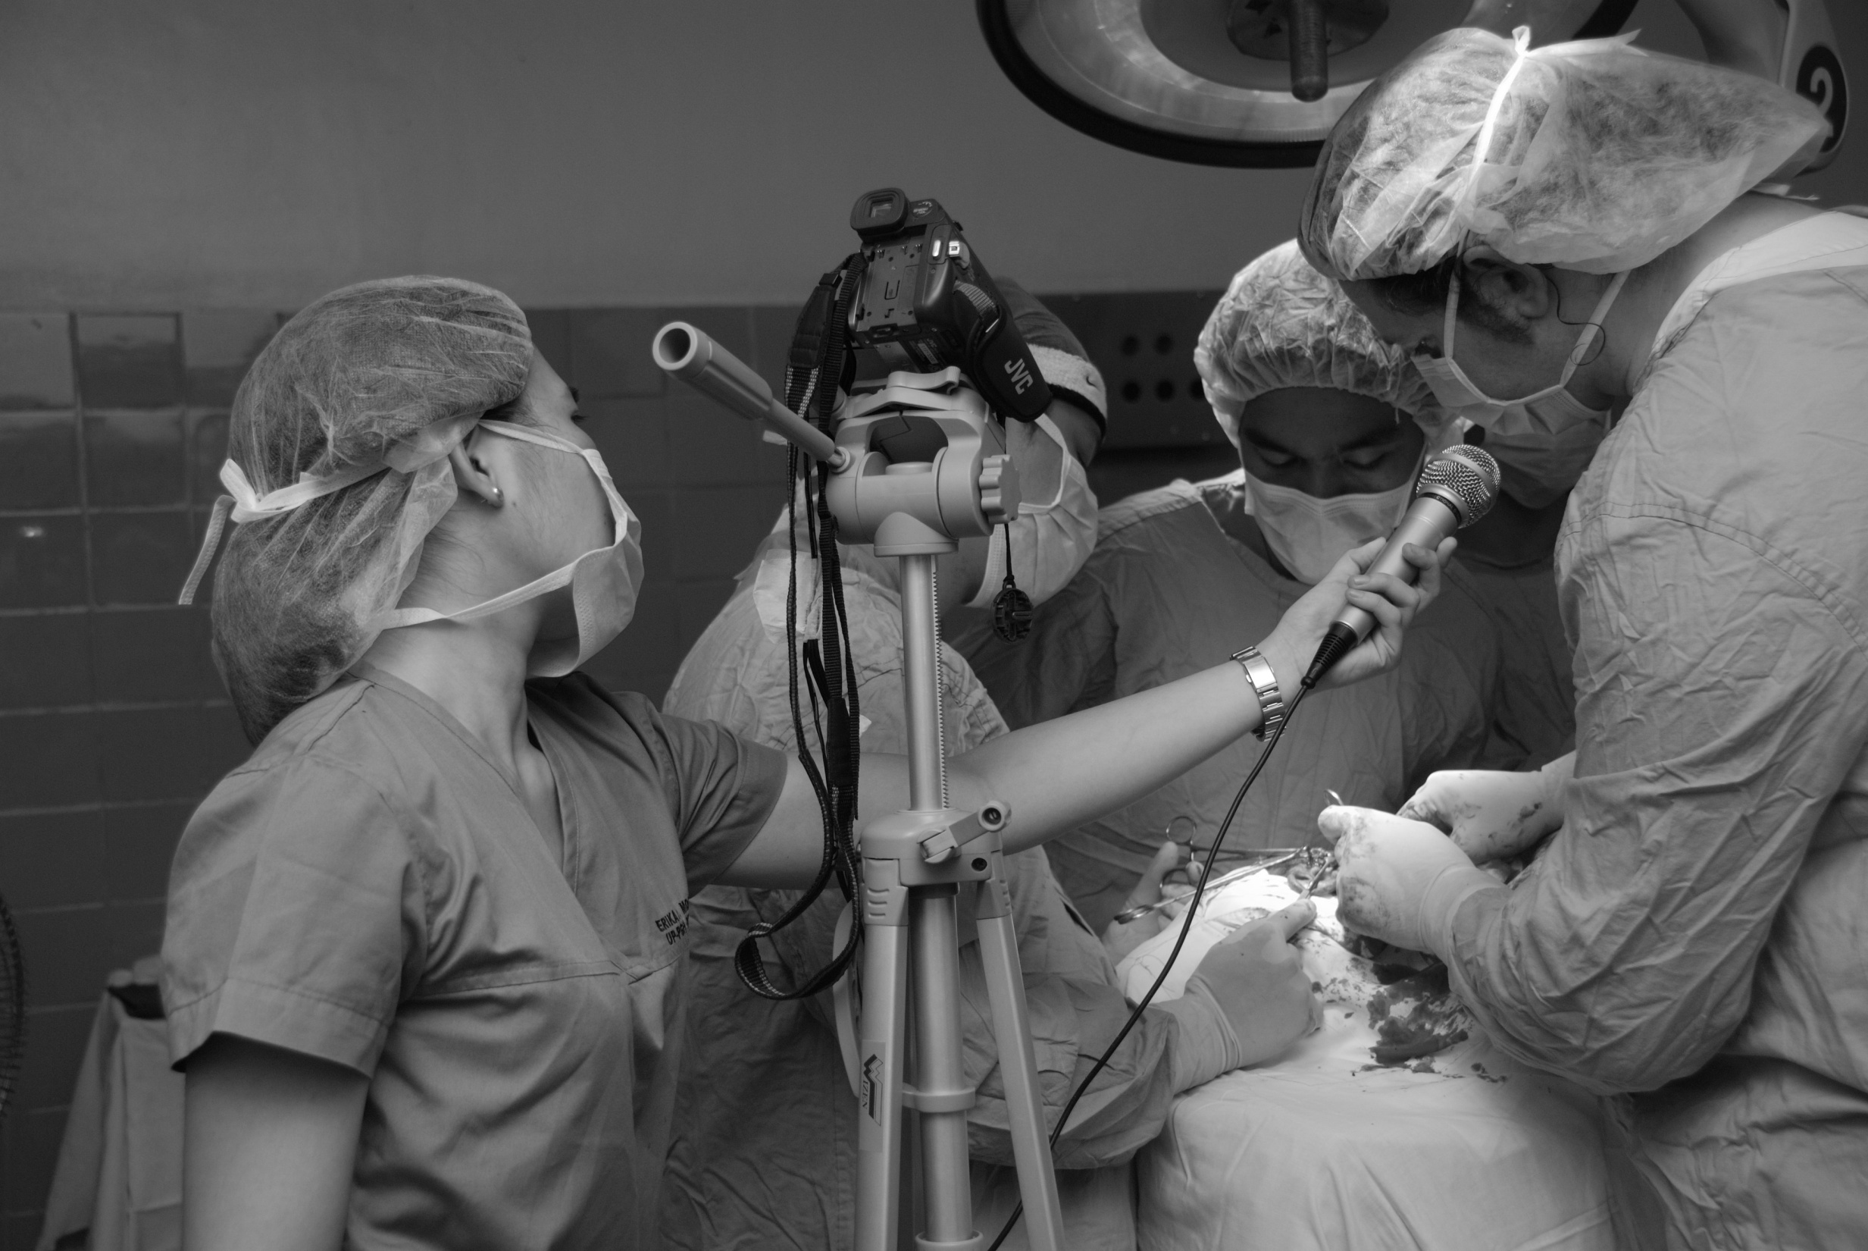
Thank You

