Slide 1
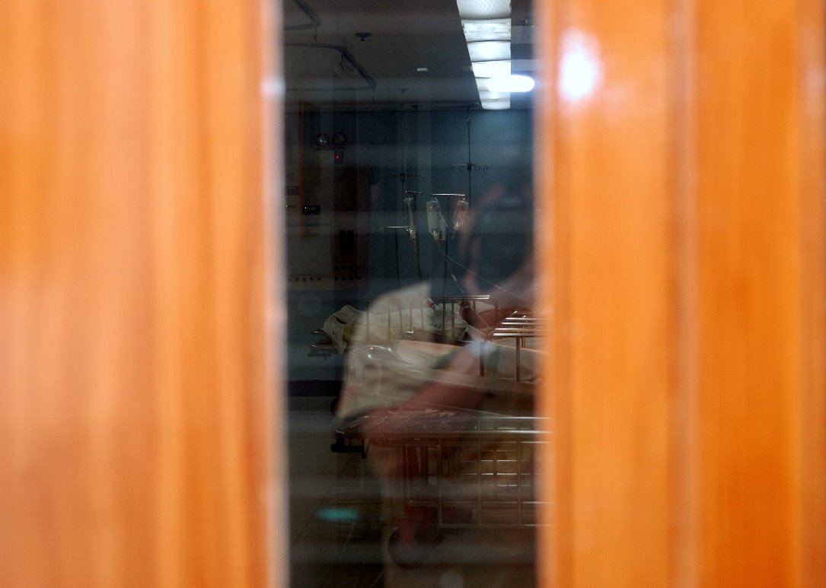
Introduction to PACU

Slide 2
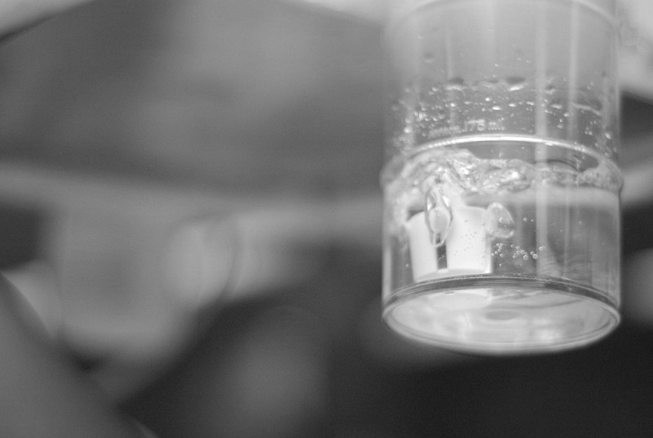
Objectives
Give an overview about the postanesthesia care unit (PACU)
Present the PACU staff
Discuss the areas of division of the PACU

Slide 3
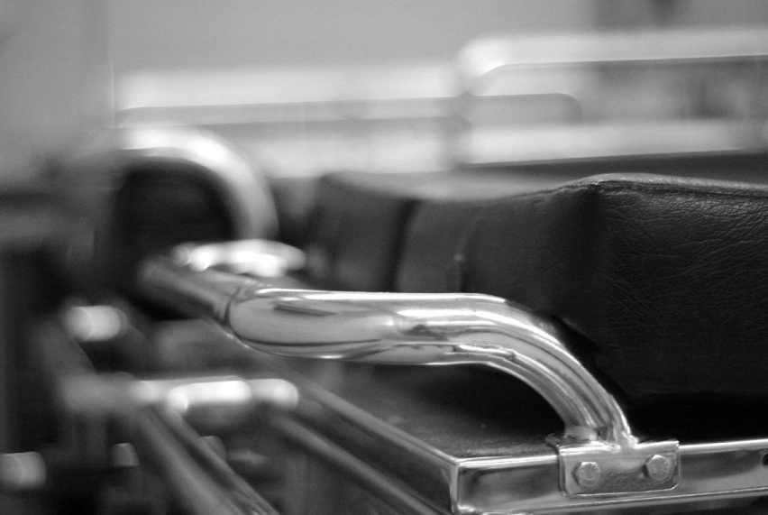
The Recovery Room
in existence for less than 50 years in most medical centers
many early postoperative deaths occurred immediately after anesthesia and surgery

Slide 4
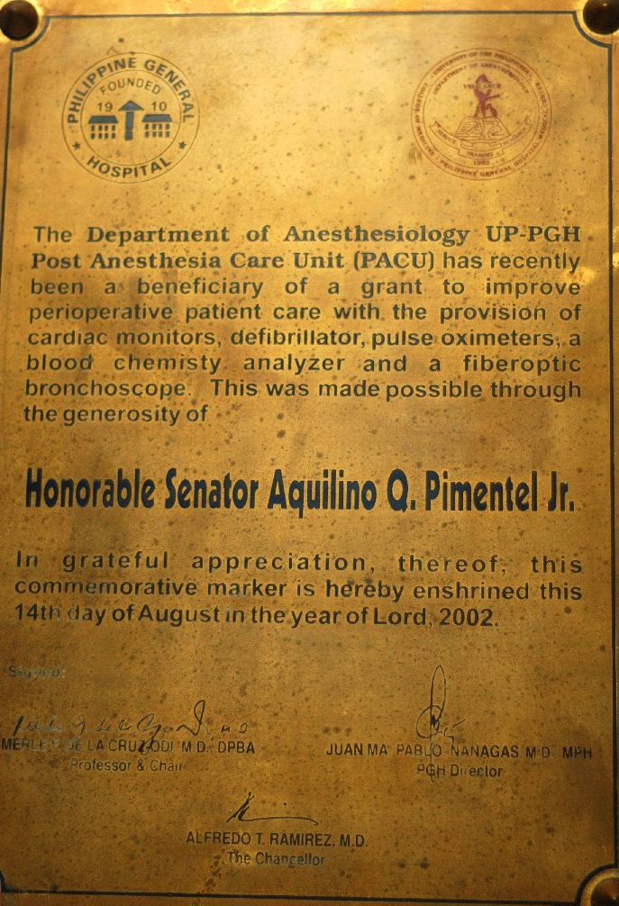
The PACU
realization that many of these deaths were preventable emphasized the need for specialized medical and nursing care immediately following surgery
received intensive care status so they are now referred to as Postanesthesia Care Unit

Slide 5
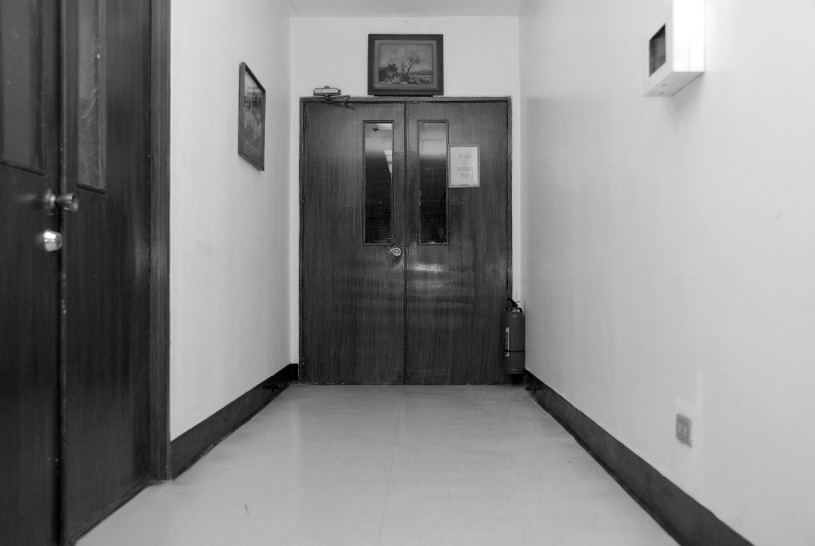
The PACU
should be located near the operating room
ensures that the patient can be rushed back to the operating room if needed
members of the operating room staff can quickly attend to patients
proximity to radiographic, laboratory and other intensive care facilities on the same floor is ideal

Slide 6
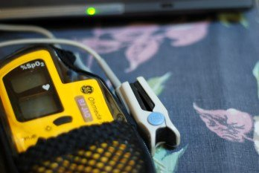
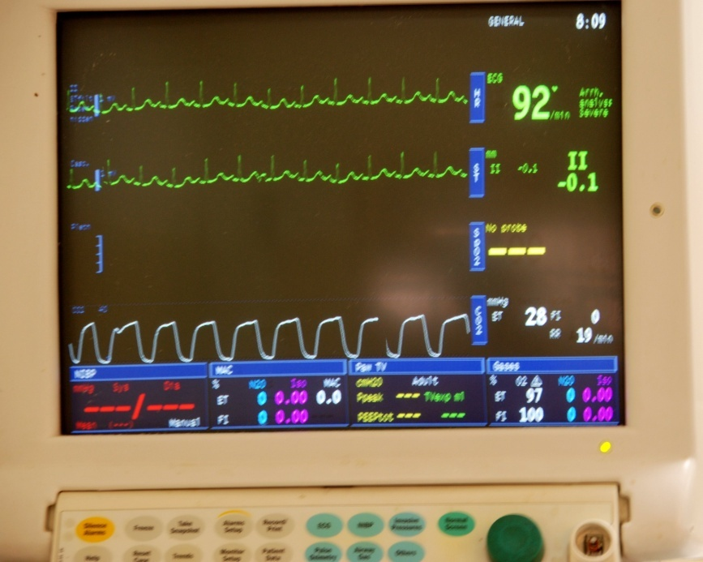
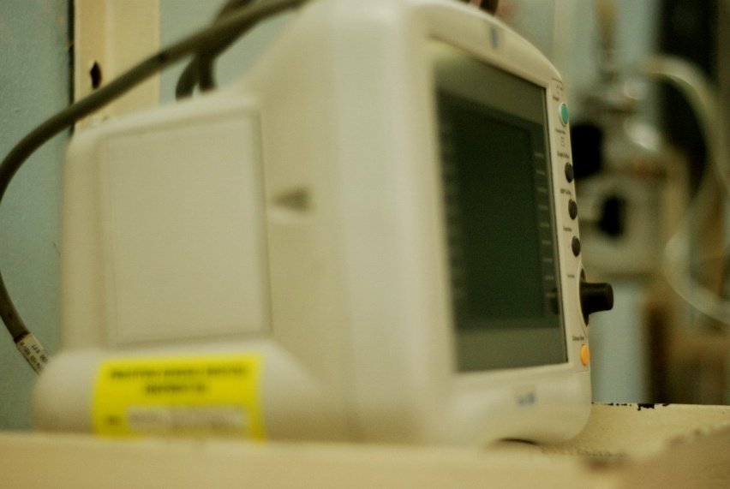
Standard Monitors
Pulse Oximeter
Electrocardiogram
Automated noninvasive blood pressure

Slide 7
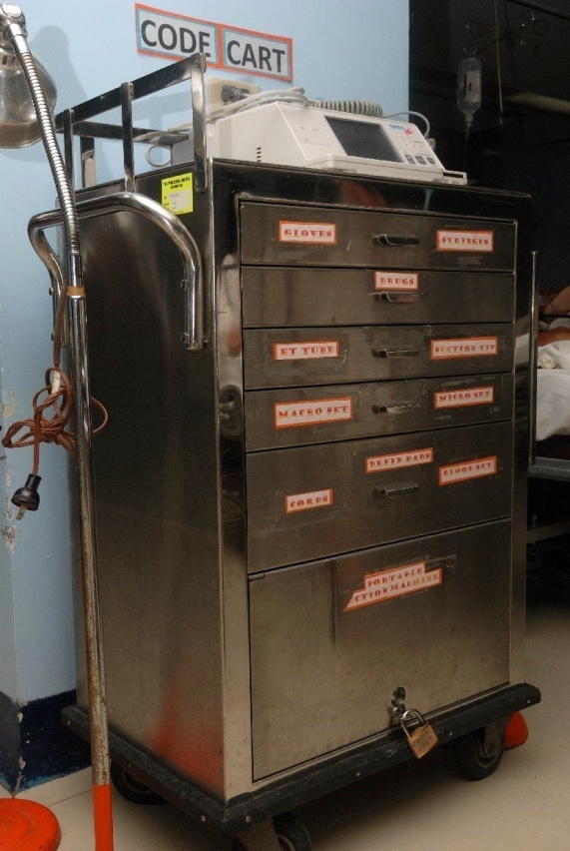
Equipment
The PACU should have its own supply of emergency medications and equipment
  Laryngoscope
  Endotracheal tubes
  Defibrillator

Slide 8
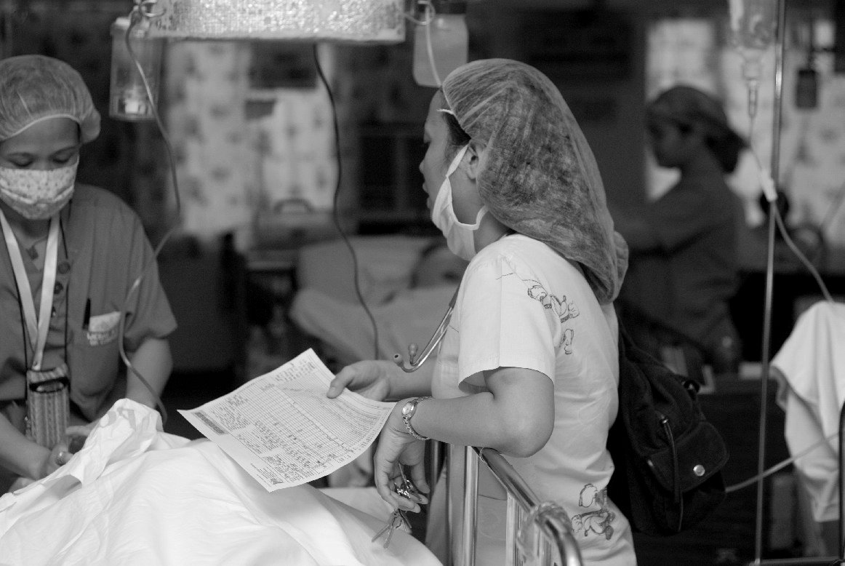
The PACU Staff
Should be trained in the care of patients emerging from anesthesia
Should be trained in emergency airway management and advanced cardiac life support

Slide 9
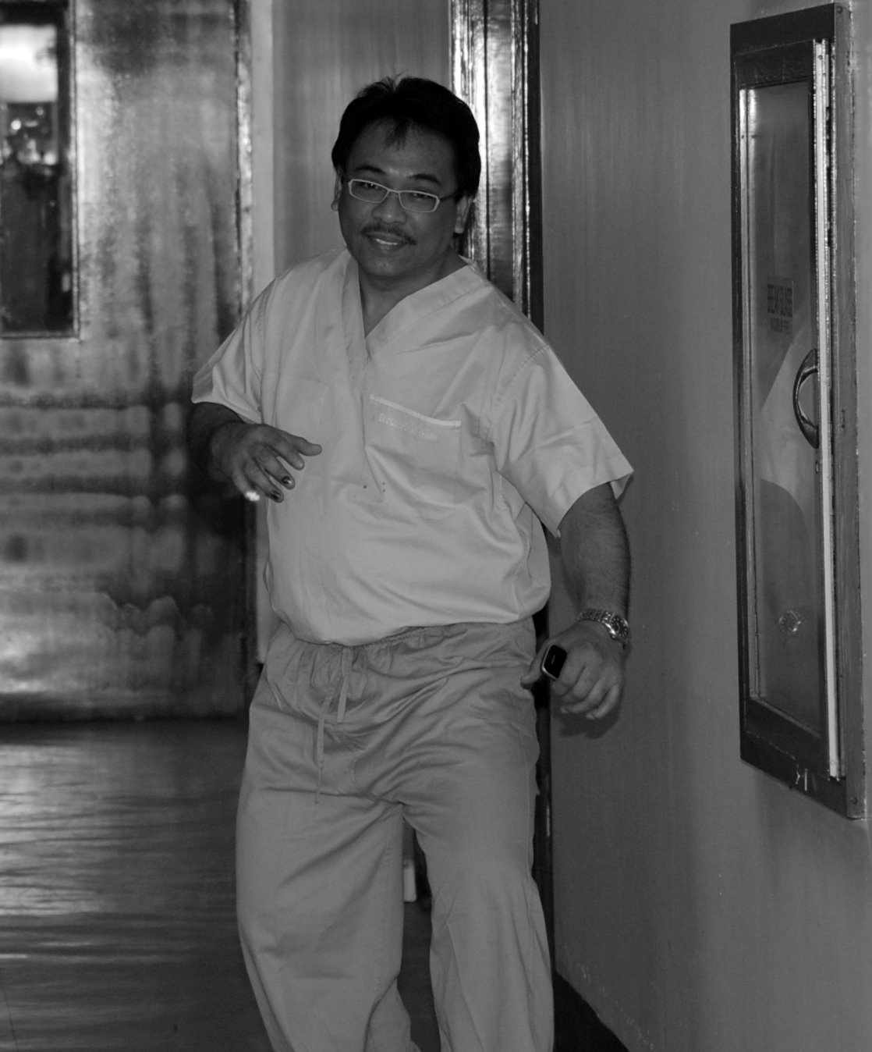
PACU Consultant
PACU administrator
Answers referrals from the PACU Resident-on-duty regarding difficult cases

Slide 10
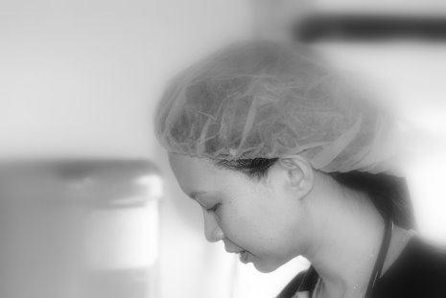
PACU Resident-on-duty
Should be familiar with the patients in the PACU
Competent in managing common post-op complications
Discharges patients from the PACU
Answers referrals from the PACU nurses and interns

Slide 11
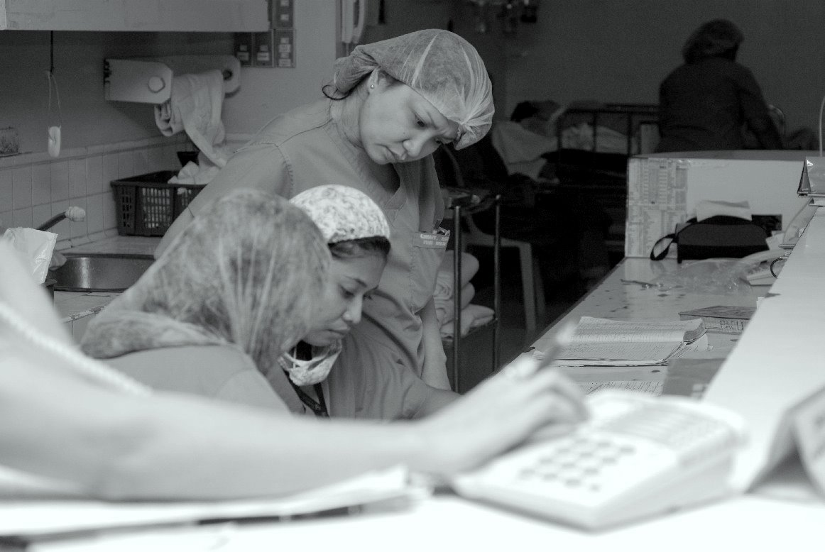
PACU Nurses
Receives endorsements from the OR Nurse regarding the patient
Attaches an oxygen facemask to the patient
Makes sure that patient is thermoregulated
Checks medications given to the patient

Slide 12
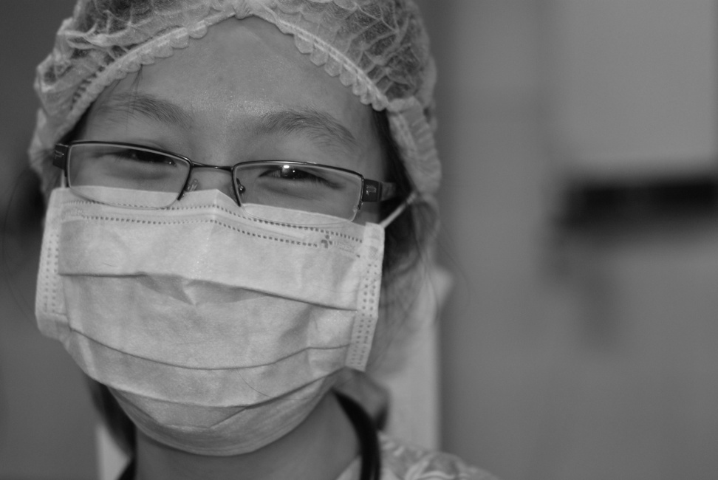
PACU Intern
Receives endorsements from the anesthesiologist regarding the patient and operation
Checks initial vital signs
Vigilant for post-op complications and manages them initially

Slide 13
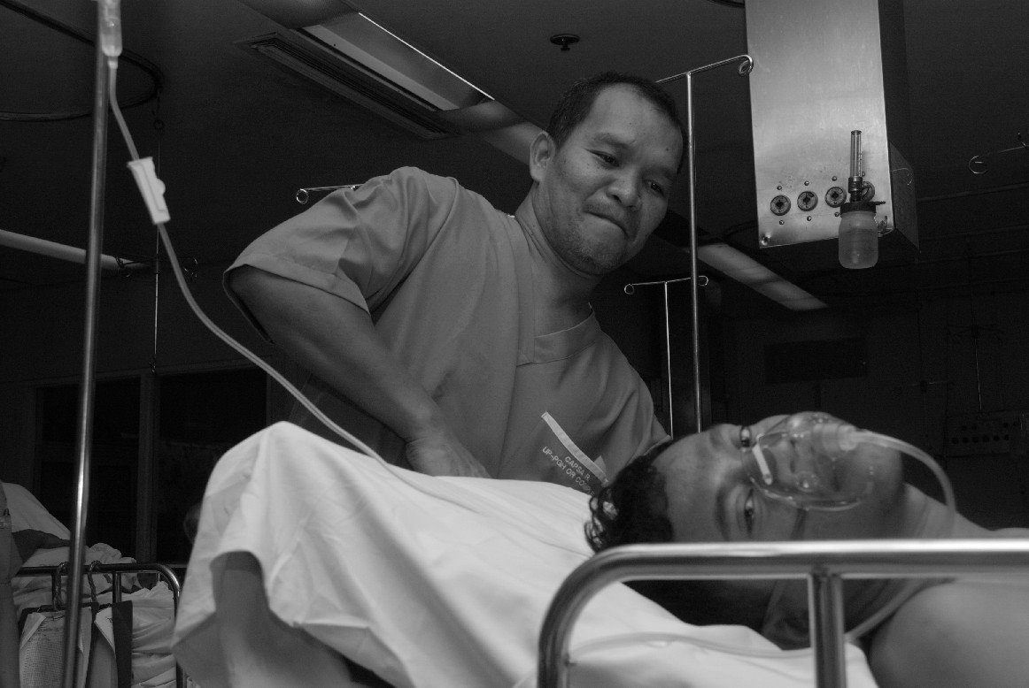
PACU Utility Worker
Assists in transporting the patients in or out of the PACU
Helps in positioning patients

Slide 14
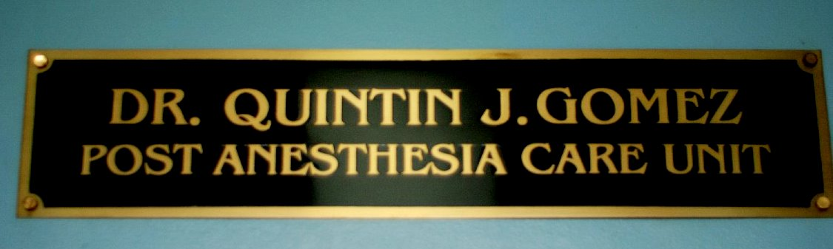
Our PACU

Slide 15
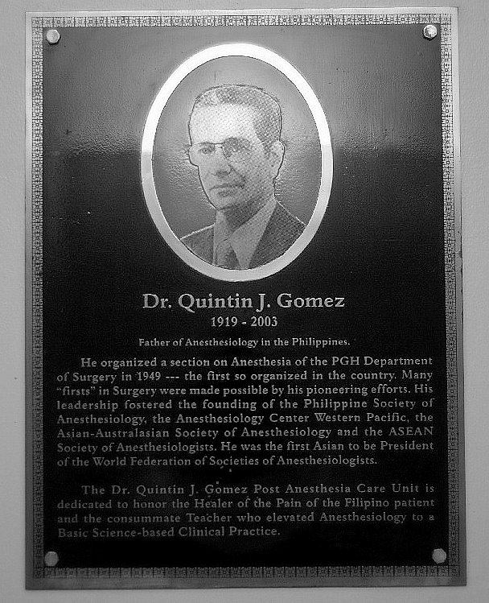
PACU named after the Father of Philippine Anesthesiology

Slide 16

PACU Areas
The PACU is divided into 7 areas
Patients are segregated accordingly

Slide 17
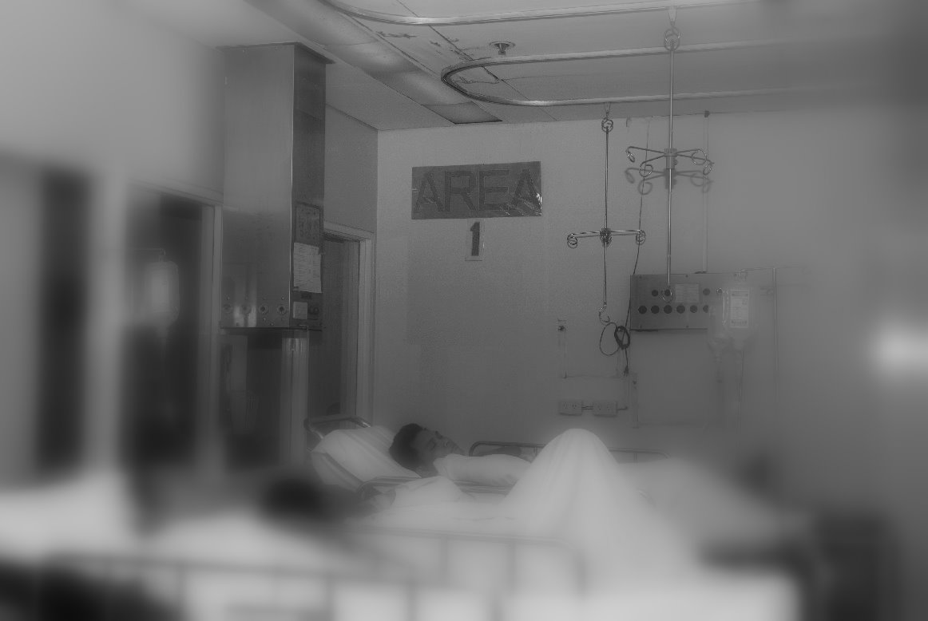
Area 1
Stable Patients
Overstaying Patients without a ward bed
Patients to be discharged straight home from the PACU

Slide 18
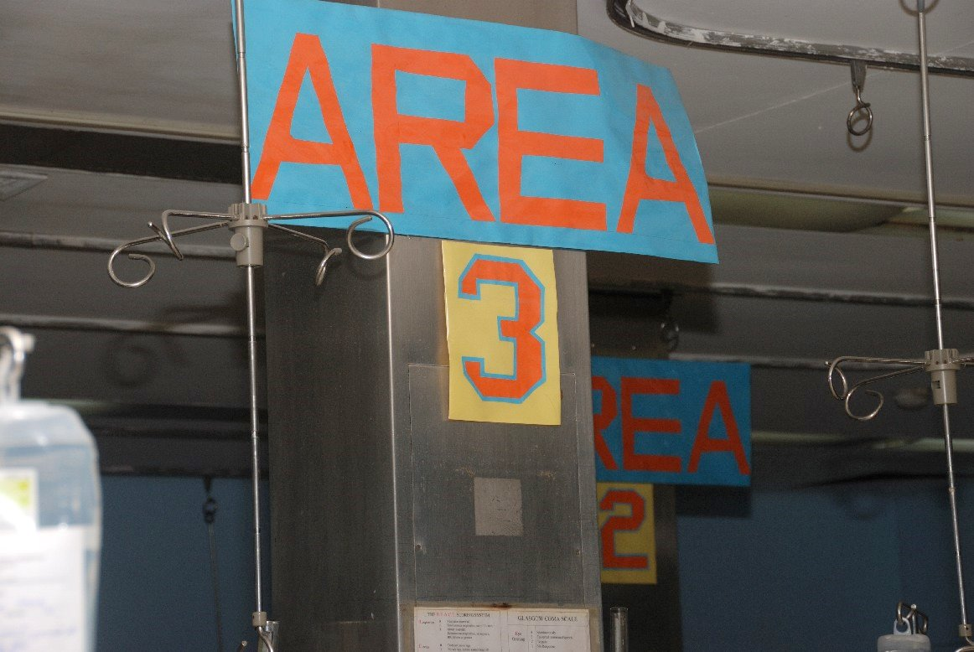
Areas 2 and 3
New Patients are placed in area 3
If stable for at least 30 mins, can be moved to area 2 to give more room to new post-op patients
Only stable patients can be placed in these areas

Slide 19

Area 4
Intensive Care area
  Intubated patients
  Patients with new tracheostomies
  Unstable patients
Standard Monitors are attached

Slide 20
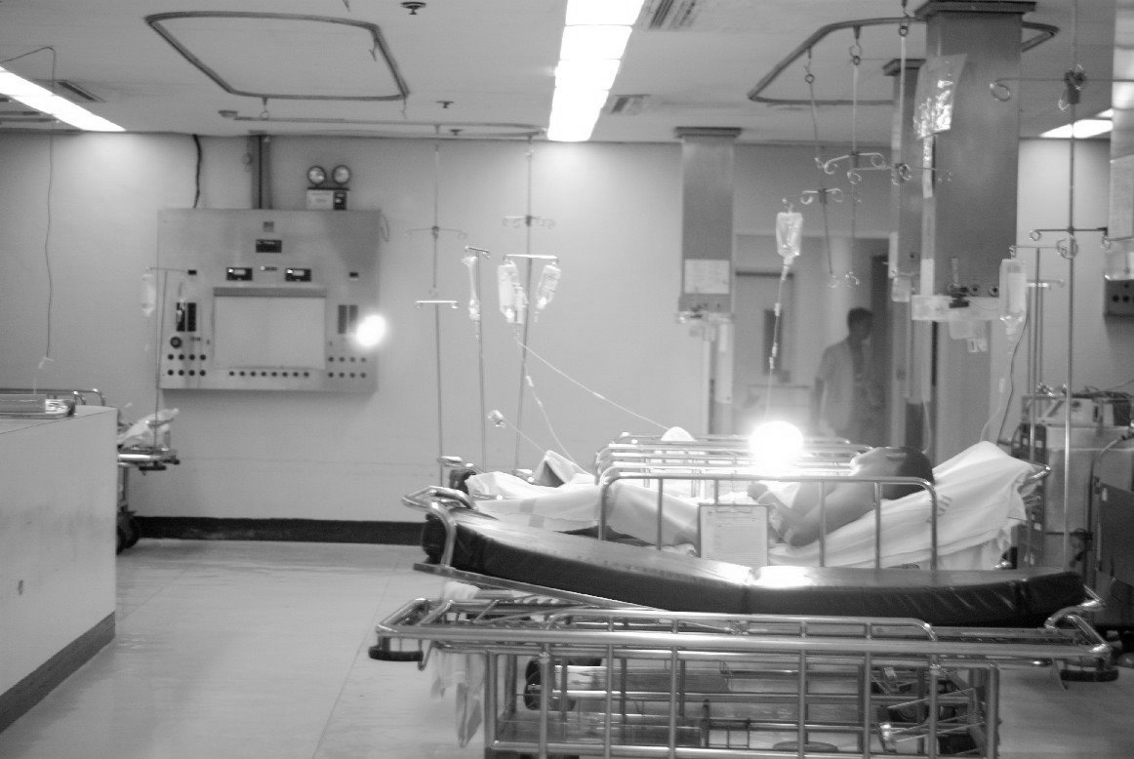
Pay area
Near the entrance
Sometimes extends up to area 2 or the pediatric area

Slide 21
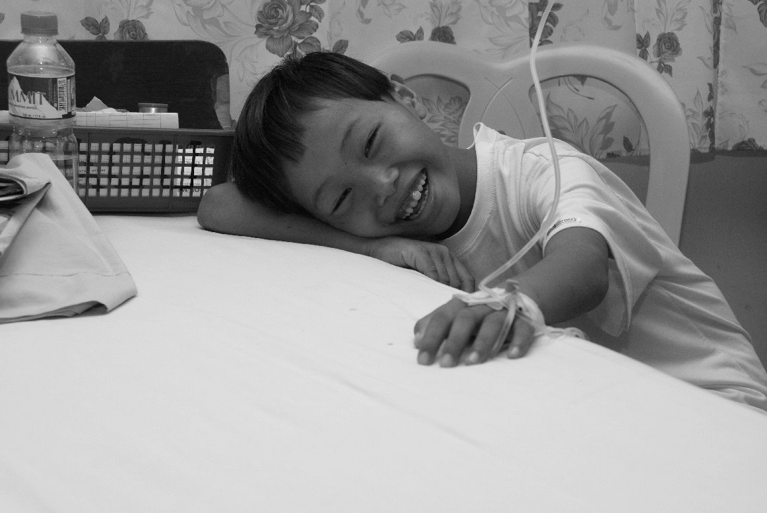
Pediatric area
Stable pediatric patients are placed here
Neonates up to 14 years old
Older adolescents can be placed in area 2

Slide 22
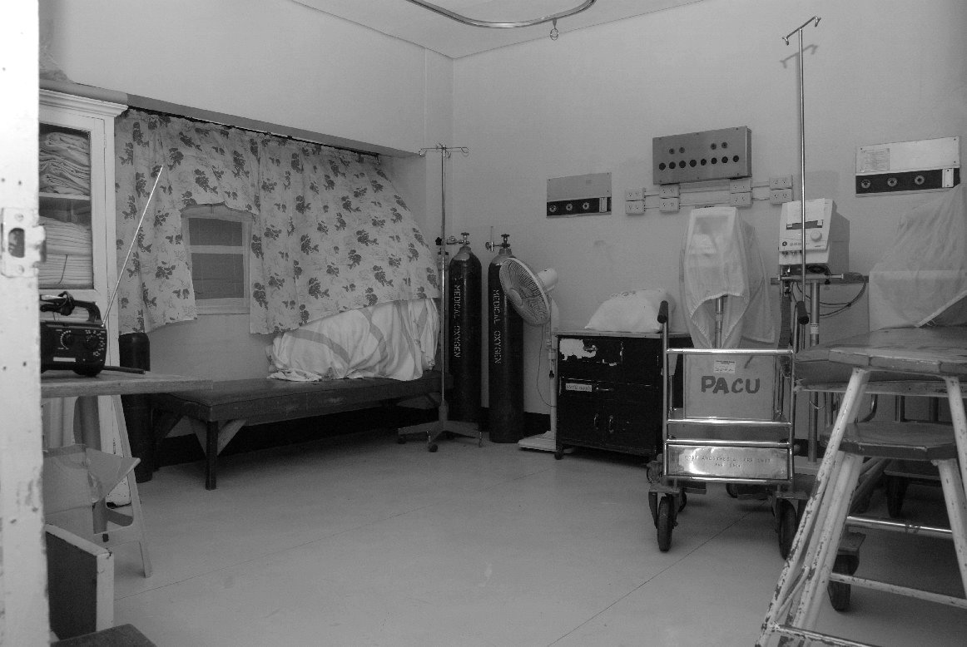
Isolation Room
Can be used for patients who are infectious
Can be used for patients that should not be disturbed e.g. tetanus patient

Slide 23
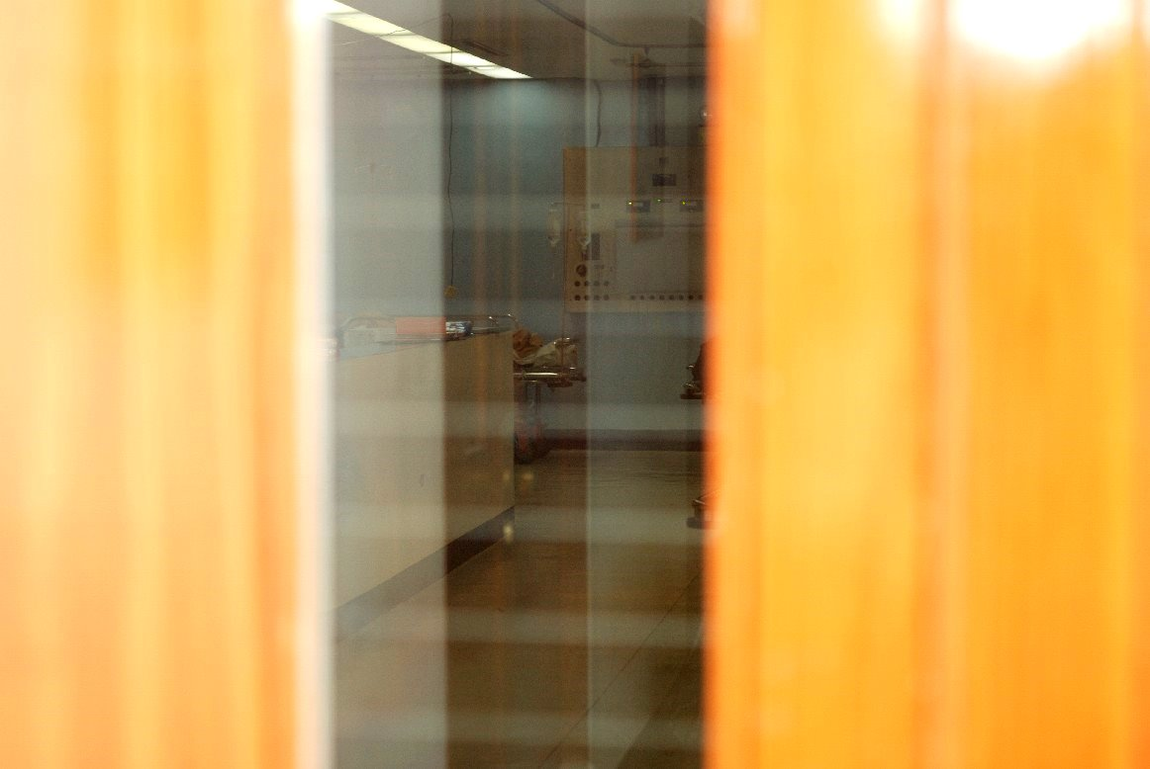
Thank you

