Slide 1
OS 216
Human Disease and Treatment 6
Hematopoiesis and the Immune Response
Hematology Module

Slide 2
Course Description
This is a 1-week course that covers the pathophysiology, symptomatology, diagnosis, prevention and principles of treatment of diseases of the Hematopoietic System.

Slide 3
Module Learning Outcomes
1. Define different benign and malignant hematologic disorders and identify their causes and risk factors.
2. Differentiate pediatric and adult hematologic disorders in terms of epidemiology and clinical presentations.
3. Correlate the pathophysiology and manifestations of different benign and malignant hematologic disorders.
4. Discuss appropriate diagnostic work-up and management principles for benign and malignant hematologic disorders.
5. Discuss the psychosocio-economic impact of hematologic disorders on the patients and their families.
6. Discuss the principles of blood donation and blood component therapy.
7. Define the indications for blood component and whole blood transfusion.
8. Discuss transfusion related complications and their management.
9. Identify ethical issues on blood transfusion.

Slide 4
Major Topics
Benign Hematology
Anemia
Bleeding Disorders
Hypercoagulable States
Bone Marrow Failure
Malignant Hematology
Transfusion Medicine

Slide 5
Involved Faculty Units
Department of Medicine (Division of Hematology)
Department of Pediatrics (Section of Hematology and Oncology)
Department of Pathology and Laboratory Medicine

Slide 6
Reference Materials
Longo et al. eds. Harrison’s Principles of Internal Medicine, 20th ed.
Kliegman et al. eds. Nelson Textbook Of Pediatrics, 21st ed.
Kumar et al. eds. Robbins and Cotran Pathologic Basis of Disease. 9th ed.
Clinical Practice Guidelines (PGH Blood bank, AABB, WHO, ELN, NCCN, ASCO, EHA etc.)

Slide 7
Module Coordinators
Consultant: Dr Teresita E Dumagay
Fellows:
Dr Rhashell Cogay
Dr Torres

Slide 8
Module Run for AY 2022-2023
Date: Oct 24 to Oct 28, 2022
Mode of Delivery
hybrid
OS 216 Human Disease and Treatment (HDT6) Hematopoiesis AY 2022-2023
https://vle.upm.edu.ph/course/view.php?id=2087
Communications: tedumagay@up.edu.ph

Slide 9
TIME | Oct 24 Monday | Oct 25 Tuesday | Oct 26 Wednesday | Oct 27 Thursday | Oct 28 Friday
8:00-9:00 AM | Orientation | Approach to Anemia in Adults | Pediatric Hematologic Malignancies | Small Group Discussion/Simulated Patient Activity/Self Study | Written Examination in Hematology
9:00-10:00 AM | Introduction to Hematology | Approach to Anemia in Pediatrics
10:00-11:00 AM | Common laboratory tests used in hematology | Bleeding Disorders in Adults | Adult Hematologic Malignancies
11:00AM-12:00NN | Simulated Patient Activity/Group Work/Self Study | Bleeding Disorders in Pediatrics
12:00-1:00PM | L U N C H B R E A K
1:00-3:00PM | Blood Bank Plenary | Hypercoagulable States | Approach to Hematologic Complaints | Small Group Discussion Simulated Patient Activity/Self Study | Simulated Patient Activity/ Small Group Discussion
3:00-5:00PM | Pathology/Morphology Plenary | Bone Marrow Failure States | Simulated Patient Activity/Group Work/Self Study

Slide 10
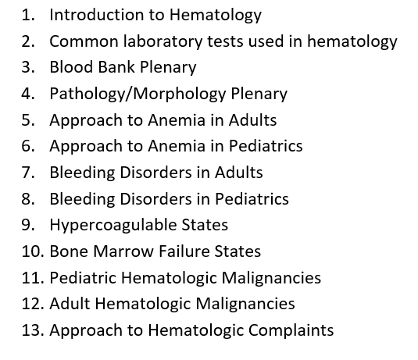
Lectures
As much as possible stick to schedule provided and/or follow the flow

Slide 11
Small Group Case Discussion
patients will be assigned per group
synchronous case discussion with consultant (face to face or zoom)
assign a moderator and a scribe for the group

Slide 12
Case Discussion House Rules
Be on time
Turn on both your audio and video (if video is not available kindly inform your coordinator beforehand so that we can also inform your faculty of the reason why)
Be dressed appropriately (uniform not required but make sure that attire is appropriate for academic forum)
Observe proper classroom etiquette
Have one speaker at a time

Slide 13
Written Case Report
One report per group (18 groups in total)
Case is based on SGD Case

Slide 14
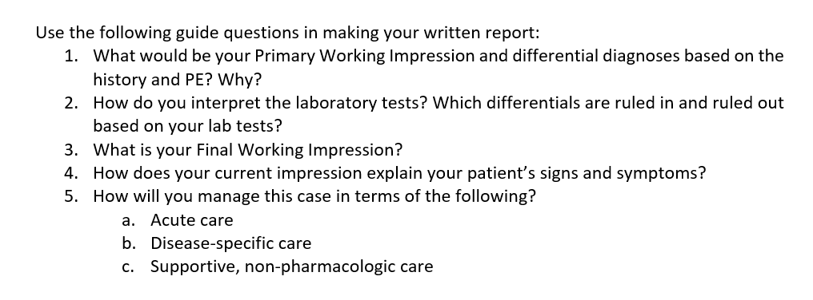
Written Case Report

Slide 15
Written Case Report

Slide 16
Simulated Patient
Process:
Access Simulated Patient link thru UVLE
You will be presented a case scenario.
After reading the initial case scenario you will be asked a question and presented with a finite set of options.
Depending on your chosen answer you will be directed to a pre-specified set of additional case details.
This will keep on repeating until you get to the patient outcome.
Evaluation:
Scoring will be set on the ending and points collected through the choices made along the case.
A student may have 3 tries for the simulation. Highest score will be recorded for summative evaluation.

Slide 17
End of Module Written Exam
Schedule for Oct 28
100 multiple choice questions
Exam will be open in VLE from 8AM to 12NN on Oct 28
Each student is allowed 2 hours

Slide 18
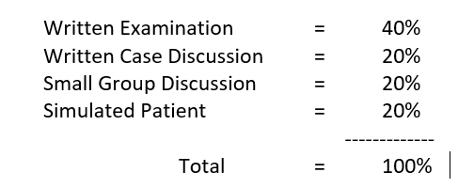
Evaluation

Slide 19
Evaluation for OS 216
50% Immuno + 50% Hema = Pre Final Grade
If you will take the finals: 80% Pre Final Grade + 20% Final Exam
Course Grade: 95% Final Grade + 5% Comprehensive Exam

Slide 20
OS 216
Human Disease and Treatment 6
Hematopoiesis and the Immune Response
Hematology Module

