Slide 1
MEDICINE 251 Clinical Clerkship in Internal Medicine
AY 2022 - 2023

Slide 2
Year Level Committee
CONSULTANT MONITORS
Dr. Lia Aileen Palileo-Villanueva
Dr. Teresita Dumagay
Dr. Diana Tamondong-Lachica
Dr. Michael San Juan
RESIDENT MONITORS
Dr. Marvin Espino
Dr. Eladio Anino V
Dr. Marc Lharen Barsabal
Dr. Marvin Mangulabnan
Dr. Brian Alvarez
Dr. Chin Vista

Slide 3
Course Description
A 6-week comprehensive training course in the clinical management of common and important medical diseases in a setting that may require ward or critical care unit admission with focus on diagnosis, treatment, prevention, and control.

Slide 4
Course Objectives
At the end of the course, the student should be able to:
correlate the pathophysiology of the patient's disease to the history, physical examination and laboratory data in order to arrive at a definitive diagnosis and differential diagnosis of common diseases and some less common but serious/life threatening diseases
acquire skills in organizing and presenting information pertinent to the diagnosis and differential diagnosis
propose diagnostic and therapeutic plans and perform specific diagnostic and therapeutic interventions
demonstrate sensitivity to the human needs and social implications of the patient's disease
work harmoniously with peer groups, supervisor and related coworkers and develop good interpersonal relationship with all the personnel involved in the care of his patient

Slide 5
Must Know Topics
Coronary Artery Disease and Acute Coronary Syndromes
Hypertensive emergency/urgency
Heart Failure
Common arrhythmias (Atrial Fibrillation, Supraventricular Tachycardia, Ventricular Tachycardia, Ventricular Fibrillation)
Rheumatic Heart Disease/Rheumatic Fever
Acute Respiratory Failure
Pneumonia
Pleural effusion
COPD/Asthma
Diabetes mellitus including Diabetic Emergencies
Thyroid Storm
GI bleeding
Liver disease, including hepatic encephalopathy
Intoxications/ poisoning cases
Febrile Jaundice
Introduction to Blood Component Therapy
Acid-base/Electrolyte disorders
Acute renal failure
Chronic kidney disease
Tuberculosis
Sepsis
Pyelonephritis
Dengue
Leptospirosis
Acute infectious diarrheal diseases and bacterial food poisoning
Infectious Arthritis
Typhoid
COVID
Malaria
Recognition of Connective tissue diseases
Prevention of Nosocomial Infections
Anaphylaxis
Patient Safety

Slide 6
Essential Skills
ABG Interpretation
ECG Interpretation
Chest X-ray Reading
IV cannulation
Venous Blood extraction
ABG sample extraction
Foley Catheter insertion
NGT insertion
Proper Donning and Doffing

Slide 7
References
Harrison’s Principles of Internal Medicine 20th ed. (Longo DL, Fauci AS, Kasper DL, Hauser SL, Jameson J, Loscalzo J. eds. Harrison's Principles of Internal Medicine, 20e. New York, NY: McGraw-Hill; 2018)
-Note that we already have the 21st edition made available just this June 2022
Latest Clinical Practice Guidelines for specific diseases (e.g. CAP, GOLD, GINA, ACS, Sepsis, etc)

Slide 8
Changes for AY 2022 - 2023
Activities will remain a hybrid of online and F2F activities but F2F activities will be emphasized
Students will have a total of 6 weeks in the Department
3 weeks in the “1st sem’’ (Aug 29– Dec 11)
3 weeks in the “2nd sem” (Jan 2 – May 21)
Rotation will include 2 weeks of OPD rotation

Slide 9
Course Rotation
For the entire year:
2 weeks Outpatient – General Medicine
4 weeks Inpatient – Medicine Ward (Non-COVID areas only)
For each sem:
1 week Outpatient – General Medicine
2 weeks Inpatient – Medicine Ward (Non-COVID areas only)
WEEK | 1 | 2 | 3 | 4 | 5 | 6
ROTATION | OPD | Ward | Ward | OPD | Ward | Ward
For block 9 only:
WEEK | 1 | 2 | 3 | 4 | 5 | 6
ROTATION | Ward | Ward | OPD | Ward | Ward | OPD

Slide 10
Week/ Day | Mon | Tues | Wed | Thurs | Fri | Sat | Sun
1 OPD | Lectures Made Available ECG, ABG, CXR | Department Conference** |  | Department Conference**
2 Ward | Ward Work⁺⁺ | Department Conference** Ward Work⁺⁺ | Ward Work⁺⁺ | Department Conference** Ward Work⁺⁺ | Ward Work⁺⁺ ^{Bioethics Discussion^^} | Ward Work⁺⁺ | Ward Work⁺⁺
3 Ward | Ward Work⁺⁺ | Department Conference** Ward Work⁺⁺ | Ward Work⁺⁺ | Department Conference** Ward Work⁺⁺ | Ward Work⁺⁺ ^{Bioethics Discussion^^} | Ward Work⁺⁺ | Ward Work⁺⁺

Slide 11
SAFETY REMINDER
Before heading to your designated post for the day (whether OPD or ward), make sure to check temperature and check for COVID symptoms
if with symptoms DO NOT go to the hospital – please notify buddy/LO and safety officer

Slide 12
OPD Rotation

Slide 13
OPD Rotation
Introduce yourself to Consultant (Adult Med) or Resident (team captain)
Take History and PE of patient and come up with diagnosis and plan
Present to Consultant or Resident your patient and have them check your plan and disposition of patient
Prioritize new patients but may also see follow-up patients

Slide 14
OPD daily schedule
If you are not at the OPD physically, take the time to go thru the introductory lectures, patient safety module, bioethics module, and to read up on must know topics.

Slide 15
OPD Rotation Output (for the entire year)
Patient Census (Patient Initials only and Diagnosis) – countersigned by resident/consultant
At least 1 consultant graded patient presentation
Patient Safety Case presentation on 2nd sem OPD rotation (finalize schedule with Dr Lachica)

Slide 16
Ward Rotation

Slide 17
Attendance
Attendance sheets outside Patient Education Room/Medicine Office
Official time-in (AM duty): 7 AM
Official time-in (PM duty): 7 PM
Late: 7:10 to 7:30 AM
Considered absent: later than 7:30 AM
3 lates = 1 unexcused absence
No signature = 1 unexcused absence
Attendance at Guazon Hall will be checked by resident monitors and/or seniors

Slide 18
Attendance
Always sign the attendance sheet
If absent or unable to sign on time:
Submit a letter addressed to the LU6 Committee to resident monitors for excused absence/late within 3 days
Have your WAPOD/RIC sign the letter indicating the reason for failure to sign the attendance on time
No excuse letter = unexcused absence
Missed duties/absences will have corresponding make up duties/activities

Slide 19
General Medicine Services
6 General Medicine Services
2-3 consultants (with 1 LU consultant), 1 senior resident, 2-3 junior residents, 6 interns, 3-4 clerks
each service admits patients every 6 days
3 duty teams: each duty team is composed of 2 sister services
sister services (residents) go on duty every 3 days

Slide 20
General Medicine Services Assignment
Clerks will be divided among the 6 Gen Med Services
3-4 clerks per service
clerks will remain with the same service for the entirety of their ward rotation per sem
Clerks will be assigned a maximum of 5 co-managed patients per service
co-SIC will be another clerk

Slide 21
General Medicine Services Activities
Accomplish clinical abstract and discharge summaries of assigned patients
Updates the details of the their assigned patients in RADISH service census
May do procedures (BE, ABG, Foley, IV, NGT insertion, etc) and make requests for imaging/blood requests (supervised by the RIC/WAPOD)
Attendance in all physical and Zoom service rounds (prioritize rounds with LU consultants)
Monitor patients needing HOURLY monitoring (supervised by the RIC/ROD) and refer deranged vitals (if unsure, don’t hesitate to ask)

Slide 22
General Medicine Services Activities
Make sure you see your patients
Discuss management with residents, fellows and consultants
During periods with no bedside activity, you may stay in the callroom

Slide 23
Ward Endorsements
GUAZON ENDORSEMENTS
presided by JWAPODs
730-9AM
moderated by pre-duty Gen Med and Pay Senior

Slide 24
Ward Endorsements
WAPOD Endorsements
Facilitated by the WAPOD of the Specific WARD
6-630PM – 7-730PM
Endorsements of Q1 monitoring patients by SICs
General Info, Current assessment, “Watch out for” and What to do, Endorse procs
Brief endorsements ONLY, lectures/learnings discouraged
Floor Manager should be assigned by the duty team
Attendees: WAPOD, JWAPOD, Duty Team of that Ward and SICs

Slide 25
Duty Posts
There are 3 Posts for Gen Med Services
Pre-duty, Post-duty and Duty
Clerks will follow these duty posts with the exemption of the night duty
During night duty, only 1 clerk per Duty Service will be present
Clerks who went on night duty will have a true post duty status the next day (may leave after endorsements)

Slide 26
Night Duty

Slide 27
Night Duty
Receiving endorsements from AM duty team
Monitoring
Procedures
Conductions/accompany patients within PGH
Preparing for morning endorsements

Slide 28
Sample Daily Schedule
Time | Activity
7:00AM | Time In; Check on patients
7:30AM | Guazon Endorsements
9:00AM | Check on Patients/Do Procedures/Attend Rounds
6:00PM | WAPOD Endorsements
7:00PM | Home
Time | Activity
6:00PM | Time In; WAPOD Endorsements
7:ooPM | Monitoring/Procedures
7:00AM | Time In
7:30AM | Guazon Endorsements
9:00AM | Home

Slide 29
Ward Rotation Output (for the entire year)
Patient Census (Patient Initials only and Diagnosis) – countersigned by resident/consultant
At least 1 consultant graded patient presentation
2 Written Case Discussion (at end of week 3 and week 5)
Bioethics Discussion (finalize schedule with Dr San Juan for 1st sem and Dr Gueco for 2nd sem)

Slide 30
Course Activities/Requirements

Slide 31
Course Requirements (for the entire 6-week rotation)
Requirement | % Grade | Comment
Consultant Cognitive Evaluation | 30% | At least 1 inpatient and 1 OPD
Clinical Performance: Consultant | 10% | At least 2 – either LU or ward consultant
Clinical Performance: Resident | 5% | At least 2 – 1 senior and 1 junior
Peer Evaluation | 5%
Written Case Discussion | 20% | 1 after week 3 and 1 after week 5
Final Examination | 15% | 100 items MCQ
Comprehensive Examination | 10%
Bioethics Reaction Paper and Discussion | 5%
Portfolio | Formative | Patient census; Procedure log; Introductory Lecture Assignments

Slide 32
Course Requirements (for the entire 6-week rotation)
**If comprehensive exam will be deemed formative the 10% allotted to it will be divided between final exam and written case discussion
***If a student fails the final examination or has a failing overall grade then they will be required to have a remedial activity. The remedial activity is a pass or fail activity.
- If the student fails the final examination but has a passing overall grade, his/her final grade will be the overall grade once the student passes the remedial activity.
- If the student has a failing overall grade, his/her final grade will be the equivalent of a 3.00 once the student passes the remedial activity.

Slide 33
Summative Evaluation: Consultant Cognitive Evaluation
Evaluation is based on oral case presentation (individual)
Students should have at least 2 evaluations from consultants – 1 from OPD and 1 from inpatient
For inpatient evaluation we will be assigning a consultant who will grade student presentation on week 6 (students will be allowed to choose which patient they will discuss)
Final score for this course requirement will be an average of all evaluations made by consultants throughout the entire year (both 1st and 2nd semesters)

Slide 34
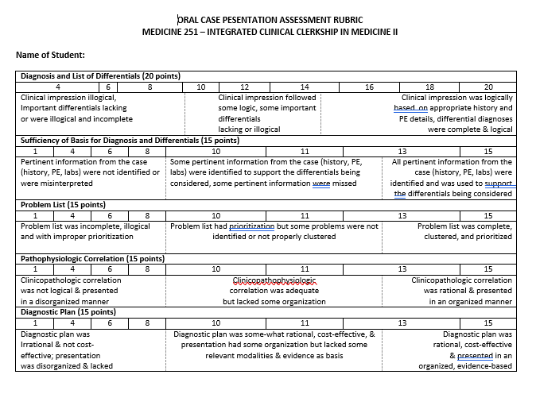
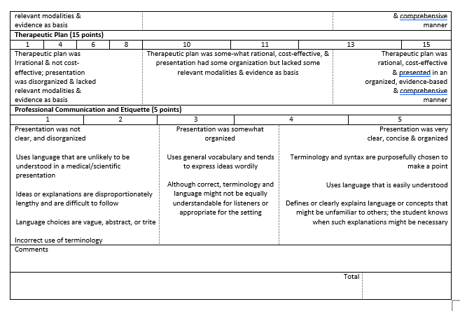
Grading Sheet

Slide 35
Summative Evaluation: Consultant Clinical Performance Evaluation
Evaluation may come from LU consultant or ward consultant
Based on Behavior and Attitude
Students should have at least 2 evaluations from consultants
Final score for this course requirement will be an average of all evaluations made by consultants throughout the entire year (both 1st and 2nd semesters).

Slide 36
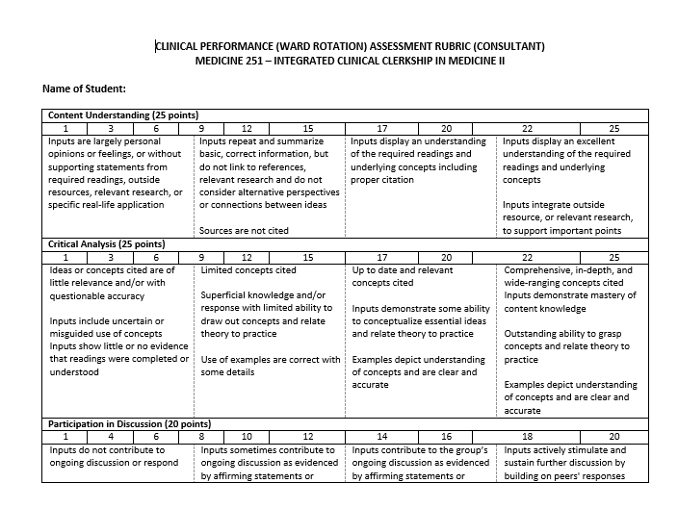
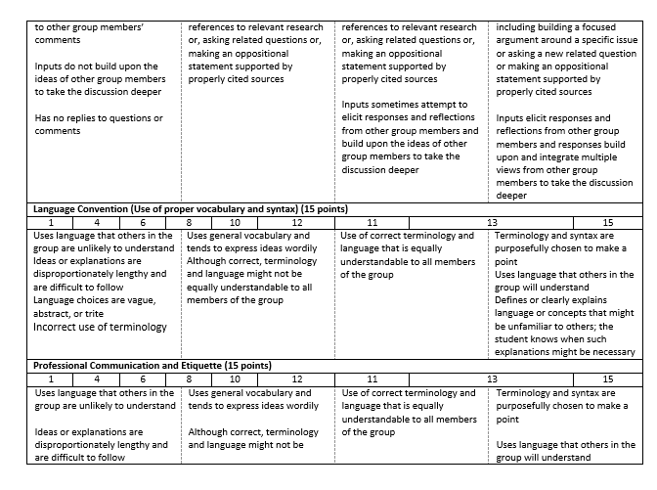
Grading Sheet

Slide 37
Summative Evaluation: Resident Clinical Performance Evaluation
Evaluation may come from senior or junior IM resident
Based on Behavior and Attitude
Students should have at least 2 evaluations from 2 different residents
Final score for this course requirement will be an average of all evaluations made by residents throughout the entire year (both 1st and 2nd semesters).

Slide 38
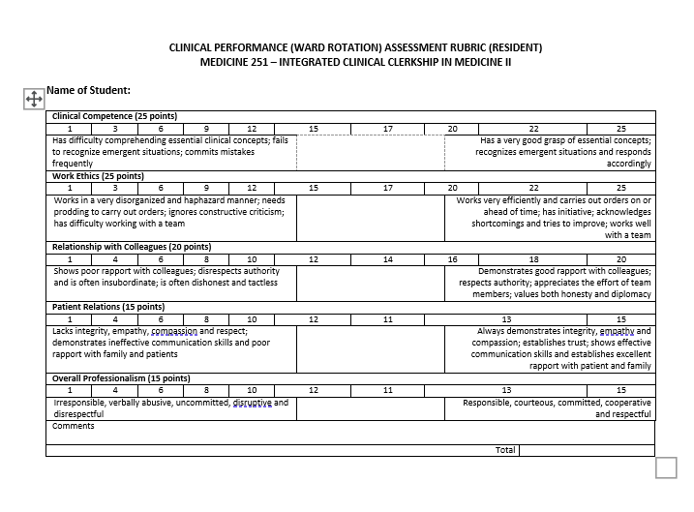
Grading Sheet

Slide 39
Summative Evaluation: Peer Evaluation
Evaluation done at the end of the year
Based on Behavior and Attitude
Students should have at least 1 evaluation from another clerk who was on the same service or they went on duty (OPD or ward)
Final score for this course requirement will be an average of all evaluations made by clerks throughout the entire year (both 1st and 2nd semesters).

Slide 40
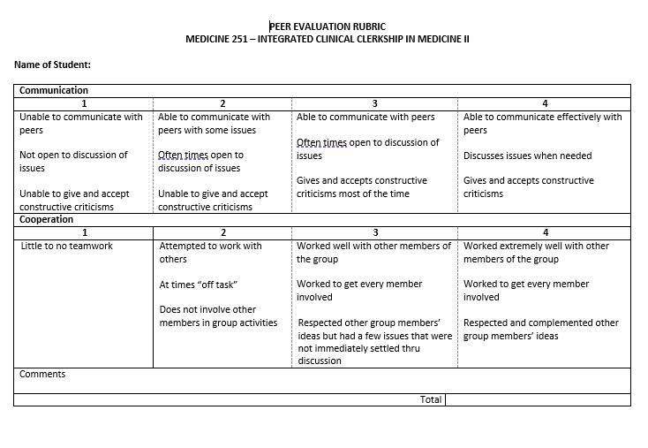
Grading Sheet

Slide 41
Summative Evaluation: Written Case Discussion
written case discussion will be based on a case handled by the clerks in the wards
students are allowed to pick which case they will discuss
students will be asked to submit a total of 2 written case discussions

Slide 42
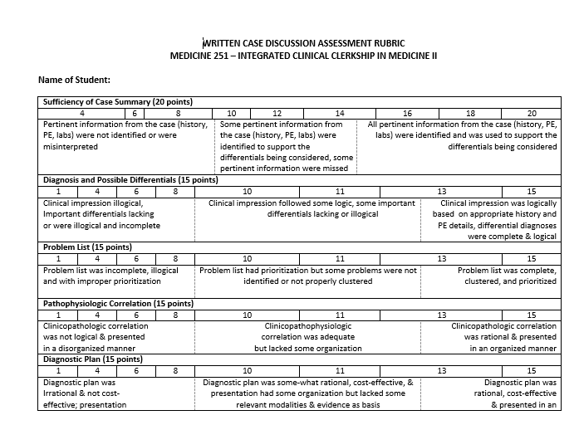
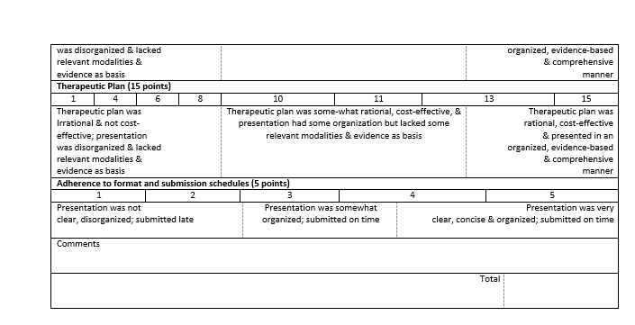
Grading Sheet

Slide 43
Summative Evaluation: Bioethics Module
The numerical grade for this requirement will be an average of the score from the reaction paper and the synchronous case discussion.

Slide 44
Summative Evaluation: Final Examination
This will be given at the end of the year.
The examination will consist of 100 multiple choice questions on the must know topics and essential skills.

Slide 45
Formative Evaluation: Introductory Lectures and Curated Content
5 annotated lectures by our faculty are as follows:
ECG Interpretation
ABG Interpretation
Chest x-ray Reading
Fluids and Electrolytes
Telemedicine
Curated materials are for the following topics:
Concept mapping
Making problem lists
Essential Skills
Patient Safety

Slide 46
Formative Evaluation: Patient Safety
Curated Materials will be provided and a case per sub-block will be given for analysis and discussion.
There will be a discussion per block with Dr Diana Tamondong-Lachica on the 4th week of your rotation (Saturday).
Patient Safety conferences are done every 1st Thursday of the month.

Slide 47
Attendance: Department Conferences
Department Conferences are on Tuesdays and Thursdays
May attend Division Conferences also if not in conflict with other activities

Slide 48
Final Reminders

Slide 49
RADISH Computerized Registry of Admissions and Discharges
ORIENTATION: https://www.youtube.com/playlist?list=PLKEAaSpp30LQwzsENOsqdQigN4FVly8pQ
RADISH USER ACCOUNT REQUEST FORM: https://docs.google.com/forms/d/e/1FAIpQLSezv0Jg0zrBph0aqUQNOLEROrmIWmS5--kMRb9f7COKHXkXuA/viewform?vc=0&c=0&w=1&flr=0

Slide 50
Mandatory Activities
Introductory Lectures
Bioethics Discussions
OPD Rotation
Ward Rotation**
Written Case Discussions
Final Examination
Comprehensive Examination
Remedial Activity⁺⁺
++ Only mandated for students who fail the finals or have a failing overall grade
**Missed duties/absences will have corresponding make up duties/activities

Slide 51
Final Reminders
The course is designed to be self-directed.
Proper decorum is expected of students (University and College Rules apply).
If you have any concerns, kindly direct them thru proper channels (Resident and Consultant Coordinators).

Slide 52
MEDICINE 251 Clinical Clerkship in Internal Medicine
AY 2022 - 2023

