Slide 1
BASIC EYE EXAM
Felice Katrina T. Ranche
Clinical Associate Professor

Slide 2
The 5-POINT EYE EXAM
Visual Acuity
Gross Examination
Motility
Intraocular Pressure
Funduscopy

Slide 3
VISUAL ACUITY (DISTANCE/FAR)
Distance visual acuity is taken one eye at a time. Ask the patient to cover the fellow eye with an occluder or his palm.
The visual acuity is taken in this sequence:
  Uncorrected or without spectacles (sc)
  Corrected or with spectacles (cc)
  With pinhole (ph), which is the best acuity a patient can have.

Slide 4
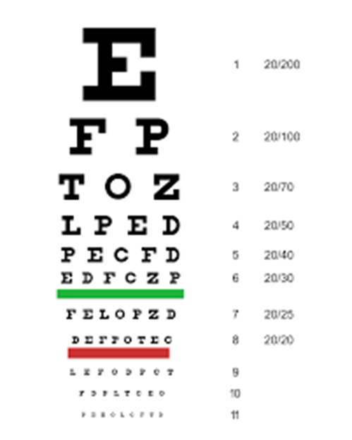
USING THE SNELLEN CHART
Ask the patient to stand 6m or 20ft from the Snellen chart.
Ask him to read the smallest line that he can see.
Record this using the Snellen notation.
You may use the metric system or the imperial system, as long as you are consistent.

Slide 5
PATIENTS WITH POOR VISION
The largest letter is 20/200 or 6/60.
If the patient cannot read it, move him forward by 1 meter. VA at that point is 5/60.
Move another meter closer if the patient still cannot see.
4/60, 3/60, 2/60, 1/60…

Slide 6
PATIENTs WITH POOR VISION
If your patient cannot see the E from 1m or 3ft, check if he can COUNT FINGERS (CF or FC) at 3feet.
CF at 2ft, 1ft, 6”…

Slide 7
PATIENTs WITH POOR VISION
If your patient cannot count fingers at 6”, check if he can detect HAND MOTIONS (HM) or not.
HM is always paired with LIGHT PROJECTION (LPj), which you can test with a penlight.
  Good = 4 quadrants
  Fair = 2-3 quadrants
  Poor = 1 quadrant

Slide 8
PATIENTs WITH POOR VISION
If your patient cannot detect hand motions or localize light, check if he can detect the presence of light. Report this as LIGHT PERCEPTION (LP) or NO LIGHT PERCEPTION (NLP).

Slide 9
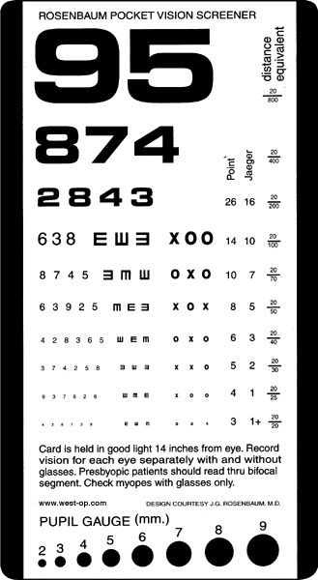
NEAR VISION
Test this in patients aged 35 and older, in whom we expect a decrease in accommodation.
Hold the near vision chart 14 inches away and ask the patient to read until the smallest line.
Record using the Jaeger notation.
Near vision is a binocular function.

Slide 10
SAMPLE REPORTING
 | sc | cc | ph | Near
OD | 20/100 | 20/40 | 20/20 | J3
OS | 20/70 | 20/40 | 20/40

Slide 11
Gross Examination
Eyelids and eyelashes
Proptosis or enophthalmos
Corneal clarity and corneal light reflex
Sclera
Bulbar and palpebral conjunctiva
Pupil size and pupillary light reaction

Slide 12
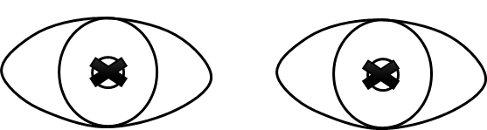
SAMPLE REPORTING

Slide 13
MOTILITY (EOM TESTING)
Ask the patient to follow your finger in the 6 directions of gaze.
  Version - Conjugate binocular eye movement
  Duction - Monocular eye movement

Slide 14
PALPATION TONOMETRY
Ask the patient to look down.
Place you index fingers on the right upper eyelid. Press lightly using alternating fingers to check the consistency of the right globe. Repeat for the left.
  hypotonic: lips
  soft: ala of nose
  firm: forehead
Do not palpate if you suspect an open eye injury.

Slide 15
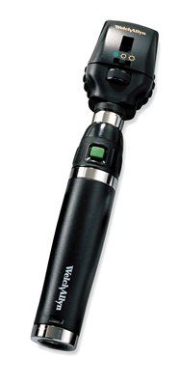
DIRECT FUNDUSCOPY
Use your ophthalmoscope properly
  Adjust the rheostat to the brightest light your patient can tolerate
  Adjust for EOR (red for myopes, green for hyperopes, 0 for plano)
  Adjust aperture size (smaller than pupil) to reduce glare
Ask the patient to look at a distant target
Use your right eye to examine the patient’s right eye and vice versa

Slide 16
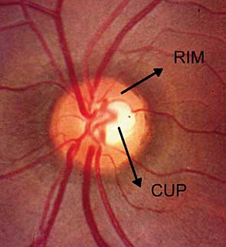
FUNDUSCOPY REPORTING
Clear or hazy media
Distinct or indistinct disc borders
Cup:disc ratio
AV ratio
Hemorrhages or exudates
Good or dull foveal reflex

Slide 17
THANK YOU

