Slide 1
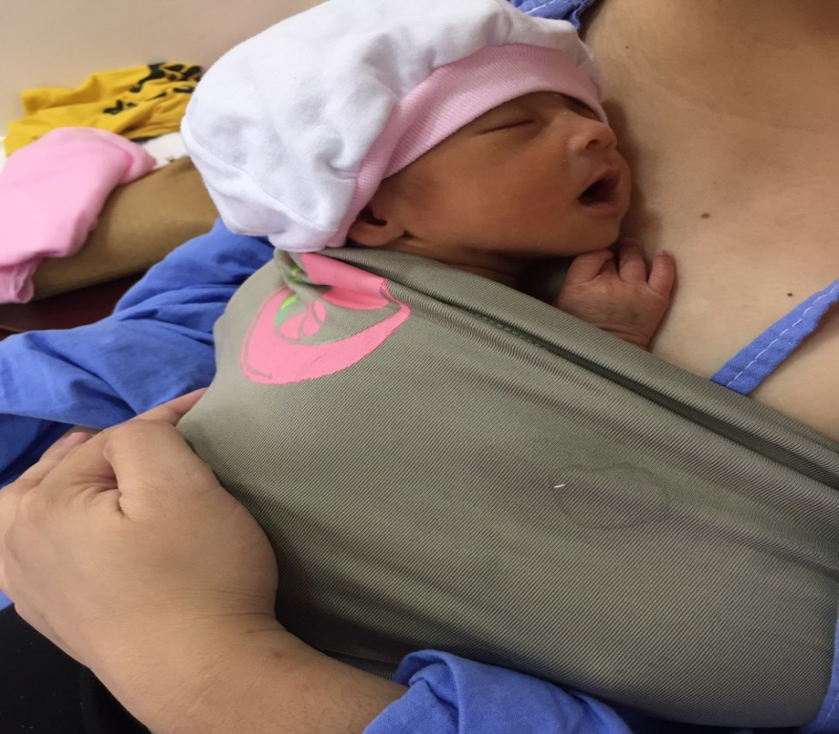
NECROTIZING ENTEROCOLITIS
Aurora Gloria I. Libadia, MD, FPPS, FPSNbM
Clinical Associate Professor, UP College of Medicine
Notes:
The most common gastrointestinal emergency in NICU. NEC is a feared complications in every NICU.

Slide 2
Outline
WHO are affected ?
WHY?
WHAT are the clinical manifestation ?
HOW to Diagnose?
HOW to Treat?

Slide 3
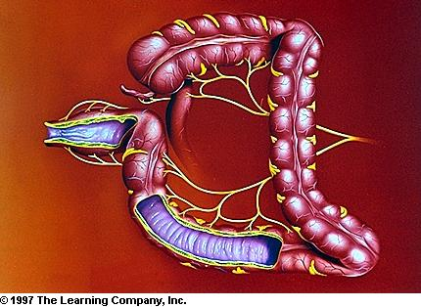
NEC
Premature LBW infants ( Less than 35 weeks old , weighing less than 1000 grams ) – comprise 90% of cases are at a higher risk
Notes:
The leading cause of death among preterm and LBW. Although NEC may affect all infants, premature LBW infants ( Less than 35 weeks old , weighing less than 1000 grams ) – comprise 90% of cases are at a higher risk.

Slide 4
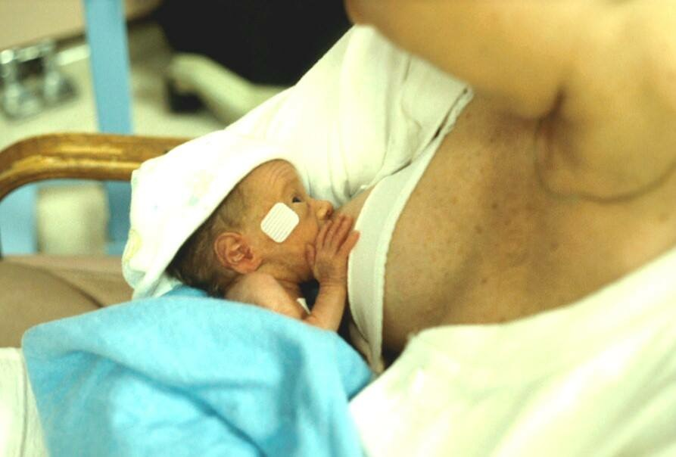
Etiology
Unknown
Impaired mucosal barrier
Pathogenic bacteria
Feeding with milk formula
Hypoxia or hypotension
Notes:
The exact cause is unknown, but combination of impaired mucosal barrier , pathogenic bacteria, feeding with milk formula are inciting factors. Hypoxic and hypotensive episodes contribute to mucosal injury and ischemia. Neonates with these stressors are vulnerable to NEC .
Milk formula feeds , apart from being hyperosmolar , also lack the beneficial components of breastmilk , like trophic hormones , vitamins and immune mediators
2.8 fold increase in the risk of NEC in premature infants fed with formula compared with those fed with human milk
Cristofalo et al, 2013; Quigley and Mc guire, 2014

Slide 5
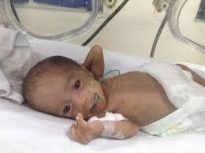
Etiology
CHD
Prophylactic PDA closure with Indomethacin, 30% risk of NEC
Combination of CHD and NEC increased overall mortality rate to 55%
Anemia and pRBC transfusion
- it is hypothesized that intestinal vascular autoregulation occurs after correction of anemia leading to transfusion related acute GUT injury
Notes:
Congenital heart disease that will hemodynamically compromise our newborn , PDA with large defect , or prophylactic PDA closure with indomethacin , with 30% risk of NEC . Combination of CHD and NEC increased overall mortality rate to 55%.
Anemia and pRBC transfusion
- it is hypothesized that intestinal vascular autoregulation occurs after correction of anemia leading to transfusion related acute GUT injury

Slide 6
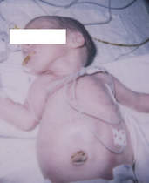
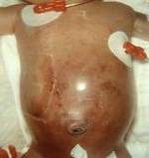
Clinical manifestation
Premature
Feeding intolerance (vomiting or increased gastric residuals
Abdominal distention
Fecal occult blood positive
Gross blood on stool
Notes:
NEC is suspected in a preterm who develops feeding intolerance manifested as vomiting or increased gastric residuals in those who are fed by tube. The abdomen becomes distended . Fecal occult blood becomes positive , indicating mucosal sloughing. With the progression of ischemia and sepsis, the abdomen becomes increasingly distended, and gross blood may be seen in the stools.

Slide 7
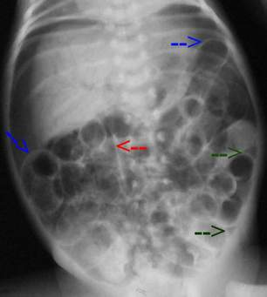
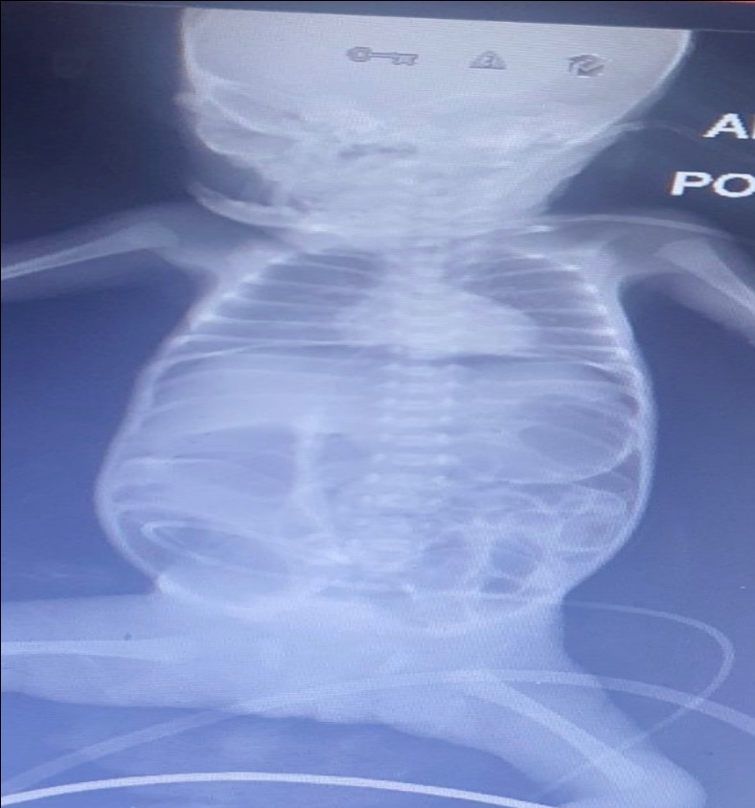
Diagnosis
Abdominal Xray – ileus later subserosal air collections (pneumatosis intestinalis)
Perforation
Portal vein gas – intestinal necrosis
Thrombocytopenia
Notes:
Abdominal Xray showing dilated bowel loops suggestive of ileus may later reveal subserosal air collections known as pneumatosis intestinalis . Abdominal wall ischemia may ensue , and frank intestinal necrosis or perforation may set in. Portal vein gas suggests intestinal necrosis. Thrombocytopenia is commonly encountered.

Slide 8
Treatment Modified Bell Staging for NEC
STAGE | SYSYTEMIC SIGNS | INTESTINAL SIGNS | RADIOLOGIC SIGNS | TREATMENT
I. SUSPECTED
A | Temperature instability Apnea Bradycardia | Elevated pregavage residuals, mild abdominal distention, Occult blood in stool | Normal or mild ileus | NPO x 3 days Antibiotics
B | Same as IA | Same as IA Plus Gross blood in stool | Same as IA | Same as IA
From Walsh MC, Kleigman RM, Fanaroff AA. Necrotizing enterocolitis:
a practitioners perspective; 1998
Notes:
The modified Bell Staging is useful to determine the management of a patient with NEC. A patient is suspected to have NEC is placed on nothing per orem (NPO) with decompression and broad spectrum antibiotics .
Stage IA . SUSPECTED NEC
Systemic signs are : Non-specific signs of sepsis : Temperature instability, Apnea (pathologic apnea more than 20 sec cessation of breathing or any duration but with central cyanosis or bradycardia), Bradycardia
Intestinal signs : Elevated pregavage residuals, mild abdominal distention, Occult blood in stool
Radiologic signs : Normal or mild ileus
Treatment : NPO for 3 days , antibiotics
NEC Stage IB – the same with Stage IA but with gross blood in stool

Slide 9
Treatment Modified Bell Staging for NEC
STAGE | SYSYTEMIC SIGNS | INTESTINAL SIGNS | RADIOLOGIC SIGNS | TREATMENT
II. DEFINITE
Mildly ill | Same as for IA | Same as for I, plus Absent bowel sounds Abdominal tenderness | Ileus, intestinal pneumatosis | NPO,x 7-10 days Antibiotics
B. Moderately ill | Same as for I, plus mild metabolic acidosis, Mild thrombocytopenia | Same as for I, Absent bowel sounds,definite Abdominal tenderness, abdominal cellulitus, right lower quadrant mass | Same as for IIA, plus portal vein gas with or without ascites | NPO, x 14 days Antibiotics
From Walsh MC, Kleigman RM, Fanaroff AA. Necrotizing enterocolitis: a practitioners perspective;1998
Notes:
Stage IIA . DEFINITE NEC Mildly ill
Systemic signs are : Non-specific signs of sepsis : Temperature instability, Apnea (pathologic apnea more than 20 sec cessation of breathing or any duration but with central cyanosis or bradycardia), Bradycardia
Intestinal signs : Elevated pregavage residuals, mild abdominal distention, Occult blood in stool or gross blood in stool , with absent bowel sounds and abdominal tenderness
Radiologic signs :Ileus, intestinal pneumatosis
Treatment : NPO for 7-10 days , antibiotics
Stage IIB . DEFINITE NEC Moderately Ill
Systemic signs are : Non-specific signs of sepsis : Temperature instability, Apnea (pathologic apnea more than 20 sec cessation of breathing or any duration but with central cyanosis or bradycardia), bradycardia, mild metabolic acidosis, mild thrombocytopenia
Intestinal signs : Elevated pregavage residuals, Occult blood in stool or gross blood in stool , with absent bowel sounds , definite abdominal tenderness, abdominal cellulitis , right lower quadrant mass
Radiologic signs :Ileus, intestinal pneumatosis plus portal vein gas , with or without ascites
Treatment : NPO for 14 days , antibiotics

Slide 10
Treatment Modified Bell Staging for NEC
STAGE | SYSYTEMIC SIGNS | INTESTINAL SIGNS | RADIOLOGIC SIGNS | TREATMENT
III. Advanced
Severely ill, bowel intact | Same as for IIB plus hypotension, bradycardia, respiratory acidosis, metabolic acidosis, DIC, neutropenia | Same as for I and II, plus signs of generalized peritonitis, marked tenderness and distention of abdomen | Same for IIB plus definite ascites | NPO, antibiotics x 14 days, fluid resuscitation, inotrophic support,ventilator therapy, paracentesis
B. Severely ill, bowel perforated | Same as for IIIA | Same as for IIIA | Same for IIB plus Pneumoperitoneum | Same as for IIA, plus surgery
From Walsh MC, Kleigman RM, Fanaroff AA. Necrotizing enterocolitis: a practitioners perspective;1998
Notes:
Stage IIIA . ADVANCED NEC Severely ill, bowel intact
Systemic signs are : Non-specific signs of sepsis : Temperature instability, Apnea (pathologic apnea more than 20 sec cessation of breathing or any duration but with central cyanosis or bradycardia), bradycardia, hypotension , respiratory and metabolic acidosis, thrombocytopenia , neutropenia , DIC
Intestinal signs : Elevated pregavage residuals, Occult blood in stool or gross blood in stool , with generalized peritonitis , marked abdominal tenderness and distention
Radiologic signs :Ileus, intestinal pneumatosis, portal vein gas , with definite ascites
Treatment : NPO for 14 days , antibiotics, fluid resuscitation , inotrophic support, vemtilator therapy, paracentesis
Stage IIIB . ADVANCED NEC Severely Ill, bowel perforated
Systemic signs are :Same as IIIA
Intestinal signs : Same as IIIA
Radiologic signs :Same as IIB plus pneumoperitoneum
Treatment : Same as IIIA , surgery

Slide 11
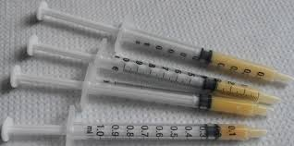
Hand Expression of breast milk
.
Notes:
Express breast milk by hand expression to establish and sustain lactation , even the neonate is sick with NEC on NPO. Colostrum may come out in drops, as it is thick and a small amount. You may use a tuberculin syringe, remove the needle and aspirate the colostrum when first learning to express . This is very helpful when mother gives birth to a premature /sick baby. She may express within 6 hours after delivery of her baby to stimulate the breast and increase milk supply. . Later the milk may spray out in streams after the oxytocin reflex works.
Expressing breast milk will get better and easier with practice. It is important to note the volume expressed is not the volume of milk the baby is suckling.

Slide 12
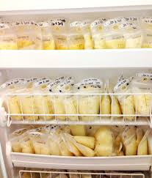
Storage of breast milk
Room air 4-6 hours
Refrigerator 1-8 days
Freezer (one door compartment ) 2 weeks
Freezer (two door compartment) 3 months
Deep freezer 6-12 months
Cooler with frozen gel packs/ice 24 hours
Notes:
Storage of breast milk Room air 4-6 hours, Refrigerator 1-2 days , Freezer (one door compartment ) 2 weeks , Freezer (two door compartments) 3 months, Deep freezer

Slide 13
Take Home Message
Strict infection control measures
Breastmilk feeding
Management of Sepsis
Prevention of hypoxia and hypotension
Notes:
The development of NEC may be minimized through:

Slide 14
Reference
Fundamentals of Pediatrics Competency based

Slide 15
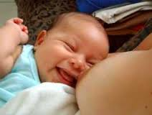

Slide 16
Questions
1. The baby has found the breast and nipple and started to suck. It is normal for the mother to:
a. Complain of pain in her nipple as it is the first time she has felt a baby suck at her breast
b.Want reassurance the baby is sucking well and is getting something
c.Stimulate the baby to keep sucking
d.All of the above

Slide 17
Questions
1. The baby has found the breast and nipple and started to suck. It is normal for the mother to:
a. Complain of pain in her nipple as it is the first time she has felt a baby suck at her breast
b.Want reassurance the baby is sucking well and is getting something
c.Stimulate the baby to keep sucking
d.All of the above

Slide 18
Questions
2. Signs of optimal attachment are:
a. Mother says her breasts and nipples are comfortable during sucking after the first few sucks
b. Baby’s chin is well in to the breast during feeds and deep jaw movements during sucking cycle
c. Cheeks are full and not dimpled when sucking
d.All of the above

Slide 19
Questions
2. Signs of optimal attachment are:
a. Mother says her breasts and nipples are comfortable during sucking after the first few sucks
b. Baby’s chin is well in to the breast during feeds and deep jaw movements during sucking cycle
c. Cheeks are full and not dimpled when sucking
d.All of the above

Slide 20
Questions
3. The mother complains that she feels a pinching pain in her nipple when the baby is sucking. You advise the mother to:
a. Keep feeding, she will get used to it
b. Take the baby off by gently putting her finger into the corner of the baby’s mouth to break the suction and try to attach again
c. Take the baby off by gently putting her finger into the corner of the baby’s mouth to break the suction and settle the baby because the baby must have had enough
d. Take the baby off and give the baby some formula until her nipple feels better

Slide 21
Questions
3. The mother complains that she feels a pinching pain in her nipple when the baby is sucking. You advise the mother to:
a. Keep feeding, she will get used to it
b. Take the baby off by gently putting her finger into the corner of the baby’s mouth to break the suction and try to attach again
c. Take the baby off by gently putting her finger into the corner of the baby’s mouth to break the suction and settle the baby because the baby must have had enough
d. Take the baby off and give the baby some formula until her nipple feels better

Slide 22
Questions
4. A preterm baby, day 5 of life , was born 26 weeks by pediatric aging 650 grams , eith episodes of apnea, bradycardia, feeding residulas and abdominal distension . Radiographic findings showed : Ileus with pneumatosis intestinalis . The most likely diagnosis is :
NEC Stage IA
NEC Stage IIA
NEC Stage IIB
NEC Stage IIIA

Slide 23
Questions
4. A preterm baby, day 5 of life , was born 26 weeks by pediatric aging 650 grams , with episodes of apnea, bradycardia, feeding residulas and abdominal distension . Radiographic findings showed : Ileus with pneumatosis intestinalis . The most likely diagnosis is :
NEC Stage IA
NEC Stage IIA
NEC Stage IIB
NEC Stage IIIA

