Slide 1
Ambulatory Pediatrics
2019-2020

Slide 2
CHOLERA
Cause
Vibrio cholerae bacteria
Mode of Transmission
Eating of food or drinking of water contaminated with human waste.
Signs and Symptoms
Sudden onset of frequent painless watery stools
Vomitting
Rapid dehydration (e.g. sunken eyeballs, wrinkled and dry skin)
ImmediateTreatment
Replace lost body fluid by giving Oral Rehydration Solution (ORESOL) or a homemade solution composed of 1 teaspoon of salt, 4 teaspoons of sugar mix to 1liter of water. If diarrhea persists, consult your health workers or bring the patient to the nearest hospital.
Prevention and Control
Drink only safe and clean water. If unsure, boil drinking water (Upon reaching boiling point, extend boiling for two or more minutes), or
Do water chlorination.
Keep food away from insects and rats by covering it.
Wash and cook food properly.
Sanitary disposal of human waste.
Use toilet properly and clean toilet everyday.
Wash hands with soap after using toilet and before eating.
Keep surroundings clean to prevent flies and other insects and rodents from breeding.
https://www.doh.gov.ph/Health-Advisory/Cholera

Slide 3
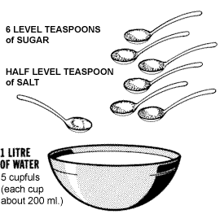
HOME MADE ORESOL

Slide 4
DENGUE FEVER

Slide 5
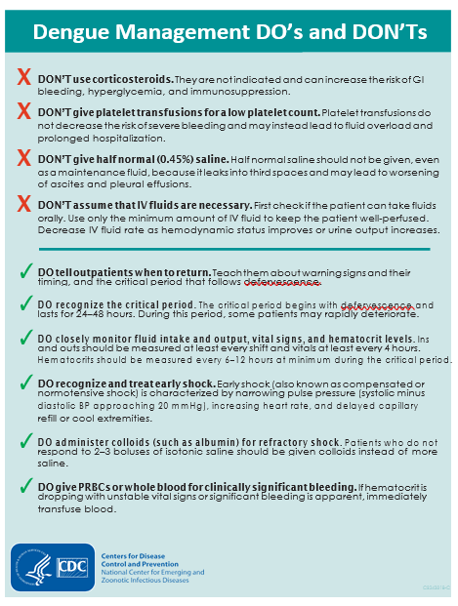

Slide 6
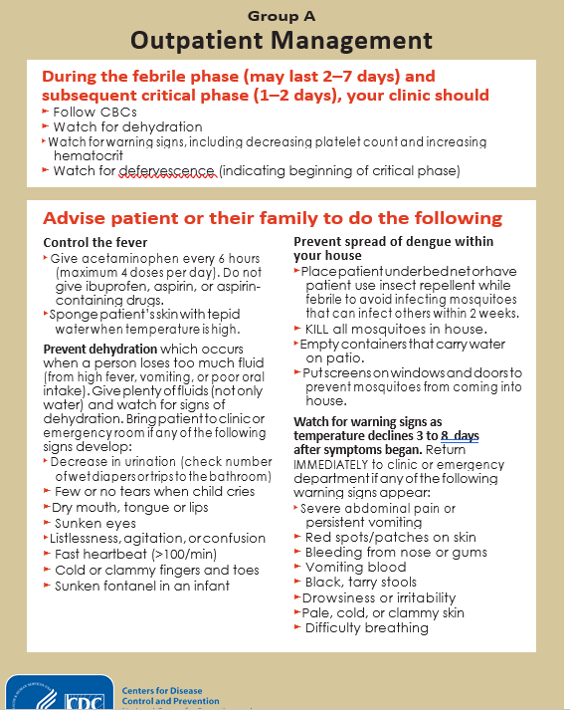

Slide 7
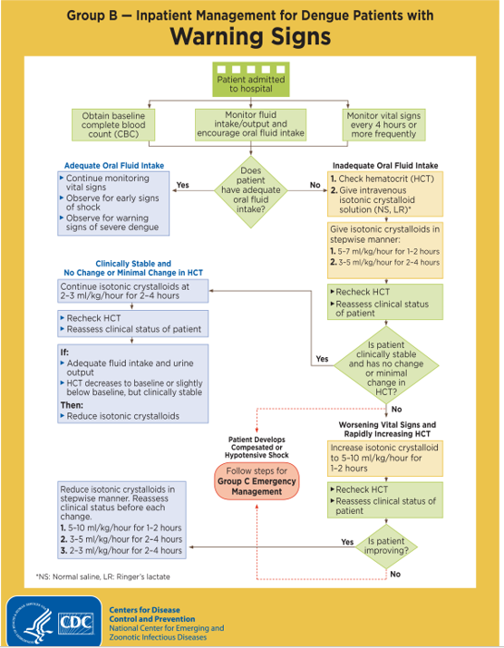

Slide 8
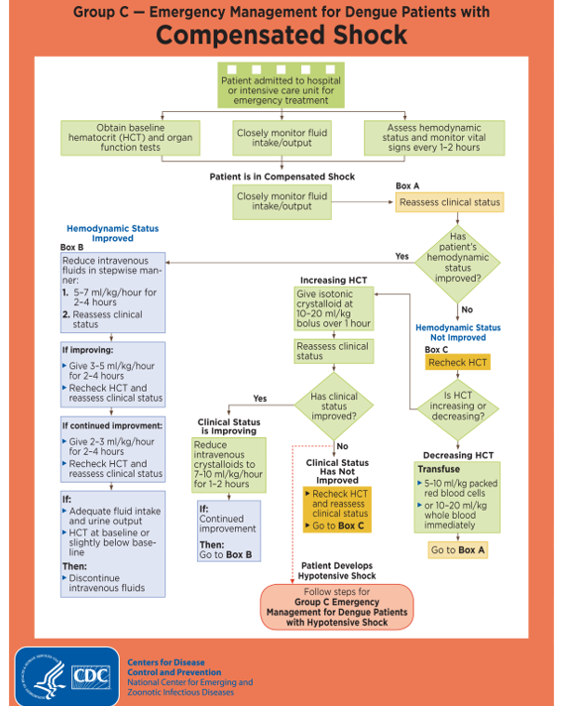

Slide 10
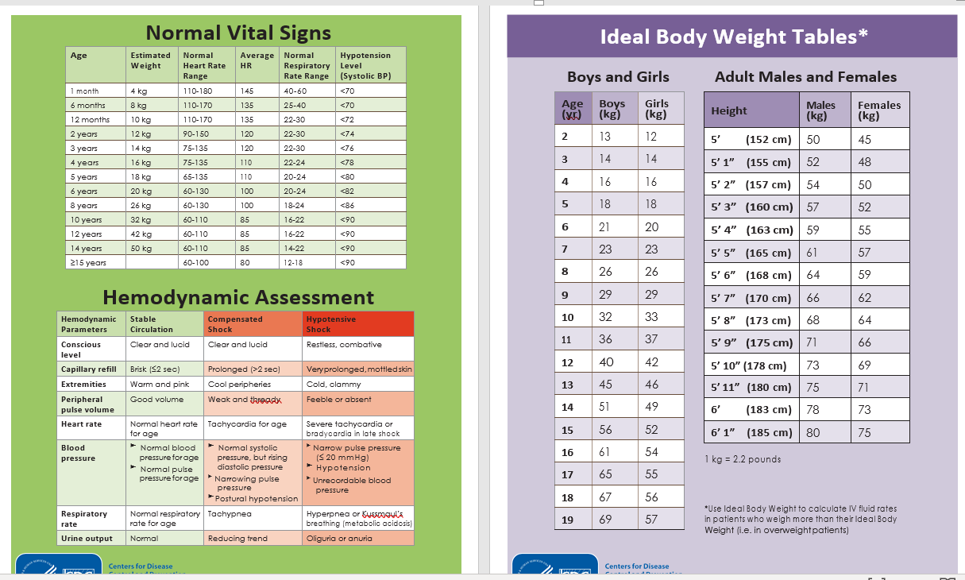

Slide 11
NEWBORN SCREENING
ONCE WITH POSITIVE NEWBORN SCREENING RESULTS, CHECK IF NEWBORN SCREENING FACILITY COORDINATED WITH THEM AND ADVISED TO DO CONFIRMATOY TESTING.
IF NOT, COORDINATE WITH NEWBORN SCREENING COORDINATOR WRITTEN IN THEIR RESULTS PAPER.
ONCE WITH POSITIVE CONFIRMATORY NEWBORN SCREENING RESULTS, OR SYMPTOMATIC OF HIGHLY SUSPICIOUS FOR INBORN ERROR OF METABOLISM, INFORM GENETICS PHONE: 09285060962
Read attached here:

Slide 12
NEWBORN SCREENING

Slide 13
VISION SCREENING
VISION ASSESSMENT
PUPILS
GROSS ABNORMALITIES
EOM + SENSORIMOTOR EVALUATION
POSTERIOR POLE EVALUATION: RETINA, OPTIC NERVE, VESSELS, MEDIA
NEEDS:
Snellen chart
Eye cover
Ophthalmoscope
Check for Red Orange Reflex! ☺

Slide 14
DENTAL CARE
From Dr. Memorando’s Lecture PGH PEDIA POST GRAD 2019
REFER PEDIATRIC PATIENTS TO DENTISTS BY
6 TO 8 MONTHS OF AGE
ANTICIPATORY GUIDANCE
Guided toothbrushing until 7 years of age
First permanent tooth to erupt: 1st molars and incisors by 6 years of age
Wean from bottle feeding by 12 to 14 months
Avoid putting the baby to sleep through bottle feeding
Limit frequency of snacking, train to eat full meal
Avoid distracted eating (slow chewing puts the child to develop caries)
Injury prevention
Limit sugar intake
REGULAR DENTAL VISIT

Slide 15
APPROACH TO PREVENT DRY SKIN
*From Pedia PGH Postgrad 2019
Determine etiology and contributing factors
Use luke warm water
Use mild soaps
Reduce bathing time to 10 mins
Apply moisturizers
*SUNPROTECTION IN CHILDREN
Avoid sun from 9AM to 4PM
Use SPF 25 and it blocks more than 96% UVB
Amount of sunscreen to be used = 2mg/cm²
Reapply every 1 to 2 hours
Apply sunscreen 30 mins prior sun exposure
Use eyeglasses
Oil-based emulsions of inorganic filters (titanium dioxide, zinc oxide)

