Slide 1
Nutrition in the different age-groups

Slide 2
Objectives:
To give an overview on the Philippine Dietary Reference Intake 2015 as a reference for dietary assessment / planning
To discuss rationale on the difference in nutrient requirements in the different age groups
To provide nutrition talking points to highlight during clinic encounter in the different age groups

Slide 3
Good Health starts with Good Nutrition
Good Nutrition starts with a diet that provides the necessary levels of energy and essential nutrients
Diets based on the reference values for energy and nutrient levels of intake

Slide 4
Philippine Dietary Reference Intake 2015
From a single reference standard, Recommended Energy and Nutrient intake (RENI) to a new set of multi-level standards
- meet the need of various stakeholders for appropriate nutrient reference values for planning and assessing diets for healthy groups and individuals
- endpoints of the DRI are to ensure nutrient adequacy, prevent nutrient deficiency and avoid excess
- based on reference weight (0-18 yrs) reflecting WHO- Child Growth Standard (WHO-CGS), and for adult BMI of 22 kg/m²using 2013 NNS median height at 19y/o

Slide 5
Components of PDRI
Estimated Average Requirement (EAR)
Recommended Energy/Nutrient (REI/RNI)
3. Adequate Intake (AI)
Tolerable Upper Intake Level or
Upper Limit (UL)

Slide 6
Estimated Average Requirement (EAR)
The daily nutrient level that meets the median or average requirement of healthy individuals in a particular life stage and sex group
Corrected for incomplete utilization or dietary nutrient bioavailability
Note: EAR is not useful as an estimate of nutrient adequacy in individuals, because it is a mean requirement for a group, and the variation around this number is considerable.

Slide 7
Recommended Energy / Nutrient Intake (REI/RNI)
Levels of intake of energy and nutrients considered adequate for the maintenance of health and well-being of healthy persons in the population
RNI = EAR for nutrients, translated into dietary recommendation to cover the needs of almost all individuals in the population (EAR+2SD).
REI = the computed average requirement of the individuals in that group.

Slide 8
Adequate Intake (AI)
The daily nutrient intake level based on observed or experimentally-determined approximation of the average nutrient intake by a group (or groups) of apparently healthy people that is assumed to sustain a defined nutritional state.
It is used when there is insufficient data to establish the EAR.

Slide 9
Tolerable Upper Intake Level or Upper Limit (UL)
The highest average daily nutrient intake level likely to pose no adverse health effects to almost all individual in the general population.
Lack of suitable data could not establish ULs for other nutrients, but this does not mean that there is no potential adverse effects resulting from high intake.
When data about adverse effects are extremely limited, extra caution may be warranted.

Slide 11
Coverage of Nutrients

Slide 12
Uses and Applications of PDRI
For assessing and planning dietary intakes for an individual / group/population
Appropriate DRI to use is hinged on the concept that requirements represent a distribution
Assessment – determining adequacy and inadequacy of individuals and prevalence of adequate or inadequate intakes of the group or population. ( National Nutrition Survey result compared with DRI)
Planning – setting intake targets for individuals and determining desirable intake distributions for groups or population. ( Meal planning for individuals and groups, like in hospitals, prisons) and development of dietary guidelines, feeding programs

Slide 13
Uses and Applications of PDRI
Individual consumers - as reference as to what foods to eat and how much
Food and beverage industry – for fortification and marketing of foods
Government, NGO, private institutions– to design, implement and evaluate food and nutrition assistance programs
Scientific and regulatory bodies – to formulate standards and regulations
Nutrition and health professionals – to educate and counsel public health

Slide 14
Estimating Recommended intakes
Review process –assessment of published foreign and local studies and unpublished important local studies
Review/adoption of recommendations by expert scientific bodies
Requirement is defined – lowest nutrient that maintain level of nutriture among apparently healthy individuals.
Criterion – prevention of nutrient deficiency or prevention of chrnoic diseases for certain life stage ( e.g. dental caries for fluoride)

Slide 15
Estimating Recommended Intakes
Recommendation for infants 0-5 months was based on AIs
Estimated from nutritional composition and average volume of breastmilk (BM) of 780 ml consumed daily by exclusively breastfeed babies
For protein, Vitamin D, Vitamin K, selenium, iodine and electrolytes –estimation done by using factorial mode
Recommendation for older infants
BM (650ml) and complementary foods (CF).
In the absence of CF data, requirements for most nutrients was extrapolated from either younger infants or adults.
For protein, requirements for infants were estimated using a linear regression model

Slide 22
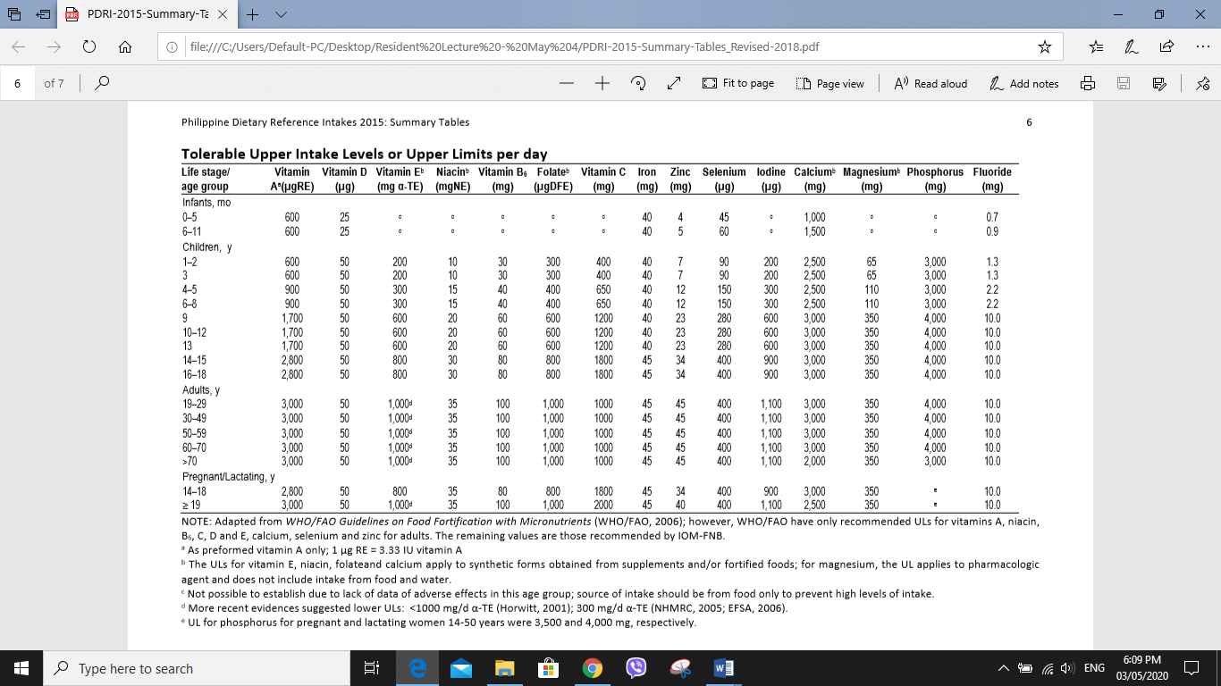

Slide 23
Infants and Early Childhood
Requirements for macronutrients and micronutrients are higher on a per-kilogram basis during infancy and childhood compared to later life cycle.
Energy – breastmilk sole source until 6 months when complementary foods will be given for optimal growth and development
Protein – Provides amino acids for the synthesis of membranes, hormones, antibodies, other proteins, and peptides. Requirements per kilogram decrease rapidly after the first year.
Essential Fatty Acids - through desaturation and elongation, linoleic and alpha-linolenic acids are converted to long-chain fatty acids (arachidonic and docosahexanoic acids) – play key roles in CNS

Slide 24
Adolescence and Adulthood
Adolescent – higher intake of protein and energy for growth
Most micronutrients, same as for adults except for calcium and phosphorus for bone growth.
Iron requirements higher in menstruating females

Slide 25
Talking points
Infancy
Breastfeeding
Influence of infant nutrition in brain growth and development – complementary feeding, critical nutrient iron, folate, Choline
Feeding problems / developmental readiness
Iron deficiency Anemia
Maternal nutrition
Toddler and Older Child
Picky eating / restrictive diets
Protein Energy Malnutrition
Iron deficiency Anemia
Adolescent
Fad diets
Calcium and physical activity

Slide 26
Tips on what to discuss:
It should be targeted based on the present need
Start with what she is doing right
Follow up with what can be improved
Close with what she have agreed on doing till next meeting

Slide 27
References:
Food and Nutrition Research Institute, Department of Science and Technology (2015). Philippine Dietary Reference Intakes 2015: Summary of Recommendations. Taguig City: FNRI-DOST.
Foundation in Review in Young Children. www.nutritioninmedicine.org
Mun JG, Legette LL, Ikonte CJ and Mitmesser SH (2019). Choline and DHA in Maternal and Infant Nutrition: Synergistic Implications in Brain and Eye Health. Nutrients. May; 11(5): 1125. Published online 2019 May 21. doi: 10.3390/nu11051125
Zulfarina, MS, Sharkawi AM, et al (2016). Influence of Adolescents’ Physical Activity on Bone Mineral Acquisition: A Systematic Review Article. Iran J Public Health, Vol. 45, No.12, pp.1545-1557

