Slide 1
RATIONAL ANTIBIOTIC USE
UNIVERSITY OF THE PHILIPINES
DIVISION OF INFECTIOUS DISEASES

Slide 2
LEARNING OBJECTIVES
Review the classification of antimicrobials
Review relevant microbiologic information as it relates to choosing an antimicrobial
Discuss patient and drug related factors that influence the selection of the appropriate antimicrobial agent

Slide 3
WHAT ARE ANTIMICROBIALS?
Drugs that destroy microbes, prevent their multiplication or growth, or prevent their pathogenic action
Differ in their physical, chemical, and pharmacological properties
Differ in antibacterial spectrum of activity
Differ in their mechanism of action

Slide 4
CLASSIFICATION OF ANTIMICROBIALS
Inhibit cell wall synthesis
Penicillins
Cephalosporins
Carbapenems
Monobactams (aztreonam)
Vancomycin
Inhibit protein synthesis
Chloramphenicol
Tetracyclines
Macrolides
Clindamycin
Streptogramins (quinupristin/dalfopristin)
Oxazolidinones (linezolid)
Aminoglycosides
Alter nucleic acid metabolism
Rifamycins
Quinolones
Inhibit folate metabolism
Trimethoprim
Sulfamethoxazole
Miscellaneous
Metronidazole
Daptomycin

Slide 5
THE ANTIMICROBIALS

Slide 6
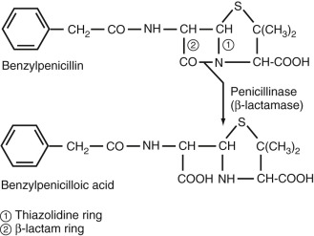
PENICILLINS AND B LACTAMASE INHIBITORS
Basic structure of penicillin:
a nucleus with a thiazolidine ring (β-lactam ring) and a side chain
β-lactam ring
- essential for antibacterial activity
Side chain
- determines the antibacterial spectrum and pharmacologic properties of a particular penicillin

Slide 7
PENICILLINS AND B-LACTAMASE INHIBITORS
MECHANISM OF ACTION
Inhibition of bacterial cell wall synthesis
inhibits enzymes by binding to PBP (penicillin binding proteins) that catalyze the final step in bacterial cell wall assembly >>> formation of the cross-links that bridge peptidoglycan

Slide 8
PENICILLINS AND B-LACTAMASE INHIBITORS
CLASSIFICATION
Penicillins are conveniently divided into five classes on the basis of antibacterial activity:
natural penicillins—penicillin G and penicillin V
penicillinase-resistant penicillins—methicillin, nafcillin, and isoxazolyl penicillins
aminopenicillins—ampicillin and amoxicillin
carboxypenicillins—carbenicillin and ticarcillin
acyl ureidopenicillins—azlocillin, mezlocillin, and piperacillin.
**The carboxypenicillins and ureidopenicillins are also referred to as antipseudomonal penicillins.

Slide 9
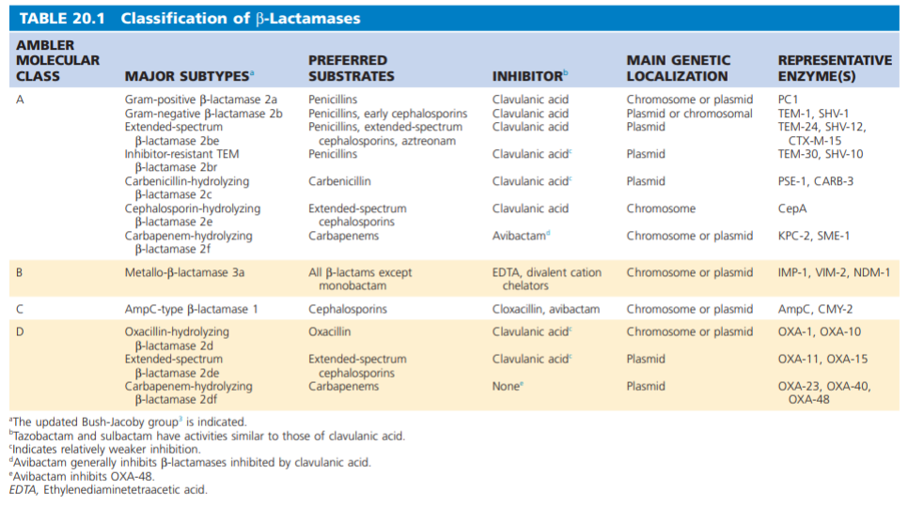

Slide 10
PENICILLINS AND B-LACTAMASE INHIBITORS
CLINICAL USE
Penicillin G
primary agent for treatment of infections due to Streptococcus pyogenes, penicillin-susceptible strains of Streptococcus pneumoniae, and penicillin-susceptible strains of S. aureus
Drug of choice for all stages of syphilis
IV penicillin G the treatment of choice for pneumococcal and meningococcal meningitis, streptococcal endocarditis, and neurosyphilis.
Used to treat puerperal infections due to anaerobic streptococci or group B streptococci (Streptococcus agalactiae)

Slide 11
PENICILLINS AND B-LACTAMASE INHIBITORS
CLINICAL USE
Penicillinase-resistant penicillins
Drug of choice for treatment of infections caused by methicillin-susceptible strains of staphylococci
Used to treat viridans streptococci , S. pyogenes , penicillin-susceptible strains of S. pneumoniae, anaerobic gram-positive cocci, and anaerobic gram-positive bacilli
Inactive against Listeria monocytogenes, Enterococcus spp., and methicillin-resistant strains of staphylococci

Slide 12
PENICILLINS AND B-LACTAMASE INHIBITORS
CLINICAL USE
Aminopenicillins
indicated for treatment of upper respiratory tract infections, lower respiratory tract infections, bacterial gastroenteritis (ampicillin only), bacterial endocarditis, meningitis, and urinary tract infections (UTIs)
Amoxicillin: the preferred agent for oral administration in most situations
Ampicillin: most potent activity is observed for Enterococcus faecalis

Slide 13
PENICILLINS AND B-LACTAMASE INHIBITORS
CLINICAL USE
Aminopenicillins
indicated for treatment of upper respiratory tract infections, lower respiratory tract infections, bacterial gastroenteritis (ampicillin only), bacterial endocarditis, meningitis, and urinary tract infections (UTIs)
Amoxicillin: the preferred agent for oral administration in most situations
Ampicillin: most potent activity is observed for Enterococcus faecalis

Slide 14
PENICILLINS AND B-LACTAMASE INHIBITORS
CLINICAL USE
Carboxypenicillins
Ticarcillin, carbenicillin, and indanyl carbenicillin are no longer used
large doses required
the greater potential for toxicity
availability of more potent alternatives

Slide 15
PENICILLINS AND B-LACTAMASE INHIBITORS
CLINICAL USE
Antipseudomonal penicillins
indicated for the treatment of infections caused by resistant gram-negative bacilli, especially P. aeruginosa
Ureidopenicillins, particularly piperacillin: active against many strains of Klebsiella spp., Enterobacter spp., Serratia marcescens, and Providencia spp
Piperacillin is often given in combination with tazobactam because of β-lactamase–producing strains of bacteria

Slide 16
β-Lactamase Inhibitors and Inhibitor Combinations
β-Lactamase inhibitors are grouped into β-lactam compounds (clavulanic acid, sulbactam, and tazobactam) and non–β-lactam compounds (avibactam, vaborbactam)
Five β-lactamase inhibitors are currently in clinical use:
Clavulanic acid
Sulbactam
Tazobactam
Avibactam
Vaborbactam
The former three are potent inhibitors of class A β-lactamases, EXCEPT Klebsiella pneumoniae carbapenemase (KPC) β-lactamase
The latter two are inhibitors of class A β-lactamases, including KPC β-lactamase, and class C (AmpC) β-lactamase

Slide 17
β-Lactamase Inhibitors and Inhibitor Combinations
MECHANISM OF ACTION
the inhibitors prevent hydrolysis of the antibiotics, thereby restoring their activity.
Although competitive inhibition is seen, the β-lactam β-lactamase inhibitors—clavulanic acid, sulbactam, and tazobactam—primarily act as suicide inhibitors that form a stable intermediate, rendering the β-lactamase enzyme inactive.

Slide 19
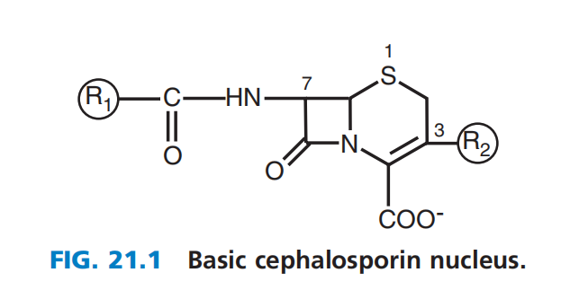
CEPHALOSPORINS
Most of the available cephalosporins are semisynthetic derivatives of cephalosporin C
The basic structure of the cephem nucleus includes:
β-lactam ring fused to a six-member sulfur-containing dihydrothiazine ring
Basic structure numbering of the cephalosporin ring system begins within the dihydrothiazine ring at the sulfur moiety

Slide 20
CEPHALOSPORINS
Alterations in positions C7 and C3 are also commonly referred to as R1 and R2, respectively
Changes at R1 affect the microbial spectrum of activity
Modifications at R2 often alter the pharmacology of the compound
For example, changes in the R2 constituent may influence the half life of the drug

Slide 21
CEPHALOSPORINS
FIRST-GENERATION
exhibit activity focused on gram positive bacteria
SECOND-GENERATION
have enhanced activity against gram-negative bacilli but maintain varying degrees of activity against gram-positive cocci
The cephamycin group is included in the second-generation class: noted for their additional activity against gram-negative anaerobic bacteria, such as Bacteroides spp.
The most widely accepted classification includes five divisions, or generations, based loosely on the microbial spectrum of activity

Slide 22
CEPHALOSPORINS
THIRD-GENERATION
have markedly increased potency against gram-negative bacilli
for some compounds in this group, activity against gram-positive cocci is reduced
a few compounds, CEFTAZIDIME and CEFTOLOZANE have activity against P. aeruginosa
FOURTH-GENERATION
Has the widest activity against most gram-negative bacilli, including P. aeruginosa, and maintain their potency against gram-positive cocci
The third- and fourth-generation drugs combined are also called the extended-spectrum cephalosporins
The most widely accepted classification includes five divisions, or generations, based loosely on the microbial spectrum of activity

Slide 23
CEPHALOSPORINS
MRSA-ACTIVE CEPHALOSPORINS
Currently includes ceftaroline and ceftobiprole
Has unique activity against MRSA
Also have enhanced activity against Streptococcus pneumoniae and Enterococcus faecalis
Gram-negative activity is similar to that of the third-generation cephalosporins
The most widely accepted classification includes five divisions, or generations, based loosely on the microbial spectrum of activity

Slide 24
CEPHALOSPORINS
The mechanism of action is similar to that of other β-lactam drugs
Bacterial growth is inhibited by interference with the synthesis of the cell wall.
The primary target within the cell wall is the peptidoglycan cross-linkage structure
MECHANISM OF ACTION

Slide 25
CEPHALOSPORINS
FIRST GENERATION CEPHALOSPORINS
CEFAZOLIN
recommended as the prophylactic antibiotic of choice:
for foreign-body implantation
clean and clean-contaminated surgical procedures in which there is a high risk of infection
cardiac surgery
insertion of orthopedic devices
high-risk cesarean section
high-risk gastroduodenal and biliary tract procedures
Cefazolin alone is not recommended for intraabdominal procedures that involve the intestine due to its poor activity against Bacteroides spp.
cefazolin, cephalexin, and cefadroxil
Used as alternatives to penicillin for susceptible staphylococcal and streptococcal infections
Most commonly used to treat skin and soft tissue infections and more severe infections such as streptococcal and methicillin-susceptible S. aureus bacteremia
MAJOR CLINICAL USES

Slide 26
CEPHALOSPORINS
FIRST GENERATION CEPHALOSPORINS
CEPHALEXIN and CEFADROXIL
Both are oral first-generation cephalosporins
Both have very high oral bioavailability
Provide appropriate outpatient therapy for many skin and soft tissue infections
Active against Streptococcus pyogenes and effective treatment for streptococcal pharyngitis.
cefazolin, cephalexin, and cefadroxil
Used as alternatives to penicillin for susceptible staphylococcal and streptococcal infections
Most commonly used to treat skin and soft tissue infections and more severe infections such as streptococcal and methicillin-susceptible S. aureus bacteremia
MAJOR CLINICAL USES

Slide 27
CEPHALOSPORINS
SECOND GENERATION CEPHALOSPORINS
CEFUROXIME
used extensively for treatment of various respiratory tract infections and meningitis
+ activity against S. pneumoniae, H. influenzae, and M. catarrhalis
Also an important cephalosporin for surgical prophylaxis for many of the same surgical procedures for which cefazolin is recommended
Cefprozil and cefuroxime (true cephalosporins) and cefoxitin (cephamycin)
MAJOR CLINICAL USES

Slide 28
CEPHALOSPORINS
SECOND GENERATION CEPHALOSPORINS
CEFOXITIN
As a cephamycin, it has inferior activity against staphylococci but enhanced antibacterial activity against some Enterobacteriaceae and B. fragilis
Important adjunct to surgical prophylaxis for colorectal procedures and appendectomies
Used for the treatment of intraabdominal, pelvic, and gynecologic infections; infected decubitus ulcers; diabetic foot infections; and mixed aerobic-anaerobic soft tissue infections.
Cefprozil and cefuroxime (true cephalosporins) and cefoxitin (cephamycin)
MAJOR CLINICAL USES

Slide 29
CEPHALOSPORINS
THIRD GENERATION CEPHALOSPORINS
CEFTRIAXONE
drug of choice for all forms of gonococcal infection and is used in combination with a single oral dose of azithromycin
drugs of choice for meningitis caused by H. influenzae and various Enterobacteriaceae
One of the most potent cephalosporins against penicillin-resistant pneumococci
cefdinir, cefditoren, cefixime, cefotaxime, cefpodoxime, ceftazidime, ceftibuten, and ceftriaxone
major drugs for the treatment of many important infections due to:
high antibacterial potency
wide spectrum of activity
low potential for toxicity
favorable pharmacokinetics (enhanced drug concentrations in the CSF)
Limited by bacterial resistance: new AmpC β-lactamases, ESBLs, and carbapenemases, which inactivate third-generation cephalosporins
MAJOR CLINICAL USES

Slide 30
CEPHALOSPORINS
THIRD GENERATION CEPHALOSPORINS
CEFTAZIDIME
reserved for infections that are likely to involve P. aeruginosa
effective for the treatment of acute exacerbations of chronic pulmonary infections in patients with cystic fibrosis
penetrates into CSF and is one of two cephalosporins as treatment of choice for meningitis caused by P. aeruginosa
cefdinir, cefditoren, cefixime, cefotaxime, cefpodoxime, ceftazidime, ceftibuten, and ceftriaxone
major drugs for the treatment of many important infections due to:
high antibacterial potency
wide spectrum of activity
low potential for toxicity
favorable pharmacokinetics (enhanced drug concentrations in the CSF)
Limited by bacterial resistance: new AmpC β-lactamases, ESBLs, and carbapenemases, which inactivate third-generation cephalosporins
MAJOR CLINICAL USES

Slide 31
CEPHALOSPORINS
FOURTH GENERATION CEPHALOSPORINS
CEFEPIME
usually administered twice daily, although 8-hour dosing is recommended for documented P. aeruginosa infections
recommended as initial empirical therapy in febrile neutropenic patients
one of the recommended agents for the empirical treatment of severe CAP, hospital acquired pneumonia, and ventilator-associated pneumonia
Cefepime
have the widest spectrum of all the cephalosporins: enhanced activity against certain gram-negative bacilli, such as Enterobacter, Citrobacter, and Serratia spp.
the treatment of choice for serious infections caused by AmpC inducible-resistant strains
active against P. aeruginosa and, unlike ceftazidime, maintain good potency against gram positive cocci (MSSA, S. pneumoniae and other streptococci)
MAJOR CLINICAL USES

Slide 32
CEPHALOSPORINS
FIFTH GENERATION CEPHALOSPORINS
CEFTAROLINE
effective in patients with soft tissue infections complicated by MRSA bacteremia
exhibited comparable efficacy to vancomycin plus a broad-spectrum β-lactam
have excellent activity again MRSA and against ampicillin-susceptible strains of E. faecalis
activity against gram negative bacilli is similar to that of the third-generation cephalosporins
MAJOR CLINICAL USES

Slide 33
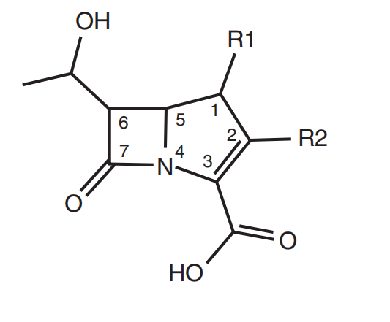
CARBAPENEMS
derivatives of thienamycin
differ from penicillins by a carbon atom replacing the sulfur at position 1 and a double bond between C2 and C3 in the five-membered thiazolidine ring
Meropenem, ertapenem, and doripenem differ from imipenem by having a 1β-methyl, 2-thiopyrrolidinyl substituent at C2
The 1β-methyl constituent provides stability to DHP-I, which allows it to be administered without a DHP-I inhibitor (cilistatin)

Slide 34
CARBAPENEMS
MECHANISM OF ACTION
inhibit cell wall synthesis by binding to most high molecular-weight PBPs
These drugs traverse the outer membrane of gram negative bacteria through specific outer membrane proteins (OMPs) to reach the periplasmic space.

Slide 35
CARBAPENEMS
CLINICAL USE
broad-spectrum activity covering gram-positive, gram-negative, and anaerobic bacteria
useful for treatment of moderate to severe infections:
bacteremia, hospital-acquired pneumonia, intraabdominal infections, complicated urinary tract infections, bone and soft tissue infections, and obstetric and gynecologic infections
Generally active against cephalosporin-resistant Enterobacteriaceae producing ESBLs and AmpC β-lactamases but not those producing KPC β-lactamases

Slide 36
CARBAPENEMS
Imipenem, meropenem, and doripenem are all appropriate for use in the treatment of hospital-acquired infections
S. maltophilia, E. meningoseptica, and Chryseobacterium indologenes are intrinsically resistant to all carbapenems
Meropenem : the only carbapenem approved for treatment of bacterial meningitis
Ertapenem differs from other carbapenems
has a long half-life permitting once-daily dosing
has poor activity against P. aeruginosa and A. baumannii

Slide 37
AMINOGLYCLOSIDES (streptomycin, kanamycin, gentamicin, amikacin)
STRUCTURE
consist of central six-membered aminocyclitol ring linked to two or more aminosugar residues by glycosidic bonds
MECHANISM OF ACTION
Bind to ribosomes at different sites (streptomycin to the 30S subunit) >> leads to inhibition of protein synthesis

Slide 38
AMINOGLYCLOSIDES (streptomycin, kanamycin, gentamicin, amikacin)
SPECTRUM OF ACTIVITY
Aerobic and facultative gram negative bacilli, especially against enteric organisms
Partner in synergystic killing with β-lactam
a. Absolutely required for Enterococci
b. In vitro, for Staphylococcus aureus, Streptococcus pneumonia
c. Pseudomonas
ADVERSE REACTIONS
Renal toxicity
VIII cranial nerve toxicity

Slide 39
TETRACYCLINES (doxycycline, tetracycline, minocycline)
MECHANISM OF ACTION
Tetracyclines are bacteriostatic drugs and act on the bacterial ribosome.
Once the drug is within the bacterial cell, inhibition of protein synthesis occurs by binding to the 30S ribosomal subunit, so as to block the binding of the aminoacyl tRNA to the acceptor site of the mRNA ribosome complex >> prevents the addition of new amino acids to the growing peptide chain

Slide 40
TETRACYCLINES (doxycycline, tetracycline, minocycline)
SPECTRUM OF ACTIVITY
Major use now is in the treatment of
a. Chlamydia
b. Mycoplasma species
c. Rickettsiae
d. Spirochetes (including Lyme Disease agent)
Also useful as part of combination therapy for
a. Plague (with streptomycin)
b. Melioidosis (with chloramphenicol)
c. Brucellosis (with streptomycin)
d. Tularemia (with streptomycin)

Slide 41
TETRACYCLINES (doxycycline, tetracycline, minocycline)
ADVERSE EFFECTS
1. Skin—photosensitivity
2. Teeth and bones
3. Gastrointestinal—fatty liver; diarrhea, nausea and vomiting

Slide 42
MACROLIDES (erythromycin, clarithromycin, azithromycin)
MECHANISM OF ACTION
An inhibitor of protein synthesis in susceptible organisms
Erythromycin binds reversibly to a single high-affinity site on the 50S subunit of the 70S bacterial ribosome.
Generally bacteriostatic; but can be bactericidal under certain conditions

Slide 43
MACROLIDES (erythromycin, clarithromycin, azithromycin)
SPECTRUM OF ACTIVITY
ERYTHROMYCIN
First line drug against Legionella, Chlamydia, Mycoplasma pneumonia
NEW MACROLIDES: CLARITHROMYCIN, AZITHROMYCIN
Broad spectrum of activity: H. influenza, tuberculosis
Better GI tolerance

Slide 44
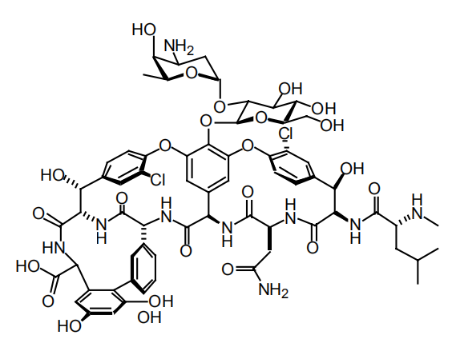
GLYCOPEPTIDES (vancomycin, teicoplanin, telavancin)
MECHANISM OF ACTION
Inhibits cell wall synthesis by binding to D-Ala-D-Ala dipeptide intermediate in cell wall biosynthesis
Injures protoplasts by altering the permeability of their cytoplasmic membrane
Impairs RNA synthesis

Slide 45
GLYCOPEPTIDES (vancomycin, teicoplanin, telavancin)
SPECTRUM OF ACTIVITY
1. Gram positive.
2. Particularly useful against methicillin-resistant compounds

Slide 46
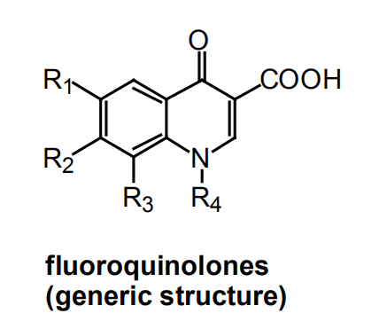
QUINOLONES
MECHANISM OF ACTION
Bactericidal effect due to inhibition of DNA topoisomerases (gyrases), which are required to supercoil strands of bacterial DNA

Slide 47
QUINOLONES
MECHANISM OF ACTION
Bactericidal effect due to inhibition of DNA topoisomerases (gyrases), which are required to supercoil strands of bacterial DNA

Slide 48
QUINOLONES
SPECTRUM OF ACTIVITY
1. Broad gram negative action. Most do not cover anaerobes.
2. Particularly useful because of high concentration in tissue interstitium
3. Do not penetrate the CNS

Slide 49
FACTORS TO BE CONSIDERED IN THE INITIAL CHOICE OF ANTIBIOTICS
The identity of the infecting organism must be known, or at the very least, it must be possible to make a probability assessment of the most likely culprit(s).
The likely antimicrobial susceptibility pattern of the invading organisms must be estimated.
Site of Infection - the site of infection determines not only the choice of the agent but also its dose and the route by which it should be administered
a. ability to achieve effective concentration at sites of interest: e.g., CSF
b. local factors that may modify drug efficacy such as presence of pus
c. pH – e.g. aminoglycosides have low activity at low pH
d. presence of foreign body

Slide 50
FACTORS TO BE CONSIDERED IN THE INITIAL CHOICE OF ANTIBIOTICS
4. The presence or absence of host factors that can modify the choice of antimicrobial agents
a. History of previous adverse reactions to the antimicrobial agent
b. Age of patient
• Children - quinolones cause cartilage damage and arthropathy
c. Pregnancy
• Pharmacokinetics are altered in pregnancy - larger volume of distribution and more rapid clearance from blood
d. Genetic or metabolic abnormalities
e. Renal and Hepatic function
• Dosage adjustment necessary in patients with hepatic or renal dysfunction

Slide 51
RATIONAL USE OF ANTIMICROBIAL COMBINATIONS IN INFECTIOUS DISEASE PROCESS
1. For preventing emergence of resistant organisms
2. High probability of a polymicrobial infection
3. Provision of broad antimicrobial spectrum as initial therapy when patient seriously ill and etiology unclear.
4. Combination therapy to permit lower doses and decrease toxicity.
5. To achieve antimicrobial synergy
• examples clinically proven to be of importance:
penicillin + aminoglycoside for serious enterococcal infection
amphotericin + flucytosine for Cryptococcus neoformans

Slide 52
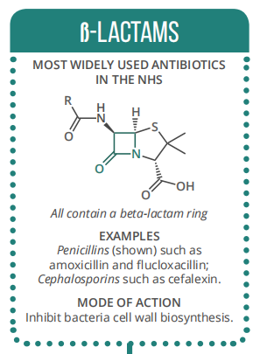
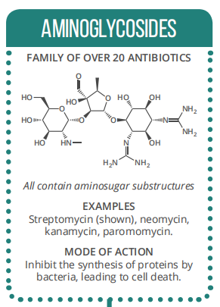
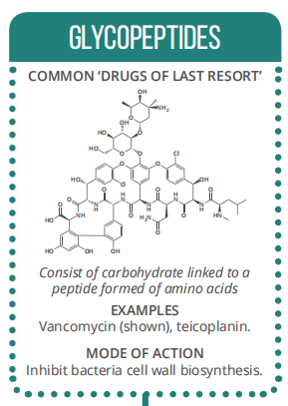
OVERVIEW

Slide 53
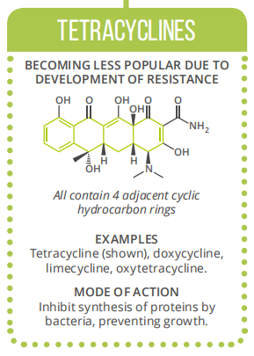
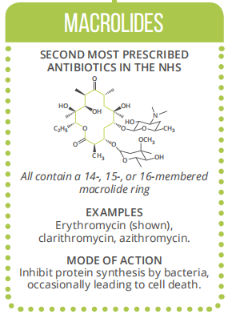
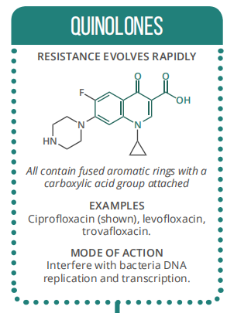
OVERVIEW

Slide 54
REFERENCES
MANDELL PRINCIPLES OF INFECTIOUS DISEASES, 9TH EDITION

