Slide 1
DISCUSSION ON COVID-19
Peter Julian A. Francisco, MD, DFM
Clinical Associate Professor, UP College of Medicine
Department of Family and Community Medicine

Slide 2
HISTORICAL BACKGROUND
At the end of 2019, a novel coronavirus was identified as the cause of a cluster of pneumonia cases in Wuhan, China.
It rapidly spread, resulting in an epidemic throughout China, followed by an increasing number of cases in other countries throughout the world.
The virus that caused it is designated as Severe Acute Respiratory Syndrome Coronavirus 2 (SARS-COV2).

Slide 3
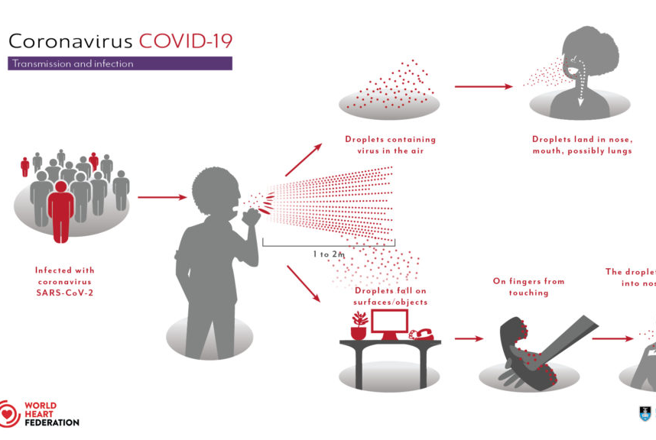
TRANSMISSION
Notes:
Direct person-to-person transmission is the primary means of transmission of severe acute respiratory syndrome coronavirus 2 (SARS-CoV-2). It is thought to occur through close-range contact, mainly via respiratory droplets; virus released in the respiratory secretions when a person with infection coughs, sneezes, or talks can infect another person if it makes direct contact with the mucous membranes; infection might also occur if a person's hands are contaminated by droplets or by touching contaminated surfaces and then they touch their eyes, nose, or mouth. Droplets typically do not travel more than six feet (about two meters).

Slide 4
VIRAL SHEDDING AND PERIOD OF INFECTIOUSNESS
SARS-COV2 can be transmitted prior to the development of symptoms and throughout the course of illness, particularly early in the course.
PERIOD OF GREATEST INFECTIOUSNESS
Infected individuals are more likely to be infectious in the earlier stages of infection.
Mean: 5.8 days between the onset of symptoms.

Slide 5
RISK OF TRANSMISSION
Increases with the closeness and duration of contact.
Highest with prolonged contact in indoor settings.
ie. household contacts, hospitals and long-term care facilities, congregate settings where individuals are residing or working in close quarters.
INDIRECT TRANSMISSION
low risk
ie. passing someone with infection on the street, handling items that were previously handled by someone with infection.

Slide 6
DIAGNOSIS
All individuals with suspected SARS COV-2 respiratory tract infection i.e., Patients Under Investigation (PUIs), should undergo testing for COVID-19 as well as other tests warranted by their clinical condition.

Slide 7
TESTS FOR COVID-19
RT- PCR
Rapid Antibody Test
OTHER TESTS:
CBC, Crea, LFTs, Na, K, Mg, Calcium, Albumin, LDH, Ferritin, CRP and procalcitonin.
Prothrombin and D-Dimer
ABG; Blood Culture; Sputum; CXR; HRCT and 12L ECG

Slide 8
INCUBATION PERIOD
MEDIAN INCUBATION PERIOD
5.1 days
11.5 days (98%)

Slide 9
CLINICAL PRESENTATIONS OF PATIENTS WITH COVID-19 INFECTION

Slide 10
CLINICAL COURSE

Slide 11
RISK FACTORS FOR POOR OUTCOME
Diabetes or coronary heart disease.
Age, lymphopenia, leukocytosis, elevated ALT, lactate dehydrogenase, high-sensitivity cardiac troponin I, creatine kinase, d-dimer, serum ferritin, IL-6, prothrombin time, creatinine, and procalcitonin were also associated with death on univariate analysis.
Higher SOFA score, and D-dimer greater than 1 μg/mL at admission were associated with increased odds of death.

Slide 12
COMPLICATIONS AND OUTCOMES

Slide 13
SURVEILLANCE DEFINITIONS

Slide 14
SURVEILLANCE DEFINITIONS

Slide 16
CLASSIFICATION OF PATIENTS WITH PROBABLE OR CONFIRMED COVID-19 INFECTION

Slide 18
SUPPORTIVE THERAPY AND MONITORING FOR COVID-19 PATIENTS
Give supplemental oxygen therapy immediately to patients with severe pneumonia and / or respiratory distress, hypoxemia, or shock and target
SpO2 >94%.
Initiate oxygen therapy at 5 L/min and titrate flow rates to reach target SpO2 >93% during resuscitation. Use face mask with reservoir bag at 10-15 L/min for critically ill patients. For acute hypoxemic respiratory failure despite conventional oxygen therapy, use high-flow nasal cannula (HFNC), if available.
- Target SpO2 ≥90% in non-pregnant adults, once stable.
- All areas where patients with pneumonia are cared for should be equipped with pulse oximeters, functioning oxygen systems and disposable, single-use, oxygen-delivering interfaces (simple face mask, and mask with reservoir bag).

Slide 19
SUPPORTIVE THERAPY AND MONITORING FOR COVID-19 PATIENTS
Use conservative fluid management in patients with pneumonia when there is no evidence of shock.
Patients with pneumonia should be treated cautiously with intravenous fluids, because aggressive fluid resuscitation may worsen oxygenation, especially in settings where there is limited availability of mechanical ventilation.

Slide 20
PRE-EXPOSURE OR POST-EXPOSURE PROPHYLAXIS FOR COVID-19
Chloroquine or hydroxychloroquine is NOT recommended for pre-exposure or post-exposure prophylaxis to prevent COVID-19. There is no high-quality direct evidence at this time to support the use of chloroquine or hydroxychloroquine for prophylaxis.
Priority protective measures to protect health care workers include proper wearing of PPE, providing rational working shifts for each team (every 4-8 hour-shifts) and providing rest periods for the health care team.

Slide 21
RECOMMENDATIONS FOR REPEAT TESTING FOR COVID-19
Repeat testing after a positive COVID-19 test (if with available test kits)
1. Submit NPS/OPS and lower respiratory tract specimens (if possible) at 14 days from the first positive COVID-19 test, or once patient is afebrile for 72 hours, whichever is longer.
2. If still positive, recollect NPS/OPS and lower respiratory tract specimens (if test kits are available) for COVID-19 testing after 14 days.
3. If test kits are not available, patients may be sent home once asymptomatic and clinically stable. Advice the patient to stay on home quarantine for another 14 days and repeat the test once kits are available.

Slide 22
REPEAT TESTING AFTER AN INITIAL NEGATIVE COVID-19 TEST
Clinical deterioration in the presence of an established disease etiology and with adequate treatment. A single negative test result, particularly if this is from an upper respiratory tract specimen, does not exclude infection. Repeat sampling and testing, preferably of lower respiratory specimen, is strongly recommended in severe or progressive disease. Consider a possible co-infection with COVID-19.
No other etiology for the patient's signs and symptoms has been identified despite work-up.
Clinical specimen(s) initially sent was/were deemed to be unsatisfactory or insufficient (delay in transport and processing, only NPS or OPS was sent).

Slide 23
CRITERIA FOR DISCHARGE OF COVID-19 PROBABLE OR SUSPECT CASE
A COVID-19 Probable or Suspect Case may be discharged after the initial COVID-19 test is negative AND any of the following conditions are met:
1. There is clinical improvement.
2. There is no other indication for admission.
3. An alternative diagnosis is available.
4. The probability of COVID-19 has been ruled out.

Slide 24
CRITERIA FOR DISCHARGE OF PATIENTS WITH CONFIRMED COVID-19 INFECTION
Patients who have clinically recovered (with resolution of symptoms) may be discharged from the hospital after a single negative test; if kits are in abundant supply, two consecutive negative tests 24 hours apart for SARS-CoV2 is preferred or at least one negative test prior to discharge.
If it is not possible to repeat the test, patients can be discharged upon discretion of the healthcare team, but they should remain under strict home quarantine for 14 more days until after resolution of their last symptom. They should be tested at least once after this 14-day period, if the testing kit is available. Either RT-PCR or a rapid antibody test can be done.

Slide 25
PARAMETERS FOR RESOLUTION OF SYMPTOMS
The body temperature returns to normal> 3 days.
Respiratory symptoms have improved significantly.
Chest radiograph shows significant improvement .

Slide 26
HEALTH MANAGEMENT FOR DISCHARGED PATIENTS
For discharged patients, close follow-up is still required.
-When a patient is discharged from the hospital, his place of residence and address should be recorded.
Patients should rest at home for 2 weeks after leaving the hospital, avoid activities in public places, and must wear masks when going out.
- Monitor the patient’s temperature and health status for 2 weeks. If fever and / or respiratory symptoms recur, the corresponding primary health care facility should assist in sending them to the designated medical institutions in the area for treatment. This should be reported to the corresponding surveillance units of the Department of Health.

Slide 27
THANK YOU VERY MUCH

