Slide 1
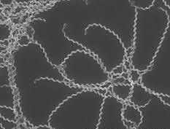
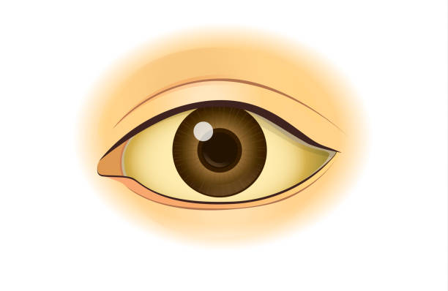
LEPTOSPIROSIS
DEPARTMENT OF FAMILY & COMMUNITY MEDICINE
UP-PGH

Slide 2
LEPTOSPIROSIS
Leptospirosis is a zoonosis with protean clinical manifestations caused by pathogenic spirochetes of the genus Leptospira.
Other names:
Weil's disease, Weil-Vasiliev disease, Swineherd's disease, rice-field fever, waterborne fever, nanukayami fever, cane-cutter fever, swamp fever, mud fever, Stuttgart disease, and Canicola fever.

Slide 3
EPIDEMIOLOGY
Widespread and prevalent zoonotic disease.
Occurs both in temperate and tropical regions (10 times higher in tropical countries).

Slide 4
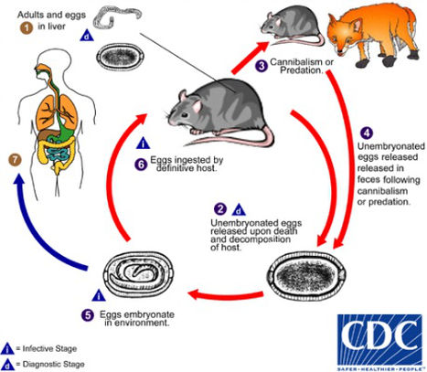

Slide 5
RISK FACTORS
Occupational exposure – Farmers, ranchers, abattoir workers, trappers, veterinarians, loggers, sewer workers, rice farmers, pet traders, military personnel, laboratory workers
Recreational activities – Freshwater swimming, canoeing, kayaking, trail biking
Household exposure – Pet dogs, domesticated livestock, rainwater catchment systems, infestation by infected rodents
Other – Walking barefoot through surface water, skin lesions, contact with wild rodents, accidental laboratory exposure

Slide 6
MICROBIOLOGY
Leptospira contains 22 species:
10 are pathogenic (L. interrogans, L. kirschneri, L. noguchii, L. alexanderi, L. weilii, L. alstonii, L. borgpetersenii, L. santarosai, L. kmetyi and L. mayottensis)
Spiral-shaped, highly motile aerobic spirochetes with 18 or more coils per cell. They tend to stain poorly with common laboratory stain and are best visualized by dark field microscopy, silver stain or fluorescent microscopy.

Slide 7
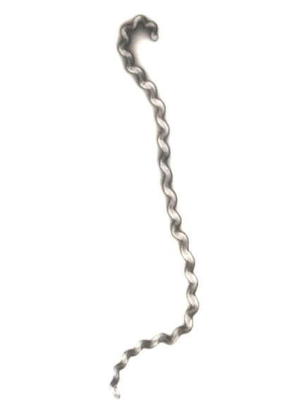

Slide 8
LEPTOSPIROSIS
BIPHASIC ILLNESS
1ST PHASE – Acute febrile bacteremic phase lasting 2 to 9 days.
2nd PHASE – “Immune Phase” characterized by renewed fever and development of complications. Leptospires are absent in the blood but may appear in the urine.

Slide 9
CLINICAL MANIFESTATIONS
Acute fever of at least 2 days
Residing in a flooded area OR has high‐risk exposure (defined as wading in floods and contaminated water, contact with animal fluids, swimming in flood water or ingestion of contaminated water with or without cuts or wounds)
Presenting with at least 2 of the following symptoms:
myalgia
calf tenderness
conjunctival suffusion
chills
abdominal pain
headache
jaundice
oliguria

Slide 10
CLINICAL MANIFESTATIONS
Other manifestations:
Productive cough
Nausea
Vomiting
Diarrhea
Splenomegaly
Lymphadenopathy

Slide 11
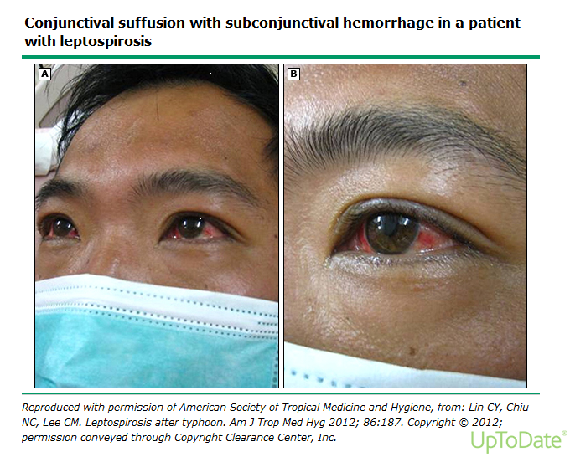

Slide 12
CLASSIFICATION OF LEPTOSPIROSIS
MILD | MODERATE | SEVERE
fever
myalgia
headache
Nonproductive cough
Maculopapular rash
Stable vital signs | Unstable vital signs | Hypotension
No jaundice/anicteric sclerae | Jaundice/icteric sclerae
Good urine output | Oliguria/anuria | Renal failure (Weil’s disease)
No meningeal irritation | Meningismus, meningeal irritation
No sepsis | Sepsis/septic shock
Nausea, vomiting, diarrhea
Conjunctival suffusion
Severe calf pain
 | Abdominal pain
 | Altered mental states
 | Hemorrhage (pulmonary)
 |  | Myocarditis

Slide 13
DIAGNOSIS
DIRECT METHODS:
Culture & Isolation (Gold standard)
PCR – for early confirmation of the diagnosis
(during the acute leptospiremic phase)
INDIRECT DETECTION METHODS:
Microagglutination Test (MAT)
- 4 fold rise of titer from acute to convalescent sera
- in endemic areas, a single titer of at least 1:1600 in
symptomatic patients is indicative of leptospirosis.
IgM Rapid Diagnostic Tests
- LeptoDipstick, Leptospira IgM ELISA, MCAT,
Dridot

Slide 14
Other Laboratory tests:
CBC with platelet – leukocytosis with neutropenia, thrombocytopenia (<100,000)
Urinalysis – pyuria, proteinuria, hematuria
Serum crea – may indicate impending AKI
CPK-MM
Liver function tests – slightly elevated SGPT, SGOT, alk phos, bilirubin
PT, aPTT – prolonged
Serum K
ABG – metabolic acidoses with hypoxemia
Chest xray – may show alveolar infiltrates
12 L ECG – signs of heart block, repolarization, mycoarditis

Slide 15
CRITERIA FOR HOSPITAL ADMISSION
Unstable vital signs
jaundice/icteric sclerae
abdominal pain
nausea, vomiting, diarrhea
oliguria, anuria
meningismus/meningeal irritation
sepsis/septic shock
altered mental status
difficulty of breathing
hemoptysis

Slide 16
CAN BE MANAGED AT THE OUTPATIENT SETTING
stable vital signs
anicteric sclerae, no jaundice
good urine output
no meningismus
no sepsis
no DOB
can take oral meds

Slide 17
TREATMENT
Mild disease
SEVERE DISEASE
- Doxycycline
100mg BID for 7 days (adult)
2mg/kg per day in 2 divided doses not to exceed 200mg daily (children)
- Azithromycin
500mg OD for 3 days (adult)
10mkd on D1, 5mkd on succeeding days (children)
- Penicillin 1.5M units IV every 6 hours
- Doxycycline 100mg IV daily
- Ceftriaxone 1 to 2g IV OD
- Cefotaxime 1g IV every 6 hours
*Antibiotic therapy should be started as soon as the diagnosis of leptospirosis is suspected regardless of the phase of the disease or duration of symptoms

Slide 18
JARISCH-HERXHEIMER REACTION
- Occurs 24 hours following antimicrobial therapy for leptospirosis.
- An acute inflammatory response to clearance of spirochetes from the circulation and is characterized by fever, rigors and hypotension.
- Results from accelerated phagocytosis by PMN leukocytes, followed by the release of lipoproteins, cytokines and immune complexes from killed organisms.
TREATMENT: NSAIDS or other antipyretics
Notes:
can be used if symptoms arise and it can reduce the severity of symptoms and duration of the reaction.

Slide 19
PRE-EXPOSURE PROPHYLAXIS
not routinely recommended
for individuals who intend to visit highly endemic areas and are likely to be exposed (e.g. soldiers, engaged in water-related recreational & occupational activities)
DOXYCYCLINE 100mg/tab 2 tabs ONCE WEEKLY to begin 1-2 days before exposure & continued throughout period of exposure

Slide 20
POST EXPOSURE PROPHYLAXIS
LOW RISK EXPOSURE:
- single exposure to flood or contaminated waters without cuts or open wounds
- Doxycycline 100mg/cap 2 capsules within 24 – 72 hours from exposure
MODERATE RISK EXPOSURE:
- single exposure to flood or contaminated waters with wounds, cuts or open lesions on skin
- Doxycycline 100mg/cap 2 capsules once daily for 3-5 days within 24 – 72 hours from exposure
HIGH RISK EXPOSURE:
- continuous exposure (several days) to flood or contaminated waters with or without wounds, cuts or open lesions on skin; swimming in flooded waters, ingestion of contaminated waters
- Doxycycline 100mg/cap 2 capsules once weekly until end of exposure
*PREGNANT: Azithromycin 1gm on Day 1, then 500mg on Day 2, 500mg on Day 3
Notes:
- OPEN WOUND: 2 Doxycycline 100mg capsules OD for 3-5 days
- HIGH RISK (WITH CONTINUOUS EXPOSURE): 2 caps, 100mg OD every week until out of the exposure.
- PREGNANTS: Azithromycin 1gm on Day 1, then 500mg on Day 2, 500mg on Day 3

Slide 21
Thank You

