Slide 1
BRONCHIAL ASTHMA IN PRIMARY CARE
DEPARTMENT OF FAMILY & COMMUNITY MEDICINE

Slide 2
DEFINITION:
a heterogeneous disease characterized by chronic airway inflammation, defined by history of respiratory symptoms such as wheeze, shortness of breath, chest tightness and cough that vary over time and in intensity, together with variable expiratory airflow limitation.
variations are often triggered by factors such as exercise, allergen or irritant exposure, change in weather, or viral respiratory infections.
affects 1-8% of the world’s population

Slide 3
Asthma in the Philippines
Prevalence estimates through the experts’ consensus was reported at 10.3% to 26.7% in 2002¹.
There is a high prevalence of asthma in urban areas:
10.3% of children²
6.2% of adults³
National Asthma Epidemiology Survey (NAES) conducted in 2002.
The Global Asthma Report 2011. ISAAC Phase 3
Masoli M, Fabian D, Holt S, et al. Global burden of asthma. Web site http://ginasthma.org/local/uploads/files/GINABurdenReport_1.pdf. Accessed October 3, 2013
Notes:
Let’s look at the prevalence of asthma in the Philippines. In 2002, according to the National Asthma Epidemiology Survey, the prevalence estimates at 10 to 26%. But take note, these are reported cases.
According to the Philippine Statistics Authority, we are a total of over 100M as of 2015. Currently, based from ABS-CBN news, at the end of 2018 , we are already at 107M.
Why we are saying this, in this slide, 10.3 of children at the year 2013, there were reported an estimated over 10M children and 6M adults. Pleas note, these were only reported cases, and as primary care physicians, we are the front liners of new patients. At the first visit of patients, we should learn to have a high suspicion of asthma by adequate history taking and physical examination in order to provide the appropriate healthcare management the patient needs.

Slide 4
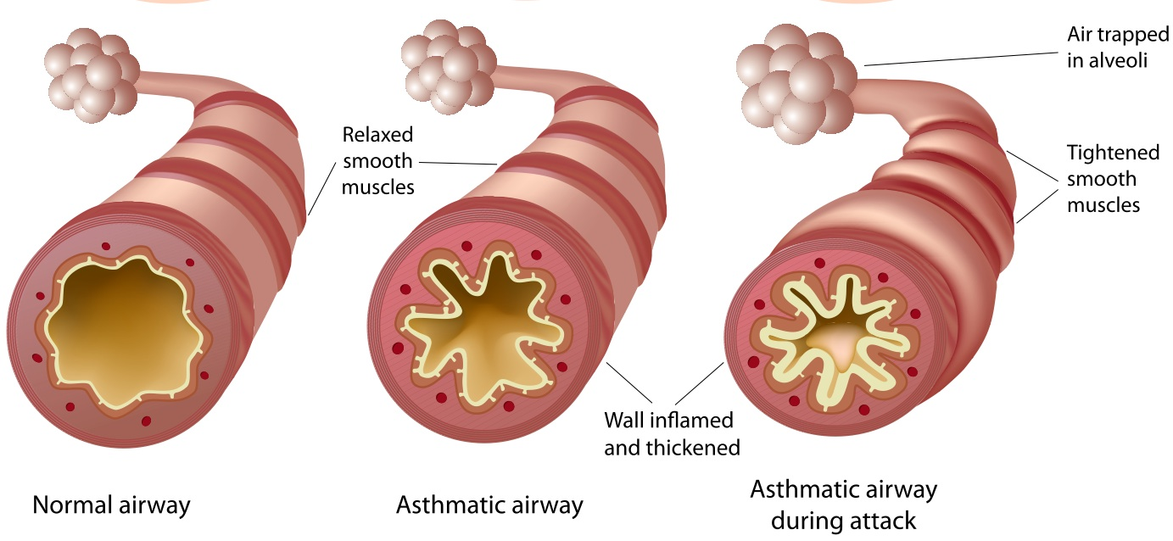
What is KNOWN about ASTHMA
Symptoms are brought about by:
Airway narrowing
Airway wall thickening
Increased mucus
It can be controlled but NOT cured
Symptoms may be triggered or worsened by factors such as viral infections, allergens, tobacco smoke, exercise and stress
GINA 2017
From the Global Strategy for Asthma Management and Prevention, Global Initiative for Asthma (GINA) 2018.
Available from: http://www.ginasthma.org/
Notes:
Asthma is a common and potentially serious chronic disease that can be controlled but not cured
Symptoms are associated with variable expiratory airflow, i.e. difficulty breathing air out of the lungs due to
Bronchoconstriction (airway narrowing)
Inflammation (airway wall thickening)
Increased mucus
Symptoms may be triggered or worsened by factors such as viral infections, allergens, tobacco smoke, exercise and stress

Slide 5
ASTHMA PHENOTYPES
Allergic asthma – most common, family history of allergy
Non-allergic asthma
Adult-onset (late-onset) asthma
Asthma with persistent airflow limitation - thought to be due to airway wall remodeling
Asthma with obesity
Notes:
Allergic asthma - this is the most easily recognized asthma phenotype, which often commences in childhood and is
associated with a past and/or family history of allergic disease such as eczema, allergic rhinitis, or food or drug allergy
not associated with allergy. The cellular profile of the sputum of these patients may be neutrophilic, eosinophilic or contain only a few inflammatory cells (paucigranulocytic). Patients with non-allergic asthma often demonstrate less short-term response to ICS.

Slide 6
DIAGNOSTIC CRITERIA FOR ASTHMA
1. PRESENCE OF TYPICAL RESPIRATORY SYMPTOMS IN ASTHMA
Respiratory symptoms of wheeze, shortness of breath, cough and/or chest tightness:
Patients (especially adults) experience more than one of these types of symptoms
Symptoms are often worse at night or in the early morning
Symptoms vary over time and in intensity
Symptoms are triggered by viral infections (colds), exercise, allergen exposure, changes in weather, laughter, or irritants such as car exhaust fumes, smoke or strong smells.

Slide 7
DIAGNOSTIC CRITERIA FOR ASTHMA
2. CONFIRMED VARIABLE EXPIRATORY AIRFLOW LIMITATION
Documented excessive variability in lung function
Documented expiratory airflow limitation
Reduced FEV1/FVC
<0.75–0.80 in adults
< 0.90 in children
Positive bronchodilator reversibility test (200-400 mcg of Salbutamol) | Adults: increase in FEV1 of >12% and >200 mL from baseline Children: increase in FEV1 of >12% predicted
Excessive variability in twice-daily PEF over 2 weeks | Adults: diurnal PEF variability > 10% Children: diurnal variability > 13%
Increase in lung function after anti-inflammatory therapy | Increase in FEV1 by >12% and >200 mL from baseline
Positive Exercise challenge test | Adults: fall in FEV1 of >10% and >200 mL from baseline Children: fall in FEV1 of >12% predicted, or PEF >15%
Positive Bronchial challenge test | Fall in FEV1 from baseline by > 15 - 20%
Excessive variation in lung function between visits | Adults: variation in FEV1 of >12% and >200 mL between visits
Notes:
is important to avoid unnecessary treatment or over-treatment, and to avoid missing other important diagnoses.
Asthma is characterized by variable expiratory airflow limitation to a greater extent than in healthy populations.
In asthma, lung function may vary between completely normal and severely obstructed in the same patient. Poorly controlled asthma is associated with greater variability in lung function than well-controlled asthma.

Slide 8
If spirometry is not available, you can opt to treat immediately depending on clinical urgency and access to other tests.
In low resource countries, variable airflow limitation can be confirmed using PEF meters

Slide 9
ASSESSING ASTHMA CONTROL
Level of asthma control is the extent to which the features of asthma can be observed in the patient, or have been reduced or removed by treatment.
Asthma control is assessed in 2 domains: symptom control and future risk of adverse outcomes.
Assess symptom
control in past 4 weeks
Assess future risk of adverse outcomes
Asthma Control
Reduce or limit:
Exacerbations
Fixed airflow limitation
Side-effects of treatment
Achieve good control of symptoms
Maintain normal activity levels
Notes:
In the GINA guidelines, the management of asthma is assessing the symptoms and assessing future risk of exacerbations.
There is asthma control when there is good control of symptoms and maintain routine activities. Moreover, reduction of exacerbations and lesser side effects from treatment medications.
to identify whether the patient is at risk of adverse asthma outcomes, particularly exacerbations, persistent airflow limitation, and side-effects of medications
it should be measured at the start of treatment, after 3–6 months of treatment (to identify the patient’s personal best), and periodically thereafter for ongoing risk assessment.

Slide 10
4. An 8 year old boy has symptoms at least thrice a week. He often requires stopping his physical activities (like running) due to asthma symptoms. He also has nocturnal symptoms at least once a week. His FEV1 was 84%. What is his symptom control classification?
Well controlled
Partly controlled
Uncontrolled

Slide 11
Assess Symptom Control
In the past 4 weeks, has the patient had: | Level of Asthma Symptom Control
 | Well controlled | Partly controlled | Un- controlled
Daytime asthma symptoms more than twice a week ? Any night waking due to asthma ? Reliever needed for symptoms more than twice a week ? Any activity limitation due to asthma ? | None of these | 1-2 of these | 3-4 of these
Yes ☐ No ☐
Yes ☐ No ☐
Yes ☐ No ☐
Yes ☐ No ☐
Global Initiative for Asthma. Global Strategy for Asthma Management and Prevention 2018. Available from: www.ginasthma.org.
Notes:
ASSESSING ASTHMA SYMPTOM CONTROL
Asthma symptoms such as wheeze, chest tightness, shortness of breath and cough typically vary in frequency and intensity, and contribute to the burden of asthma for the patient.
Poor symptom control is also strongly associated with an increased risk of asthma exacerbations.
Directed questioning is important, as the frequency or severity of symptoms that patients regard as unacceptable or bothersome may vary from current recommendations about the goals of asthma treatment, and differs from patient to patient. For example, despite having low lung function, a person with a sedentary lifestyle may not experience bothersome symptoms and so may appear to have good symptom control.
To assess symptom control (Box 2-2A) ask about the following in the past four weeks: frequency of asthma symptoms (days per week), any night waking due to asthma or limitation of activity, and frequency of reliever use for relief of symptoms. In general, do not include reliever taken before exercise, since this is often routine.

Slide 12
4. An 8 year old boy has symptoms at least thrice a week. He often requires stopping his physical activities (like running) due to asthma symptoms. He also has nocturnal symptoms at least once a week. His FEV1 was 84%. What is his symptom control classification?
Well controlled
Partly controlled
Uncontrolled

Slide 13
Assess Future Risk of Adverse Outcomes
Measure FEV1 at start of treatment, after 3–6 months of controller treatment to record the patient’s personal best lung function, then periodically for ongoing risk assessment.
Does the patient have potentially modifiable risk factors for flare-ups?
Medications: high SABA use (uses >1 200-dose canister per month), inadequate ICS dose, poor adherence, improper inhaler technique, frequent OCS use
Co-morbidities: Obesity, GERD, chronic rhinosinusitis, pregnancy, food allergy
Exposures: smoke inhalation, allergens, air pollution
Context: psychosocial , socioeconomic issues
Lung function: Low FEV1 (<60% predicted), high bronchodilator reversibility
Ever intubated or ICU admission for asthma
>1 severe exacerbation in the past 12 months
Blood eosinophilia
Elevated FeNO in adults with allergic asthma taking ICS
Notes:
The long-term goals of asthma management are to achieve good symptom control, and to minimize future risk of asthma-related mortality, exacerbations, persistent airflow limitation and side-effects of treatment. The patient’s own goals regarding their asthma and its treatment should also be identified.

Slide 14
GOALS OF ASTHMA MANAGEMENT
Achieve good symptom
control
Minimize future risks
Asthma-related mortality
Exacerbations
Persistent airflow limitation
Treatment side effects
Asthma Control
The patient’s own goals regarding their asthma and its treatment should also be identified.
Notes:
long-term goals of asthma management are to achieve good symptom control, and to minimize future risk of asthma-related mortality, exacerbations, persistent airflow limitation and side-effects of treatment. In the GINA guidelines, the management of asthma is assessing the symptoms and assessing future risk of exacerbations.

Slide 15
CONTROLLER vs. RELIEVER MEDICATIONS
Controller medication
Daily medications for persistent asthma
Provides long-term control
Mechanism is mostly anti-inflammatory
Includes:
Inhaled corticosteroids
Long acting beta2 agonists
Leukotrienes
Sustained-release theophylline
Systemic glucocorticoids
Anti-IgE (Omalizumab)
Reliever medication
Provides quick relief
Given on an as needed basis
Mostly bronchodilators
Short-acting Beta2 agonists
Methylxanthines
Anti-cholinergics

Slide 16
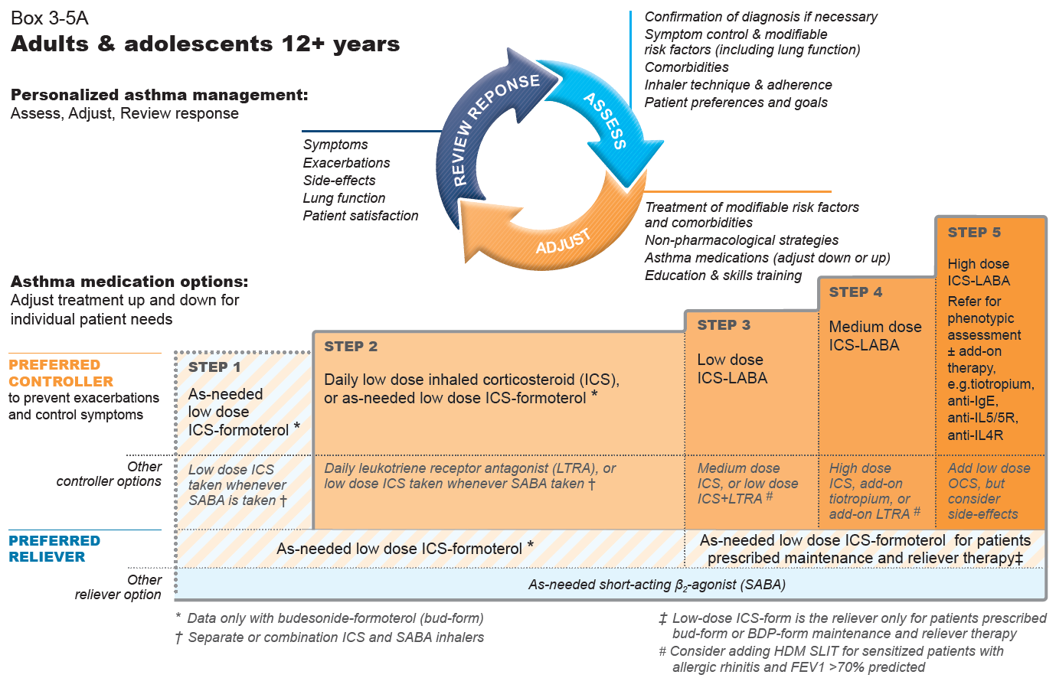
STEPWISE APPROACH IN THE MANAGEMENT OF ASTHMA
GINA 2020, Box 3-5A
Notes:
The only changes in this figure from the 2019 report are (in the arrowed circle) addition of patient preferences in the Assess section and addition of “adjust down or up” in the “Adjust” section, and removal of “off-label”. There are also some formatting changes to improve readability

Slide 17
STEPWISE APPROACH IN THE MANAGEMENT OF ASTHMA
Step 1
For patients whose symptoms are < 2x a month
PREFERRED CONTROLLER | As needed low dose ICS-Formoterol OTHER OPTION: Low dose ICS whenever SABA is taken
PREFERRED RELIEVER | As needed low dose ICS-Formoterol OTHER OPTION: As needed short acting Beta2 Agonist (SABA)
Notes:
Preferred controller to prevent exacerbations and control symptoms

Slide 18
STEPWISE APPROACH IN THE MANAGEMENT OF ASTHMA
Step 2
For patients whose symptoms are > 2x a month but less than daily
PREFERRED CONTROLLER | Daily LOW DOSE ICS or As needed low dose ICS-Formoterol OTHER OPTIONS: Daily leukotriene receptor antagonist (LTRA; e.g. Montelukast) Low dose ICS taken whenever SABA is taken
PREFERRED RELIEVER | As needed low dose ICS-Formoterol OTHER OPTION: As needed short acting Beta2 Agonist (SABA)
Notes:
Leukotriene receptor antagonists (LTRA) are less effective than ICS, particularly for exacerbations (Evidence A).
They may be appropriate for initial controller treatment for some patients who are unable or unwilling to use ICS; for patients who experience intolerable side-effects from ICS; or for patients with concomitant allergic rhinitis

Slide 19
STEPWISE APPROACH IN THE MANAGEMENT OF ASTHMA
Step 3
For patients who experience symptoms most days or waking with asthma once a week or more
PREFERRED CONTROLLER | Daily LOW DOSE ICS-LABA OTHER OPTIONS: Medium dose ICS Low dose ICS + LTRA
PREFERRED RELIEVER | As needed low dose ICS-Formoterol (for patients prescribed with Budesonide-formoterol as maintenance and reliever therapy) OTHER OPTION: As needed short acting Beta2 Agonist (SABA)
Notes:
Preferred controller to prevent exacerbations and control symptoms

Slide 20
STEPWISE APPROACH IN THE MANAGEMENT OF ASTHMA
Step 4
For patients who experience symptoms most days or waking with asthma once a week or more, or LOW LUNG FUNCTION
PREFERRED CONTROLLER | Daily MEDIUM DOSE ICS-LABA OTHER OPTIONS: High dose ICS + add-on: Tiotropium or LTRA *Short course oral corticosteroids may also be needed for severely uncontrolled asthma
PREFERRED RELIEVER | As needed low dose ICS-Formoterol (for patients prescribed with Budesonide-formoterol as maintenance and reliever therapy OTHER OPTION: As needed short acting Beta2 Agonist (SABA)
Notes:
Preferred controller to prevent exacerbations and control symptoms

Slide 21
STEPWISE APPROACH IN THE MANAGEMENT OF ASTHMA
Step 5
Patients with inadequate response to step 4
PREFERRED CONTROLLER | HIGH DOSE ICS-LABA Refer for phenotypic assessment Add-on therapies: tiotropium, anti-IgE, anti-IL5/5R, anti-IL4R OTHER OPTION: Add low dose OCS but consider side-effects
PREFERRED RELIEVER | As needed low dose ICS-Formoterol (for patients prescribed with Budesonide-formoterol as maintenance and reliever therapy) OTHER OPTION: As needed short acting Beta2 Agonist (SABA)
Notes:
Preferred controller to prevent exacerbations and control symptoms

Slide 22
Low, medium and high ICS doses: adults/adolescents
This is NOT a table of equivalence. These are suggested total daily doses for the ‘low’, ‘medium’ and ‘high’ dose treatment options with different ICS.
DPI: dry powder inhaler; HFA: hydrofluoroalkane propellant; pMDI: pressurized metered dose inhaler (non-CFC); * see product information
GINA 2020, Box 3-6A

Slide 23
GINA no longer recommends SABA-only treatment of asthma in adults or adolescents.
Studies of regular SABA in patients with newly-diagnosed asthma showed worse outcomes and lower lung function than in patients who were treated with daily low dose ICS from the start.
High reliever use is associated with asthma worsening and increased risk of an asthma attack (exacerbation)
Severe exacerbations are halved with low dose ICS even in patients with symptoms 0–1 days a week.

Slide 24
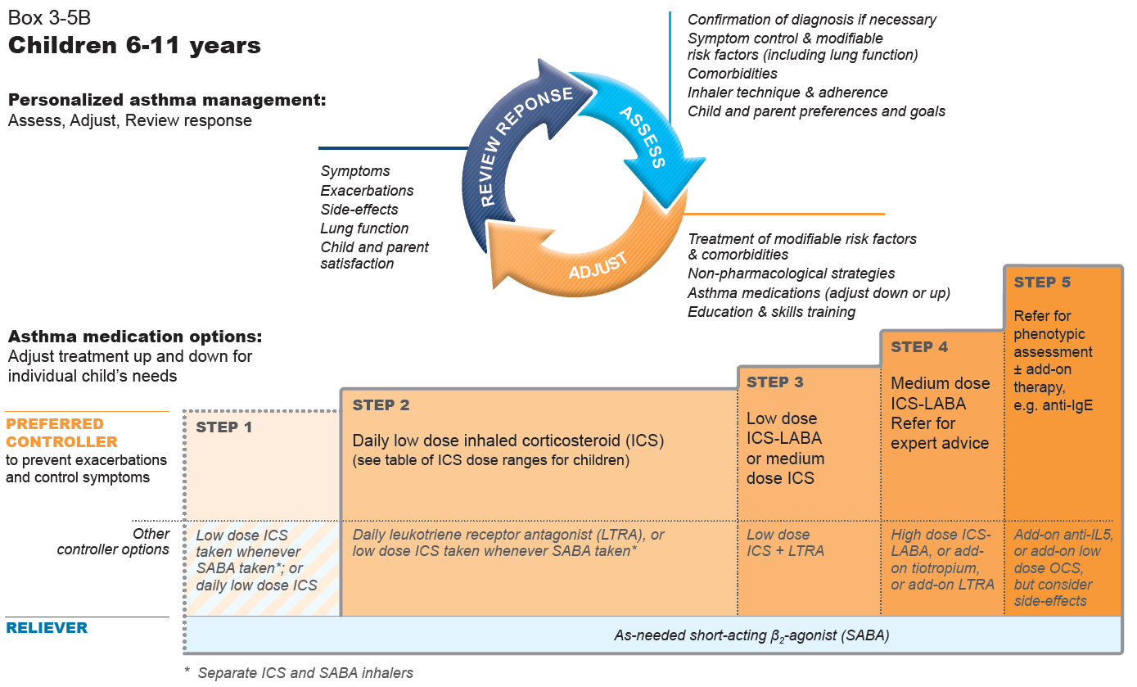
For Children ages 6-11 y/o, PRN SABA is still the recommended RELIEVER in all the steps in asthma management.
GINA 2020, Box 3-5B
Notes:
The only changes in this figure from the 2019 report are (in the arrowed circle) addition of preferences in the Assess section and addition of “adjust down or up” in the “Adjust” section, removal of “off-label”, and removal of “only one study in children” from the asterisked footnote. There are also some formatting changes to improve readability

Slide 25
Key Points in Management of Asthma in ≤ 5 years old
Wheezing episodes in young children should be treated initially with inhaled SABA, regardless of whether the diagnosis of asthma has been made.
Trial of controller therapy should be given if symptom pattern suggests asthma & respiratory symptoms are uncontrolled and/or wheezing episodes are frequent and severe.
If poor response to treatment should be reviewed, consider alternative diagnoses
Choice of inhaler device should be based on child’s age and capability
Preferred device for <4 y/o: pressurized metered dose inhaler (MDI) and spacer with face mask
for 4-5 y/o: MDI with spacer and mouth piece
Review the need for asthma treatment frequently, as asthma-like symptoms remit in many young children.

Slide 26
PATIENT FOLLOW-UP
How often should asthma be reviewed?
Frequency of visits depends upon the patient’s initial level of control, their response to treatment, and their level of engagement in self-management.
Ideally, patients should be seen 1–3 months after starting treatment and every 3–12 months thereafter. After an exacerbation, a review visit within 1 week should be scheduled
Consider STEPPING DOWN when asthma symptoms have been well controlled and stable for 3 or more months
Notes:
For most controller medications, improvement begins within days of initiating treatment, but the full benefit may only be evident after 3–4 months.
Consider stepping down when asthma symptoms have been well controlled and lung function has been stable for 3 or more months

Slide 27
NON-PHARMACOLOGIC THERAPY
Encourage smoking cessation
Strategies for weight reduction for obese patients
Engage in regular physical activity
prevention of breakthrough exercise-induced bronchoconstriction with SABA or low dose ICS-formoterol before exercise
Avoidance of occupational exposures, indoor, & outdoor allergens
Healthy diet: high in fruit and vegetables
Help patient deal with emotional stress
Distinguish between symptoms of anxiety and asthma

