Slide 1
INTERN’S ORIENTATION

Slide 2
hello!
WELCOME TO FAMILY AND COMMUNITY MEDICINE ☺

Slide 3
1.
LEARNING ACTIVITIES

Slide 4
LEARNING ACTIVITIES
Family Medicine Clinic (OPD)
Ambulatory Care Unit
Cancer Institute
Workshops and Conferences

Slide 5
Family Medicine Clinic
OPD Room 119 (New) and 118 (Follow-up)
Clinic hours: 7am-5pm
Sign in at Attendance Logbook at 7am except on scheduled activities
Workforce
AM: 1 Third year, 2 second years, 3-4 first years
PM: same as above except MWF (Service continuity)
Non-duty: New patients
From-duty: Follow up patients

Slide 6
Family Medicine Clinic
Use Health Management Record for both new and follow up patients
Complete history and PE for new patients and only pertinent for follow up patients
Include assessment and plan (plus wellness and prevention advise)
TRODAT and SIGN your charts
Endorse to resident or consultant (if present)
Fill up census forms of patients seen daily
Never use abbreviations in the charts

Slide 7
Family Medicine Clinic
DRE and IE are performed in a case-to-case basis
Complete neuro exam (including fundoscopy) on ALL patients presenting with headache, dizziness and elevated BP
What to bring for the group: at least 1 diagnostic set, neuro hammer

Slide 8
Family Medicine Clinic
For property safety:
Be careful of your belongings at FMC
Do not leave your laptops, cellphones or gadgets at your clinic desk

Slide 9
Ambulatory Care Unit
Duty: 12 hour shift (7AM-7PM and 7PM-7AM)
2 interns per shift
Post-duty status: up to 12nn at FMC
Inform ROD if you have activities

Slide 10
Ambulatory Care Unit
Upon patient arrival:
Inform ROD of new patient
Immediately check vital signs, refer to ROD if unstable for immediate transfer to ER
If stable, get complete but fast history and PE (max 30 mins per patient) then refer to ROD with initial assessment and plan
If patient or guardian declined treatment or procedure (eg DRE), sign handwritten waiver
For med cert: return after 3 days to get certificate at OPD medical record

Slide 11
Ambulatory Care Unit
AMBU Logbooks
AMBU consultation record (AMBU PC)
Intern’s Attendance Logbook
Procedure Logbook (change of IFC, IM meds injection, NGT reinsertion)

Slide 12
Ambulatory Care Unit
Always refer to ROD before managing and discharging patients
Do not use abbreviations
Procedures
Reinsertion only (we do not initiate their placement)
IV route is not an option, but IM injection may be done
Skin testing should be done esp for NSAIDs

Slide 13
Ambulatory Care Unit
PGH employees and students for consult
8am-5pm: UP Health Service
5pm onwards: inform 2nd year ROD
Get vital signs and write in a piece of paper
If for fit work: Fit to work certificates are no longer issued at AMBU → UPHS

Slide 14
Cancer Institute
Monday and Friday (PM shift)
3 interns on AMBU duty taking turns manning the CI post every 4 hours

Slide 15
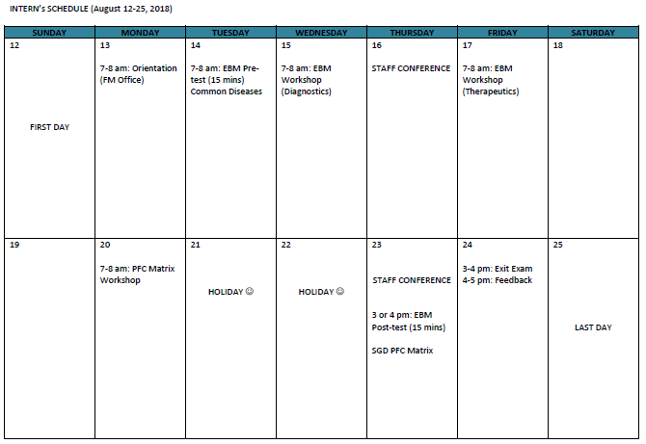
SCHEDULE

Slide 16
thanks!
Any questions?

