Slide 1
Development of the Musculoskeletal System
Lydia R. Leonardo, DrPH
Biology 133

Slide 2
Divisions of the Skeletal System
Axial skeleton
  Skull
  Vertebral column
  Ribs
  Sternum
Limbs and appendicular system
  Limbs
  Appendicular skeleton

Slide 3
Three Sources of the Musculoskeletal System
the paraxial mesoderm
the parietal layer of the lateral plate mesoderm
the neural crest cells
Notes:
The development of bone and muscle begins at the fourth gestational week, when the paraxial mesoderm differentiates into somites; the latter gives rise to sclerotomes and dermomyotomes. Sclerotomes form the vertebra and the ribs, whereas myotomes form the majority of the muscular system.

Slide 4
Bone formation can occur either by
Intramembranous ossification – exemplified by formation of the cranial vault and many bones of the face.
Endochondral ossification - ex. Formation of the base of the skull, some bones of the face, bones of the limbs and girdles, vertebral column, ribs and sternum.
Notes:
Although different, the occurrence of both processes first require the condensation of mesenchymal cells - the loosely organized embryonic connective tissue.

Slide 5
Development of the Limbs
involves the inductive influences of the apical ectodermal ridge
the formation of circular constrictions to separate parts of the limbs
opposite rotations of the upper and lower limbs.

Slide 6
Development of the Skeletal Muscle
Involves the differentiation of myotome cells into myoblasts

Slide 7
Bone Formation
The first stage of any type of bone formation involves a mesenchymal condensation, where cells become densely packed together.
From this point on, there are two ways osteogenesis can occur: intramembranous ossification and endochondral ossification.
Danny Li, 2021

Slide 8
Two Ways of Osteogenesis
Intramembranous ossification - the process in which mesenchymal cells ensheathed in membranous tissue directly undergo ossification
Endochondral ossification - the process in which mesenchymal cells first differentiate into cartilage models before undergoing ossification.
Danny Li, 2021

Slide 9
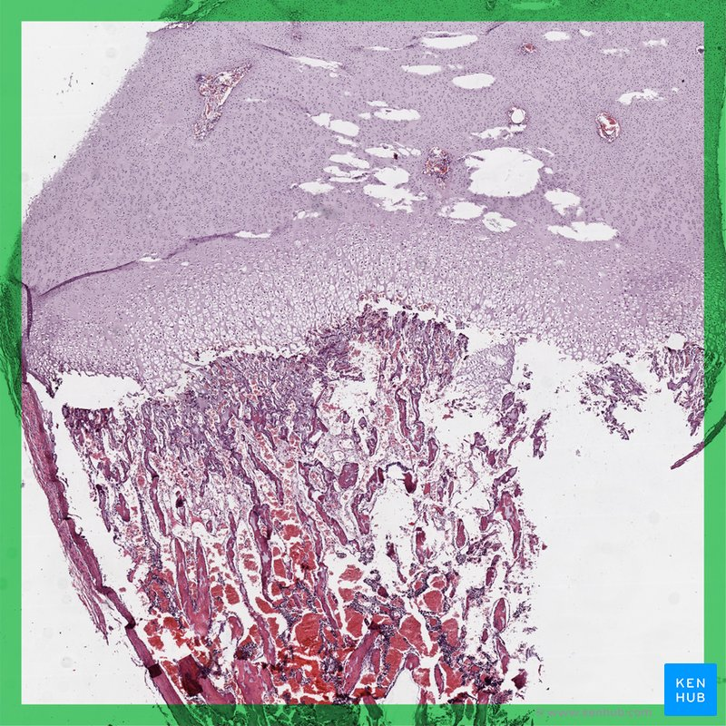
Endochondral Ossification
Notes:
Formation of the cranial vault, most bones of the face, and the clavicle occur by intramembranous ossification, whereas formation of the rest of the axial and appendicular skeleton occur by endochondral ossification. In other words, the base of the skull, some bones of the face, the vertebral column, the ribs, the sternum, and the bones of the limbs and girdles form by a two-step process: chondrification and ossification.

Slide 10
Types of Joints
Fibrous - involves mesenchymal cells in the interzone to differentiate into dense fibrous tissue (i.e. sutures of the skull)
Cartilaginous - involves mesenchymal cells in the interzone to differentiate into hyaline cartilage (e.g., costochondral joints) or fibrocartilage (e.g., pubic symphysis)
Synovial - involves a more extensive process: the central mesenchymal cells in the interzone undergo apoptosis to form the synovial joint cavities, whereas the peripheral cells differentiate into ligaments and dense fibrous tissue
Danny Li, 2021
Notes:
Sequentially, the dense fibrous tissue forms the articular cartilage that covers the ends of the adjacent bone primordia. The remaining mesenchymal cells surrounding the interzone differentiate into chondrocytes to form the joint capsules and the synovial membrane.

Slide 11
The Axial Skeleton
Skull - consists of a neurocranium and a viscerocranium, with each having membranous and cartilaginous components. The bones that make up the skull thus form either by intramembranous ossification or endochondral ossification
Vertebral Column - develops from a resegmentation process of the somites
Ribs - develop as extensions from the thoracic vertebrae
Sternum - develops as two independent bands of mesenchymal cells before fusing and ossifying as one
Danny Li, 2021
Notes:
The bones that make up the vertebral column, the ribs, and sternum form only by endochondral ossification.

Slide 12
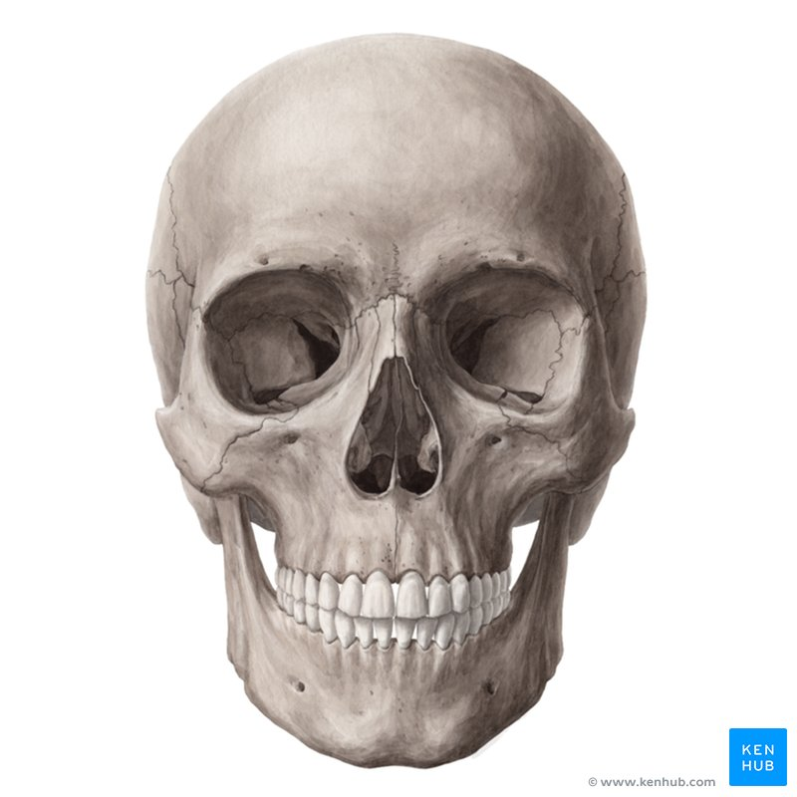

Slide 13
Two Parts of the Skull
A. Neurocranium that forms a protective case around the brain.
the membranous part that surrounds the brain as a vault,
the cartilaginous part (chondrocranium) that forms the base of the skull
B. Viscerocranium that forms the skeleton of the face.
Danny Li, 2021
Notes:
Both the neurocranium and the viscerocranium have distinct components that are formed either by intramembranous ossification or endochondral ossification.

Slide 14
Neurocranium
The membranous part of the neurocranium forms the calvaria (skullcap).
It is derived from two sources: the paraxial mesoderm and the neural crest cells.
Mesenchymal cells from these two sources surround the brain at various sites, form primary ossification centers, and undergo intramembranous ossification.
This results in the formation of membranous flat bones that are characterized by needle-like bone spicules.
Bone spicules progressively radiate from the primary ossification centers toward the periphery.
Structures derived from the membranous neurocranium include the parietal bones, part of the temporal bones, and the occipital bone.
Danny Li, 2021
Notes:
At birth, the membranous bones are separated from each other by dense connective tissue membranes that form fibrous joints, known as the cranial sutures (coronal, sagittal, and lambdoid).

Slide 15
Fontanelles
The site at which more than two bones meet
The anterior fontanelle is the most prominent one and is found where the parietal and frontal bones meet.
The posterior fontanelle is found where the parietal bones and the occipital bone meet.
The posterolateral (mastoid) fontanelles are found where the parietal, occipital, and temporal bones meet.
Danny Li, 2021
Notes:
As the brain and the skull continue to grow after birth, many of these sutures and fontanelles will remain membranous and open postnatally. Generally, the posterior fontanelle closes first by 2 months of age, the mastoid fontanelle by 6 months, the anterior fontanelle by 18 months, and the cranial sutures by 36 months.

Slide 16
Cartilaginous Part of the Neurocranium
Forms the base of the skull.
Initially consists of a number of separate cartilages that eventually fuse together.
Neural crest cells form the prechordal chondrocranium anterior to the center of the sella turcica, whereas the paraxial mesoderm form the chordal chondrocranium posterior to the center of the sella turcica.
Development of the base of the skull is complete when these cartilaginous structures fuse and undergo endochondral ossification.
Danny Li, 2021

Slide 17
Structures Derived from the Chondrocranium
include components of the occipital bone, the sphenoid bone, and the ethmoid bone, specifically the:
posterior half of the cribriform plate
lesser wings of the sphenoid
greater wings of the sphenoid
sella turcica
petrous part of the temporal bones and the adjacent parts of the occipital bone
clivus
condyles of the occipital bone
Danny Li, 2021

Slide 18
The Viscerocranium
Mainly formed by the first two pharyngeal arches.
The first pharyngeal arch undergoes intramembranous ossification to give rise to the: zygoma, maxilla, squamous part of the temporal bone and the mandible
The dorsal tip of the mandibular process and the second pharyngeal arch undergo endochondral ossification to give rise to the malleus, the incus, and the stapes.
The ossicles are the first bones to become fully ossified, with their ossification beginning in the fourth month of gestation.
Danny Li, 2021

Slide 19
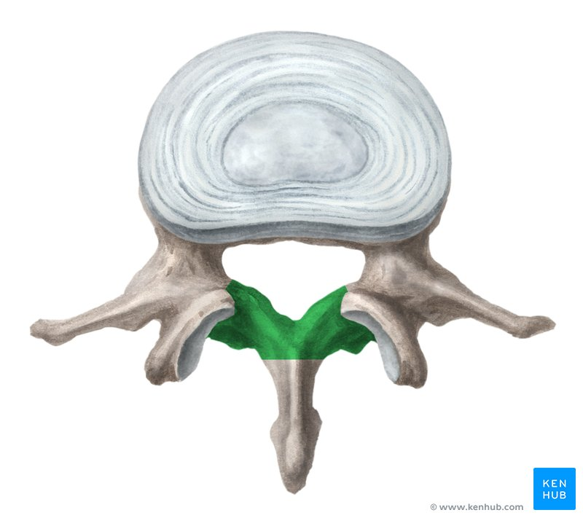

Slide 20
The Vertebral Column
develops from the sclerotomes, the ventromedial part of the somite.
By the fourth gestational week, sclerotome cells surround the neural tube and the notochord to merge with cells derived from the opposing somite.
Each sclerotome then undergoes resegmentation, a process that involves the caudal half of each sclerotome to fuse with the cranial half of each adjacent sclerotome; this forms the centrum, the primordial vertebral body.
Thus, each vertebra develops from two adjacent sclerotomes rather than from one sclerotome.
Danny Li, 2021

Slide 21
Fate of the Notochord
Not all cells in the caudal half of each sclerotome undergo resegmentation.
Instead, some migrate cranially and contribute to the formation of the intervertebral disc.
As development continues, the notochord completely degenerates in the centrum, but where it persists, it enlarges as a gelatinous center.
This forms the nucleus pulposus, which is later surrounded by circularly arranged fibers known as the annulus fibrosis.
Combined, these two structures form the intervertebral discs.
Danny Li, 2021

Slide 22
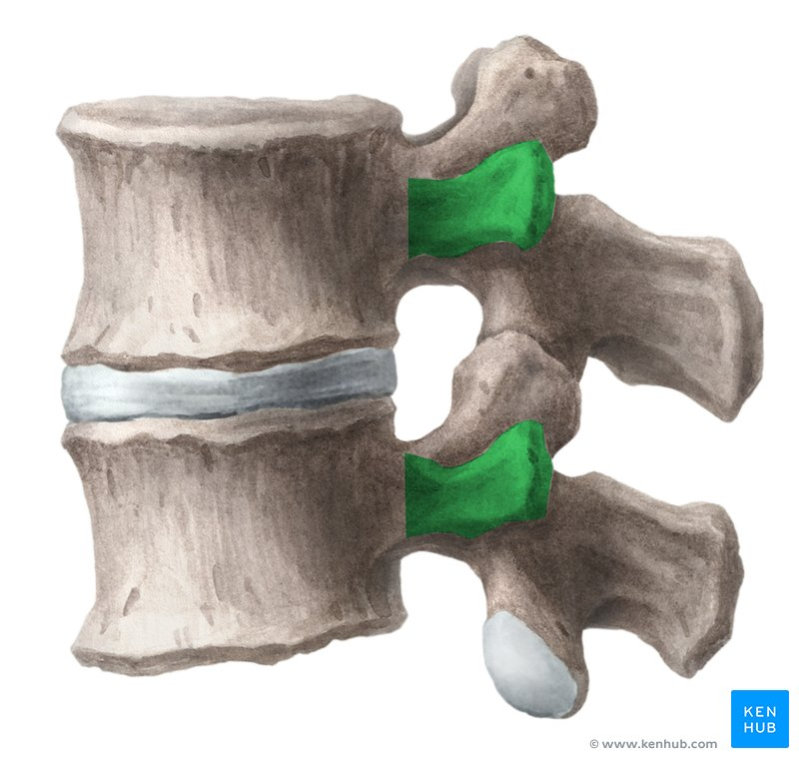

Slide 23
Ribs
Develop from the costal processes of the thoracic vertebrae.
Cartilaginous during the embryonic period and undergo ossification during the fetal period.
Original site where the costal process is connected to the vertebra becomes replaced by costovertebral synovial joints.
First seven pairs of ribs attach to the sternum through their own cartilages and are called true ribs.
Subsequent five pairs of ribs attach to the sternum through the cartilage of the seventh rib and are called false ribs.
Last two pairs of ribs do not attach to the sternum and are called floating ribs.
Danny Li, 2021

Slide 24
Sternum
Develops from a pair of separate vertical, condensed bands of mesenchymal cells, known as the sternal bars.
Form independently lateral to the midline of the ventral body wall.
Chondrification occurs while the sternal bars migrate medially.
By the tenth gestational week , they fuse in cranial-to-caudal sequence at the midline and form the cartilage model of the manubrium, the sternal body, and the xiphoid process.
Danny Li, 2021

Slide 25
Limbs and appendicular system
The appendicular skeleton includes the bones of the limbs and girdles.
The formation of these structures begin by the end of the fourth gestational week, where limb buds become visible as outpocketings from the ventrolateral body wall.
They consist of a core of mesenchymal cells - derived from the somatic layer of the lateral plate mesoderm - covered by a layer of ectoderm. At the distal border of the limb, the ectoderm forms the apical ectodermal ridge (AER).
The AER exerts an inductive influence on the core of mesenchymal cells to remain undifferentiated and to rapidly proliferate; this region is known as the progress zone.
As the limbs continue to grow, cells farther from the influence of the AER begin to differentiate into cartilage and muscle.
Development of the limbs thus proceed proximodistally.
Danny Li, 2021

Slide 26
Skeletal Muscles

Slide 27
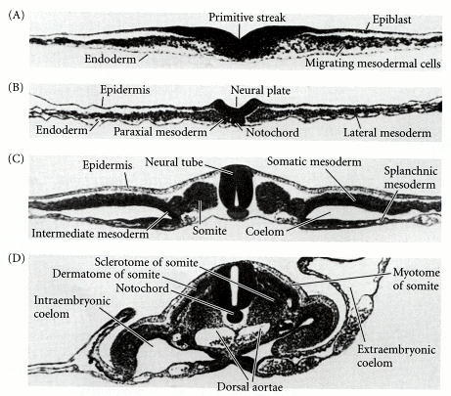
Developmental Biology. 6th edition. 2000
Notes:
Gastrulation and neurulation in the chick embryo, focusing on the mesodermal component. (A) Primitive streak region, showing migrating mesodermal and endodermal precursors. (B) Formation of the notochord and paraxial mesoderm. (C, D) Differentiation of the somites, coelom, and the two aortae (which will eventually fuse). A-C, 24-hour embryos; D, 48-hour embryo.
Skeletal muscle is derived from the mesoderm. Recall that the paraxial mesoderm forms segmented series of tissue blocks on each side of the neural tube, the somites. Cells in the ventromedial part of the somite form the sclerotome. Cells in the dorsal part form the dermatome and two edges, the ventrolateral lip and the dorsomedial lip. Cells from these two edges migrate ventral to the dermatome and proliferate to form muscle cell precursors. Collectively, these structures form the dermomyotome. In turn, the dermomyotome will differentiate into dermatome cells forming the dermis of the back and the neck, and myotome cells forming the skeletal muscles.
Before developing into skeletal muscles, myotome cells first differentiate into myoblasts (embryonic muscle cells) through elongation of their nuclei and cell bodies. Myoblasts fuse to form elongated, multinucleated, and cylindrical muscle fibers. During or after fusion, myofilaments and myofibrils develop in the cytoplasm. As development continues, the muscle cells become invested with the external laminae, segregating them from the surrounding connective tissue. Fibroblasts form the epimysium and perimysium layers of the muscle, whereas the external lamina and reticular fibers form the endomysium. In limbs, myoblasts migrate to the limb buds and surround the primordial limb bones. The pattern of muscle formation is dictated by the same mesenchymal cells that give rise to the bones.

Slide 28
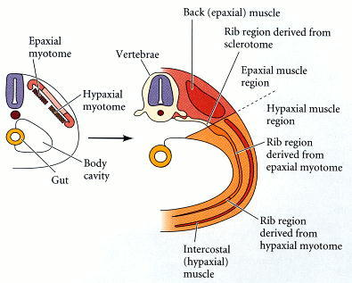
Developmental Biology. 6th edition. 2000
Notes:
Myotome derivatives of the mouse embryo. The epaxial muscles form from the region of the dermamyotome closest to the neural tube. The hypaxial muscles form from the region of dermamyotome furthest from the neural tube. The epaxial myotome will form the back muscles and the central portion of the rib. The hypaxial myotome will form the intercostal muscles and distal portion of the rib. The proximal (ventral) proteion of the rib is formed by sclerotome cells.* (After Kato and Aoyama 1998; Ordahl and Williams 1998.)
Fate mapping with chick-quail chimeras (Ordahl and Le Douarin 1992; Brand-Saberi et al. 1996; Kato and Aoyama 1998) has revealed that the remaining epithelial portion of the somite is arranged into three regions (Figure 14.7). The cells in the two lateral portions of the epithelium (those regions closest to and farthest from the neural tube) are muscle-forming cells. They divide to produce a lower layer of muscle precursor cells, the myoblasts. The resulting double-layered structure is called the dermamyotome, and the lower layer is called the myotome. Those myoblasts formed from the region closest to the neural tube form the epaxial muscles (the deep muscles of the back), while those myoblasts formed in the region farthest from the neural tube produce the hypaxial muscles of the body wall, limbs, and tongue (Figures 14.7 and 14.8; see Christ and Ordahl 1995; Venters et al. 1999). The central region of the dorsal layer of the dermamyotome is called the dermatome, and it generates the mesenchymal connective tissue of the back skin: the dermis. (The dermis of other areas of the body forms from other mesenchymal cells, not from the somites.) The dermamyotome may also produce the distal cartilage of the ribs, its lateral edge producing the most ventral portion of the rib (Figure 14.8; Kato and Aoyama 1998).

Slide 29
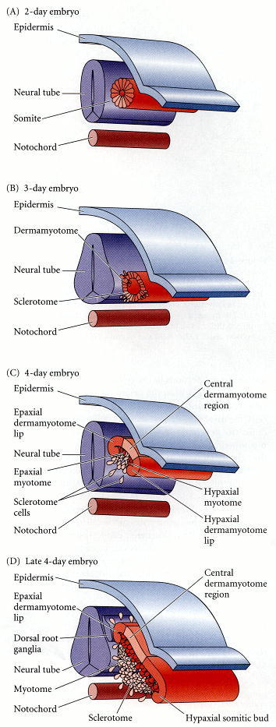
Developmental Biology. 6th edition. 2000
Notes:
Diagram of a transverse section through the trunk of a chick embryo on days 2–4. (A) The 2-day somite can be divided into sclerotome cells and dermamyotome cells. (B) On day 3, the sclerotome cells lose their adhesion to one another and migrate (more...)
Somites form (1) the cartilage of the vertebrae and ribs, (2) the muscles of the rib cage, limbs, and back, and (3) the dermis of the dorsal skin. Unlike the early commitment of the mesoderm along the anterior-posterior axis, the commitment of the cells within a somite to their respective fates occurs relatively late, after the somite has already formed. When the somite is first separated from the presomitic mesoderm, any of its cells can become any of the somite-derived structures. However, as the somite matures, its various regions become committed to forming only certain cell types. The ventral medial cells of the somite (those cells located farthest from the back but closest to the neural tube) undergo mitosis, lose their round epithelial characteristics, and become mesenchymal cells again. The portion of the somite that gives rise to these cells is called the sclerotome, and these mesenchymal cells ultimately become the cartilage cells (chondrocytes) of the vertebrae and part (if not all) of each rib (Figures 14.2 and 14.7).

Slide 30
Malformations

Slide 31
Skull malformations
Include cranioschisis and craniosynostosis.
Cranioschisis involves the failure of the cranial vault to form, thus exposing the brain tissue to amniotic fluid, resulting in anencephaly.
Craniosynostosis involves the premature closure of one or more sutures of the skull.
Premature closure of the sagittal suture can result in a long and narrow skull due to frontal and occipital expansions.
Premature closure of the coronal suture can result in a short skull.
As such, premature unilateral closure of sutures can result in an asymmetrical skull.
Danny Li, 2021

Slide 32
Vertebral malformations
Include Klippel-Feil sequence and spina bifida.
Klippel-Feil syndrome involves the fusion of cervical vertebrae, which results in reduced mobility, short neck, and low hairline.
Spina bifida involves the failure of vertebral arches to fuse, thus generally exposing the spinal cord in the sacral region.
In spina bifida occulta, there are minimal neurological deficits; the spinal cord is intact and is covered by skin.
In spina bifida cystica, the meninges and/or the neural tissue protrude through the skin at the sacral region to form a cyst-like sac.
Danny Li, 2021

Slide 33
Rib malformations
Include accessory ribs and fused ribs.
Accessory ribs are usually rudimentary and unilateral or bilateral; they develop from the costal processes of cervical or lumbar vertebrae.
Cervical ribs are usually attached to the seventh cervical vertebrae. Lumbar ribs are usually clinically insignificant, whereas cervical ribs may impinge on the brachial plexus or subclavian vessels, resulting in varying degrees of anesthesia of the upper limbs.
Fused ribs occur posteriorly when two or more ribs arise from a single vertebra
Danny Li, 2021

Slide 34
Sternal malformations
Include cleft sternum, pectus excavatum, and pectus carinatum.
Cleft sternum is the result of a complete or partial midline fusion of the sternal bars. The heart and its major vessels are covered only by skin and soft tissue and thus are unprotected.
Pectus excavatum (hollow chest) involves a concave depression of the sternum.
Pectus carinatum (keel-shaped chest) involves an anterior projecting sternum.
Both congenital deformities are often asymptomatic, but may impair cardiac and respiratory function depending on the severity.
Danny Li, 2021

Slide 35
Limb malformations
Malformations of the limbs vary greatly and can include defects in the entirety of the limb, the hand or the foot, and the digits. Malformation of the entire limbs include amelia, meromelia, phocomelia, and micromelia. Amelia (no limb) involves the complete absence of one or more limbs, whereas meromelia (part limb) involves a partial absence. Phocomelia (seal limb) involves the absence of long bones, resulting in rudimentary hands and feet attached to the trunk and pelvis. Micromelia involves abnormally small limbs.
Malformation of the hands and feet is known as cleft hand and cleft foot, which consist of an abnormal cleft between the second and fourth metacarpal or metatarsal bones and soft tissues. The third phalangeal and metacarpal or metatarsal bones are almost always absent, resulting in the possible fusion of the adjacent digits.
Malformations of digits include brachydactyly, syndactyly, polydactyly, and ectrodactyly. Brachydactyly involves shortened digits. Syndactyly involves the fusion of two or more digits. Polydactyly involves the presence of extra digits. Ectrodactyly involves the absence of a digit.
Danny Li, 2021

Slide 36
Skeletal muscle malformations
Malformations of skeletal muscle can result in certain conditions such as Poland sequence, prune belly syndrome and muscular dystrophy.
Poland sequence involves the absence of the pectoralis minor, partial absence of the pectoralis major, the absence or displacement of the nipple and areola, and the accompanying presence of digital defects.
Prune belly syndrome involves the partial or complete absence of abdominal muscles; this results with a very thin abdominal wall, making the internal organs visible and easy to palpate.
Muscular dystrophy involves a group of inherited muscle diseases that cause progressive muscular atrophy and weakness.
Danny Li, 2021

Slide 37
Thank you.

