Slide 1

Neurulation, Formation of the Nervous System, Sense Organs, Skin and other Ectodermal Derivatives
Lydia R. Leonardo, DrPH

Slide 2
Organogenesis
Ectoderm →the epidermis of the skin, nervous system, sense organs and a few other cell types.
Endoderm → tissues that line the digestive tract and organs that develop as outgrowths of the digestive tract (including the liver, pancreas, and lungs).
Mesoderm → skeletal, muscle tissues and circulatory, excretory and reproductive systems.
Notes:
I will include the skin and other derivatives in the lecture on endodermal derivatives.

Slide 3
Morphogenetic Processes in Embryogenesis
biochemical patterning of the embryo
mechanical morphogenetic movements that geometrically shape the embryo

Slide 4
Embryonic Organization
Allocation or differentiation processes to various areas of the embryo, is laid down in its general feature by the polarity of the egg cell or by an interplay of factors derived from the egg polarity, sometime after fertilization.
Realization of the plan of organization is dependent upon multitude of epigenetic events occurring in the later stages

Slide 5
Action of the “Organizer”
Most important of these events.
Function of the organizer is to initiate directly or indirectly many of the differentiation processes in other areas of the embryo (induction)
To initiate in its own area a number of differentiation processes leading to the formation of the essential part of the axial system of the embryo
Notes:
A series of well-designed surgical experiments demonstrated that the function of the organizer is to initiate directly or indirectly many of the differentiation processes in other areas of the embryo (induction), and at the sometime, to initiate in its own area a number of differentiation processes leading to the formation of the essential part of the axial system of the embryo.

Slide 6
Embryonic Induction
response of cells to the chemical signals released by adjacent cells
process by which the identity of certain cells influences the developmental fate of surrounding cells
consists of an interaction between inducing and responding tissues that brings about alterations in the developmental pathway of the responding tissue.
Notes:
We have learned that even as early as in the fertilization stage, the anteroposterior and dorsoventral axes are already specified and established. But by the blastula stage of the amphibian embryo, the fates of the cells in different regions of the embryo are already specified. Then in the gastrula stage, the cells of the blastula undergo different kinds of movements to organize and establish the three germ layers from where the different organs of the animals will be derived from.
Genetic programs are also crucial in the formation of organs. Even before the egg is fertilized, genes that will encode for specific proteins essential for development are already in existence. But with the fertilization of the egg by the sperm, a new set of genetic programs (e.g. gene expression) for new set of proteins of development come into view. These proteins released by group of cells act as chemical signals to adjacent cells or tissues to to set in motion a different pathway of differentiation, leading to the morphogenesis of tissues or organs.
Embryonic induction consists of an interaction between inducing and responding tissues that brings about alterations in the developmental pathway of the responding tissue.

Slide 7
Inductive Stimuli
Operate only at certain stages, as a rule, during early development, and they are normally ineffective unless there is an intimate contact between inducing and reacting tissues.
Once stimulated, the cells proceed along their new course of differentiation independently of a continued application of inducing stimulus.

Slide 8
Spemann-Mangold Organizer
The Spemann-Mangold organizer, also known as the Spemann organizer, is a cluster of cells in the developing embryo of an amphibian that induces development of the central nervous system.
induction is the process by which the identity of certain cells influences the developmental fate of surrounding cells.
Ribatti, Domenico (2014)
Notes:
Hilde Mangold was a PhD candidate who conducted the organizer experiment in 1921 under the direction of her graduate advisor, Hans Spemann at the University of Freiburg in Freiburg, Germany. The discovery of the Spemann-Mangold organizer introduced the concept of induction in embryonic development. Now integral to the field of developmental biology, induction is the process by which the identity of certain cells influences the developmental fate of surrounding cells. Spemann received the Nobel Prize in Medicine in 1935 for his work in describing the process of induction in amphibians. The Spemann-Mangold organizer drew the attention of embryologists, and it spurred numerous experiments on the nature of induction in many types of developing embryos.
The discovery by Hans Spemann of the “organizer” tissue and its ability to induce the formation of the amphibian embryo’s neural tube inspired leading embryologists to attempt to elucidate embryonic induction’s underlying mechanisms. Since then several studies have described several developmental model system to better understand the role of specific signaling molecules, the interplay of different signals and tissue interactions in regulating tissue induction and patterning events. Different groups of workers set out to subject embryonic amphibian tissues and inductive adult organs to various extraction methods in the hope that the active agents could be isolated and chemically identified. In addition, a large number of well characterized chemical compounds were tested.

Slide 9
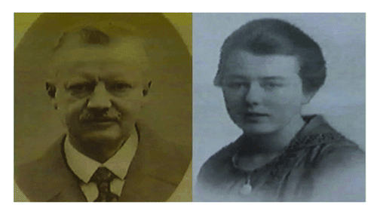
Display full size
Figure 1. A portrait of Hans Spemann and his assistant Hilde Pröscholdt Mangold.
Ribatti, Domenico (2014)
Notes:
As a young biologist Hans Spemann began work in 1894 at Würzburg as a doctoral student and teacher, and was the favorite pupil of Theodor Boveri. It was there, just after taking his doctorate, that he married Clara Binder. After 14 y at Würzburg, Spemann became professor at Rostock (1908–1914). He spent the years of World War I as director of the Kaiser Wilhelm Institute of Biology in Berlin-Dahlem; and in 1919 he succeeded Weismann as professor at Freiburg im Breisgau. He remained at Freiburg for the rest of his life, retiring in 1938.
In 1924, Spemann and his assistant Hilde Pröscholdt Mangold (Fig. 1) published the results of their work in “W. Roux Archive für Entwicklungsmekanik der Organismen,” at the time the most prestigious journal in the field of experimental embryology (Fig. 2).¹ They showed that a partial second embryo could be induced by grafting one small region of a newt embryo onto a new site on another embryo and a supernumerary neural plate developed at the site of the graft. Only a narrow central part of this was of the donor origin. This small region they called the “organizer,” since it seemed to be responsible for the organization of a complete embryonic body.
In 1935, Spemann received the Nobel prize for Physiology or Medicine, the only one ever to be awarded to an embryologist. Unfortunately, Hilde Mangold had died earlier at the age of only 26, in a kitchen stove accident while warming milk for her recently born baby. In 1938, Spemann published is famous book “Embryonic Development and Induction.”

Slide 10
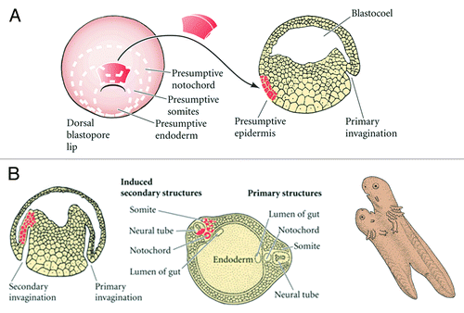
The Spemann-Mangold organizer experiment
Display full size
Ribatti, Domenico (2014)
Notes:
A graft, taken from near the blastopore of a pigmented amphibian embryo, is transplanted to a different site in an un-pigmented embryo; the transplant initiates a secondary invagination and gastrulation, which eventually results in an entire secondary larva. The graft derived tissues are perfectly integrated anatomically with host cells as shown in the transparent view of the secondary tail region (bottom right).
The participation of a dorsal blastopore lip in the program of development of a new embryo may be regarded in three significant aspects: (1) Formation of axial structures and establishment of the plane of bilateral symmetry; (2) Redetermination of fate for the party of host cells and their inclusion in the structures induced by the transplant; (3) Induction of the nervous system.
Spemann referred to the dorsal lip cells and their derivatives (notochord, prechordal mesoderm) as the organizer because they induced the host's ventral tissues to change their fates to form a neural tube and dorsal mesodermal tissue (such as somites), and they organized host and donor tissues into a secondary embryo with clear anterior-posterior and dorsal-ventral axes. He proposed that during normal development, these cells organize the dorsal ectoderm into a neural tube and transform the flanking mesoderm into the anterior-posterior body axis.
Because the fate of the transplanted cells could therefore be traced during development, Spemann and Mangold were able to demonstrate that the graft became notochord, yet induced neighboring cells to change fates. These neighboring cells adopted differentiation pathways that were more dorsal, and produced tissues such as the central nervous system, somites and kidneys.

Slide 11
Transplantation Experiment of Spemann and Mangold
Has shown that the cells in the DLB have an extraordinary role in the formation of the dorsal mesoderm, particularly the notochord and some pharyngeal endoderm.
Cells of the DLB have been referred to as the Spemann organizer since the cells here induces the formation of the CNS.
One important chemical that was later known to be the cause of the induction of the CNS is chordin (encoded by the gene chordin).
Before the CNS is induced to form, chordin is a protein that dorsalizes early vertebrate embryonic tissues binds to bone morphogenetic proteins (BMPs) that may be involved also in organogenesis
Ribatti, Domenico (2014)

Slide 12
Neurulation
first induction event in animal development
The organs first formed in the early vertebrate embryos are the notochord, brain and spinal cord.
The notochord is first formed from the mesodermal cells of the DLB or the mesodermal cells of the Hensen’s node of amniotes called the chordamesoderm.

Slide 13
Counterpart of the DLB
Further movement (by ingression) of the cells from the surface epiblast results to a thickened structure at the anterior end of the primitive streak called the Hensen’s node.
The aggregate of cells in this thickened knot are destined to form the notochord. Notochord, if you recall, is made of cartilage-like cells that serves as a flexible axial support in all chordate embryos. It grows forward along the length of the embryo as a cylindrical rod of cells.
At this point, we can generalize that where the DLB in amphibians or the Hensen’s node in amniotes, establishes the posterior end of the embryo since the notochord develops anterior to these structures.

Slide 14
NEURULATION
Is defined as the process which gives rise to the neural tube in the development of the embryo
The neural tube gives rise to the central nervous system
Also gives rise to the neural crest cells, which migrates from the dorsal side of the tube to give rise to different cell types

Slide 15
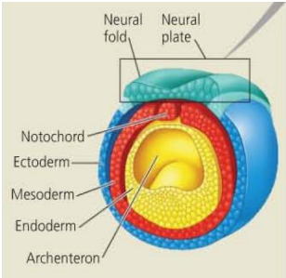
NEURULATION
First in neurulation is the formation of the neural plate
The neural plate is a result of the dorsal thickening of the ectodermal cells
Folding begins in the neural plate (formation of neural folds)

Slide 16
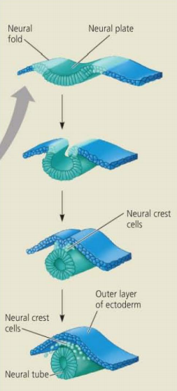
NEURULATION
The subsequent folding of the neural plate gives rise to the neural tube
The neural tube pinches off the ectodermal cells to become a separate structure
Neural crest cells form a layer between them

Slide 17
NEURULATION
The ectodermal cells are subdivided into the epidermal ectoderm and the neural ectoderm cells
Derivatives of the epidermal ectoderm include:
  Epidermis and appendages (hair, glands, nails)
  Cornea
  Otocyst (inner ear cell)
  Lining of outer part of both ends of gut (anus and mouth linings)
  Ameloblasts (makes tooth enamel)
  Tongue covering
  Part of salivary gland

Slide 18
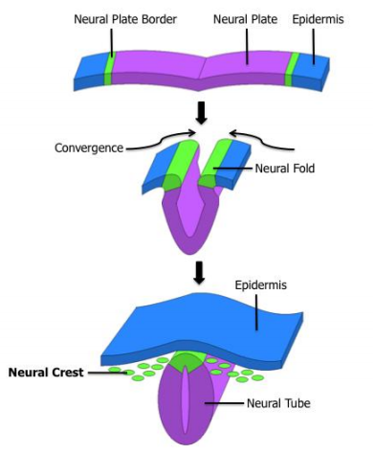
NEURULATION
The neural crest cells are sometimes termed as the “4th germ layer” because of its abundance of derivatives
These derivatives include:
  PNS ganglia
  Myenteric and submucosal plexus in GI tract
  Schwann cells (myelination of PNS)
  Adrenal Medulla (part of kidney)
  Odontoblasts (production of dentin)
  Melanocytes (pigment cells)
  CT-type derivatives in head and neck
  Neural Crest = forms the peripheral nervous system, facial cartilages and bones and corresponding connective tissues

Slide 19
Later Development of the Brain

Slide 20
Derivatives of the Three Primary Vesicles
Primary Vesicles | Secondary Vesicles | Neural Derivatives | Cavity Derivatives
Prosencephalon | Telencephalon | Cerebral hemispheres and globus pallidus | Lateral ventricle
 | Diencephalon | Thalamus, hypothalamus, and epithalamus | Third Ventricle
Mesencephalon | Mesencephalon | Midbrain | Cerebral aqueduct
Rhombencephalon | Metencephalon | Pons and cerebellum | Upper part of 4th ventricle
 | Myelencephalon | Medulla | Lower part of 4th ventricle/central canal
Notes:
Brain and Cerebellum
In the fifth week of development, swellings appear at the cranial end of the neural tube. Three primitive vesicles appear first, and subsequently these develop into five secondary vesicles.
These vesicles will give rise to all the structures of the brain and cerebellum, as well as the ventricular system shown in the table below:

Slide 21
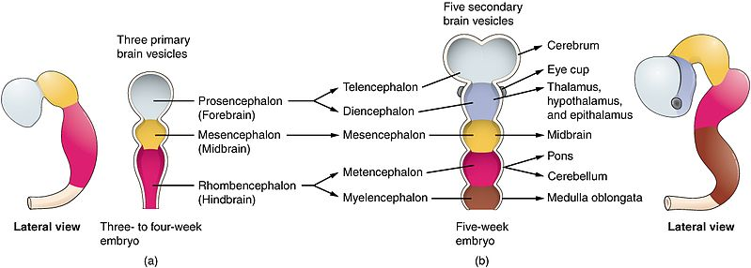
Notes:
Meanwhile, neuroderm cells begin to differentiate into neurones and glial cells. Neurones migrate throughout the brain, and once they have reached their final destination they develop axons and dendrites, forming synapses.
Spinal Cord
Whilst the cranial end of the neural tube forms the brain and cerebellum, the caudal end develops to form the spinal cord.
Cells on the dorsal side form the alar plate, which subsequently becomes the dorsal horn (posterior). Cells at the ventral end form the basal plate, which then becomes the ventral horn (anterior).
After Birth
Development of the central nervous system continues for many years after birth. Synapses form and new connections appear, increasing in number throughout childhood and into adulthood.
Only synapses and pathways that are used survive into adulthood; the process of synaptic pruning allows unused synapses to be eliminated.

Slide 22
Clinical Relevance: Defects in Neural Tube Formation

Slide 23
Anencephaly results from failure of the neural tube to close at the cephalic end, leading to the partial absence of the brain and skull. The lack of crucial brain structures mean that this is a lethal condition, and newborns with this congenital abnormality typically do not survive longer than a few hours or days after birth.
Spina bifida results from incomplete closure of the neural tube at the caudal end (most commonly in the lumbar region). There are three main types of spina bifida, of increasing severity:
Spina bifida occulta – the mildest form, is characterized by an incomplete closure of the vertebrae, without protrusion of the spinal cord. Most people with this form of spina bifida are unaware of having it, and its discovery is often incidental.
Meningocele (meningeal cyst) – where the meninges protrude between the vertebrae posteriorly, but the spinal cord is undamaged.
Myelomeningocele – the most severe form, where a portion of the spinal cord remains unfused and protrudes posteriorly through an opening between the vertebrae, in a sac formed by the meninges. This is associated with severe disability.

Slide 24
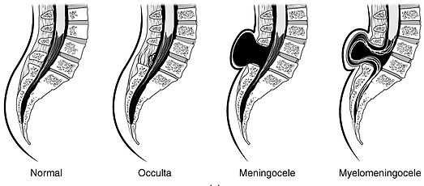
By OpenStax College [CC BY 3.0], via Wikimedia Commons

Slide 25
Thank you.

