Slide 1
Oral Visual Presentation: A Guide for the Medical Profession
LU VI 2020

Slide 2
When is an MD tasked to make a presentation?
Imparting Research Results
Reporting Clinical Cases
Giving Lectures

Slide 3
Oral Presentation

Slide 4
What are the components of a ‘presentation?’
ORAL
  What do you want to say?
  How do you say it?
VISUAL
  What do you show?

Slide 5
What do you want to say?
Keep your objective in mind.
  E.g. Breastfeeding lecture
  ‘To teach’ > Present a step by step tutorial
  ‘To encourage’ > Present advantages to mother and baby

Slide 6
What do you want to say?
Know your audience.
  E.g. Breastfeeding lecture
  Lay > Basic information, clarify misconceptions
  Paramedical staff > Scientific information, clarify misconceptions, emphasize important conclusions

Slide 7
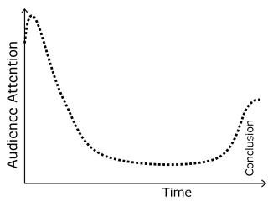
How do you say it?
Make your goals clear at the beginning.
State your point at the beginning and repeat it at the end.

Slide 8
How do you say it?
Speak clearly and deliberately.
  Volume : LOUD enough to hear
  Speed : SLOW enough to follow
  Intonation : INTERESTING enough to keep on the hook
BE CONFIDENT. PRACTICE!!!

Slide 9
How do you say it?
Be extemporaneous.
  Engage your audience.
  Maintain eye contact.

Slide 10
Visual Presentation

Slide 11
What do you show?
Identify the data that can be presented visually.
  What is important?
  What needs to be emphasized?
  What needs graphic representation?

Slide 12
What do you show?
Identify the data that can be presented visually.
  Research
    Title of presentation and authors
    Statement of the purpose or hypothesis
    A list of the essential steps in the methods
    Graphs, tables, and figures that show the major findings
    Clinical photographs or diagrams that illustrate key points or help explain content
    Summary of the conclusions

Slide 13
General Guidelines for Visual Presentations/Reports:
Include appropriate citations for important information per slide
Maximum of 8 lines/ bullets per slide
Use bullets/ numbered phrases NOT long statements
Re-type all tables
Use clear and easy-to-read fonts
Check presentation with the TV/LCD projector prior to reporting
PowerPoint/keynote presentations should be checked by a senior teacher at least two days before the presentation

Slide 14
Include appropriate citations for important information per slide

Slide 15
How to cite references
Provide the references verbally
Provide a reference list slide at the end of your presentation with corresponding in-text citations
Make a reference per slide
Combine these

Slide 16
How to cite references
You can cite references within the text of your presentation slide using the same American Psychological Association (APA) format for in-text citations (Author, Date) as in a written essay
Remember to cite sources for direct quotations, paraphrased materials, and sources of facts (such as market share data in the example slide)
Your Reference List must include the sources cited on your presentation slides

Slide 17
Basic format to reference journal articles
The basics of a Reference List entry for a journal article:
Author or authors - The surname is followed by first initials
Year of publication of the article
Article title (in single inverted commas)
Journal title (in italics)
Volume of journal
Issue number of journal
Page range of article
Tran T. T. (2016). Hepatitis B in Pregnancy. Clinical infectious diseases : an official publication of the Infectious Diseases Society of America, 62 Suppl 4(Suppl 4), S314–S317. doi:10.1093/cid/ciw092
Tran TT. Hepatitis B in Pregnancy. Clin Infect Dis. 2016;62 Suppl 4(Suppl 4):S314–S317. doi:10.1093/cid/ciw092

Slide 18
In Text
Risk for chronic infection after exposure varies from 90% in infants, to 50% in toddlers and young children, and 5% in adults (Edmunds WH, 1993)
Recent review of published literature from 1975 to 2011: active-passive immunoprophylaxis fails to prevent HBV transmission in 8%–30% of children born to highly viremic mothers (Pan CQ et al., 2012)
Reference slide at the end of the presentation
References
Edmunds WJ, Medly GF, Nokes DJ et al. The influence of age on the development of the hepatitis B carrier state. Proc R Soc Biol Sci 1993; 253:197–201.
Pan CQ, Duan ZP, Bhamidimarri KR et al. An algorithm for risk assessment and intervention of mother to child transmission of hepatitis B virus. Clin J Gastroenterol Hepatol 2012; 10:452–9.

Slide 19
Maximum of 8 lines/ bullets per slide

Slide 20
Fosfomycin for ESBL UTI?
Usual studied dose is 3 g every other day, for 3 doses
Study by Pullukcu et al. (2007) against ESBL E. coli showed clinical cure rate of 94%
Study by Senol et al. (2010) for ESBL E. coli showed non-inferiority to 14 day course of either meropenem or imipenem (not randomized though)
Senol S, Tasbakan M, Pullukcu H, Sipahi OR, Sipahi H, Yamazhan T, Arda B, Ulusoy S. Carbapenem versus fosfomycin tromethanol in the treatment of extended-spectrum beta-lactamase-producing Escherichia coli-related complicated lower urinary tract infection. J Chemother. 2010 Oct;22(5):355-7.
Pullukcu H, Tasbakan M, Sipahi OR, Yamazhan T, Aydemir S, Ulusoy S. Fosfomycin in the treatment of extended spectrum beta-lactamase-producing Escherichia coli-related lower urinary tract infections. Int J Antimicrob Agents. 2007 Jan;29(1):62-5.

Slide 21
Use bullets/ numbered phrases NOT long statements

Slide 22
Recurrent Vulvovaginal Candidiasis (RVVC)
≥4 episodes/yr
occurs in 5% to 8% of premenopausal women
1st step: make sure the patient actually has candidal infection
Usually more difficult to manage
Belayneh, M., Sehn, E., & Korownyk, C. (2017). Recurrent vulvovaginal candidiasis. Canadian family physician Medecin de famille canadien, 63(6), 455.

Slide 23
Re-type all tables

Slide 24
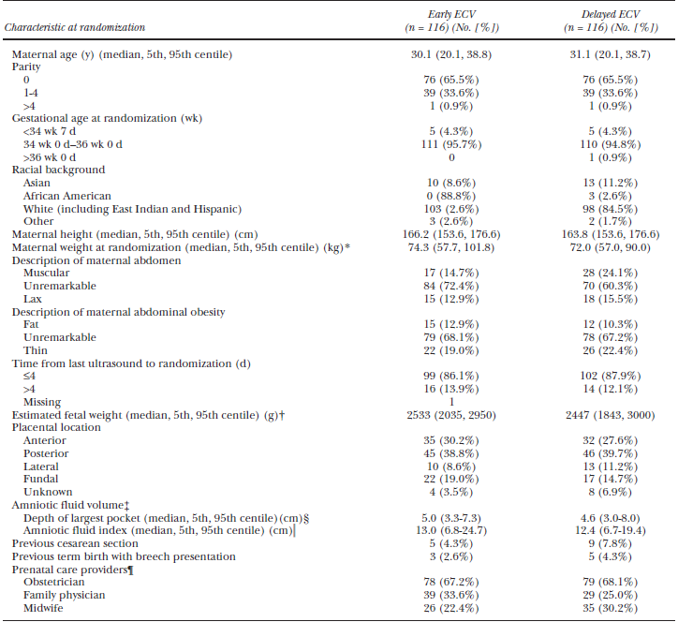

Slide 25
Pathogens in Acute Uncomplicated UTI in Women
Pathogen | Number (n=235) | Percent (%)
Escherechia coli | 179 | 76.2
Klebsiella pneumoniae | 8 | 3.4
Enterobacter aerogenes | 4 | 1.7
Citrobacter | 3 | 1.3
Proteus mirabilis | 3 | 1.3
Staphylococcus saprophyticus | 21 | 8.9
Staphylococcus aureus | 7 | 3.0
Streptococcus agalactiae | 3 | 1.3
Staphylococcus hominis | 2 | 0.9
Enterococcus faecalis | 2 | 0.9
Staphylococcus hemolyticus | 1 | 0.4
Staphylococcus warneri | 1 | 0.4
Ganguangco LM, Alejandria M et al. Prevalence and risk factors of trimethoprim-sulfamethoxazole resistant E. coli among pregnant women with acute uncomplicated UTI in a developing country. Int J Infect Dis 2015
Notes:
In a local study done in 2010-2011 among women with uncomplicated UTI, the most common pathogen is still E coli followed by Staph saprophyticus
Staphylococcus saprophyticus is a coagulase-negative and a leading cause of cystitis in young women and it shares many clinical features of urinary tract infection caused by Escherichia coli, but differs in pathogenesis, seasonal variation, and geographic distribution
S. saprophyticus. It is Urease-producing and has been associated with renal and ureteral stones.
Rectal, vaginal, and urethral colonization of S. saprophyticus was associated with UTI caused by this organism.

Slide 26
Use clear and easy-to-read fonts

Slide 27
Fonts and Sizes
Font Type
Calibri – Carboprost vs. Oxytocin
Gill Sans - Carboprost vs. Oxytocin
Cambria - Carboprost vs. Oxytocin
Corbel - Carboprost vs. Oxytocin
Constantia - Carboprost vs. Oxytocin

Slide 28
Fonts and Sizes
Font Type
Garamond – Carboprost vs. Oxytocin
Georgia - Carboprost vs. Oxytocin
Verdana - Carboprost vs. Oxytocin

Slide 29
Fonts and Sizes
Size 18
Size 24
Minimum font size: 18
Preferred: 24
Larger size: better
Practice less text on screen
Minimum font size: 18
Preferred: 24
Larger size: better
Practice less text on screen
Size 28
Minimum font size: 18
Preferred: 24
Larger size: better
Practice less text on screen

Slide 30
Sharp contrast between fonts and background

Slide 31


Slide 32
Do not use all capital letters

Slide 33


Slide 34
CDC Recommended Regimens 2015 for
Uncomplicated VVC
INTRAVAGINAL AGENTS
BUTOCONAZOLE 2% CREAM 5G X 3 DAYS
BUTOCONAZOLE 2% BIOADHESIVE 5G X 1 DAY
CLOTRIMAZOLE 1% CREAM 5G INTRAVAGINALLY X 7-14 DAYS
CLOTRIMAZOLE 2 % CREAM 5G INTRAVAGINALLY X 3 DAYS
MICONAZOLE 1200MG VAGINAL SUPPOSITORY AS SINGLE DOSE
Notes:
Clotrimazole tablets already deleted in latest CDC

Slide 35
CDC Recommended Regimens 2015 for
Uncomplicated VVC
Intravaginal agents
Butoconazole 2% cream 5g x 3 days
Butoconazole 2% bioadhesive 5g x 1 day
Clotrimazole 1% cream 5g intravaginally x 7-14 days
Clotrimazole 2 % cream 5g intravaginally x 3 days
Miconazole 1200mg vaginal suppository as single dose
Notes:
Clotrimazole tablets already deleted in latest CDC

Slide 36
Avoid script-type fonts

Slide 37


Slide 38
Limit use of italics

Slide 39
Italics
Use only for emphasis
Can change into bold font the italicized words

Slide 40
Clinical Case
How do you advise this patient against having recurrent infection?
Avoid vaginal deodorants, douches, harsh soaps, perfumed products and chlorinated swimming pools
Maintain proper hygiene
Avoid use of medications that are known risk factors like
prolonged use of antibiotics and steroids

Slide 41
Clinical Case
How do you advise this patient against having recurrent infection?
Avoid vaginal deodorants, douches, harsh soaps, perfumed products and chlorinated swimming pools
Maintain proper hygiene
Avoid use of medications that are known risk factors like
prolonged use of antibiotics and steroids

Slide 42
Limit animation

Slide 43
Clinical Case
How do you advise this patient against having recurrent infection?
Avoid vaginal deodorants, douches, harsh soaps, perfumed products and chlorinated swimming pools
Maintain proper hygiene
Avoid use of medications that are known risk factors like
prolonged use of antibiotics and steroids

Slide 44
Inserting photos

Slide 45
Use of Photos
Source from a free website (Creative Commons License)
Be conscious of authorship
Always cite reference
Notes:
A Creative Commons (CC) license is one of several public copyright licenses that enable the free distribution of an otherwise copyrighted "work". A CC license is used when an author wants to give other people the right to share, use, and build upon a work that they (the author) have created.

Slide 46
When using images in APA Style, the images should be formatted as figures
Most images won't have legends, but they should all have captions
Legend - explains symbols used in a figure
Caption - an explanation of the figure that is placed directly below the figure
  provides the title of the figure
  should be brief but descriptive
  provide additional information that may be needed to explain the image

Slide 47
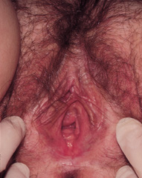
Atrophic Vaginitis
FIGURE 1. Atrophic vaginitis. Note loss of labial and vulvar fullness, pallor of urethral and vaginal epithelium, and decreased vaginal moisture.
Adapted from GLORIA A. BACHMANN, M.D., and NICOLE S. NEVADUNSKY. Diagnosis and treatment of atrophic vaginitis. Am Fam Physician. 2000 May 15;61(10):3090-3096.

Slide 48
Use of figures

Slide 49
Use figures
  To quickly emphasize a relationship between data
  To quickly state a process
    E.g. Graphs, Charts
  Line graphs
    Show continuous change over time (e.g. birth rates)
    Limit to 4 lines per graph

Slide 51
Use figures.
  Bar graphs
    Show change over time of discrete variables (e.g. item numbers, symptoms)
    Show multiple variables

Slide 52
Distribution of male and female residents in OB Gyn

Slide 53
Notes:
Slight increase in the inpatient referrals, reflective of the increasing number of department admissions.
And a 34% increase in the outpatient referrals, highest in the last 5 years

Slide 54
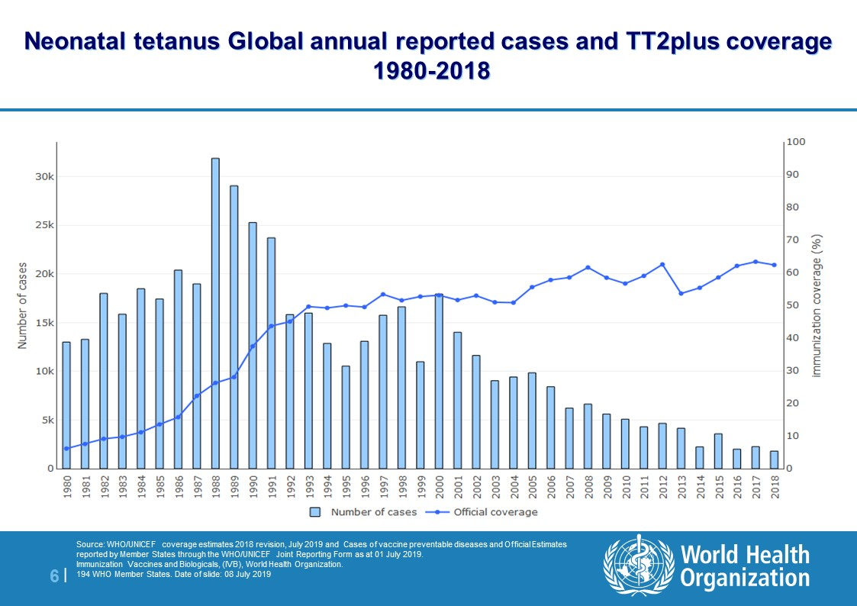
Maternal and Neonatal Tetanus
Maternal and Neonatal Tetanus remains a public health threat in 12 countries:
  Afghanistan
  Angola
  Central African Republic
  Guinea
  Mali
  Nigeria
  Pakistan
  Papua New Guinea
  Somalia
  South Sudan
  Sudan
  Yemen

Slide 55
Use figures.
  Pie graphs
    Compare the parts of a whole
    Show no more than 6 slices
    Position largest slice at 12 or 6 o’clock position.

Slide 57
Notes:
The cases with the highest number of referrals have remained the same for the past 3 years
2017: Hepatitis B, Condyloma and Syphilis, Septic abortion
2018: Hepatitis B, Syphilis and Condyloma
2019: Hepatitis B, Syphilis and Condyloma
Sexually transmitted infections remain to be the most common reasons for referral even in obstetric patients, and this may be reflective of the epidemiologic status of STIs in the country. The high number of referrals for both Hepatitis B and Syphilis infections may be attributed to the continued efforts of the WHO and DOH in promoting screening for sexually transmitted infections in pregnancy. These screening programs are very crucial in allowing for early diagnosis and prompt intervention for the prevention of mother-to-child transmission.

Slide 58
Summary
Know your objective.
Know your audience.
Identify information that needs graphic representation.
4. An effective presentation is gets the message across.
5. An effective message is clear, short and simple.

Slide 59
Rules on Online Presentation
Introduce everyone at the beginning.
Ensure you have a clean, work-appropriate background.
Eliminate distractions.
Modified and adapted from: Video Meeting Etiquette: 7 Tips to Ensure a Great Attendee Experience. November 27, 2019. 2020 Zoom Video Communications, Inc.

Slide 60
Rules on Online Presentation
Look into the camera when talking instead of yourself.
Adjust audio and video settings as needed.
Invite appropriate participants only.
If you are the host, stick around.
Modified and adapted from: Video Meeting Etiquette: 7 Tips to Ensure a Great Attendee Experience. November 27, 2019. 2020 Zoom Video Communications, Inc.

Slide 61
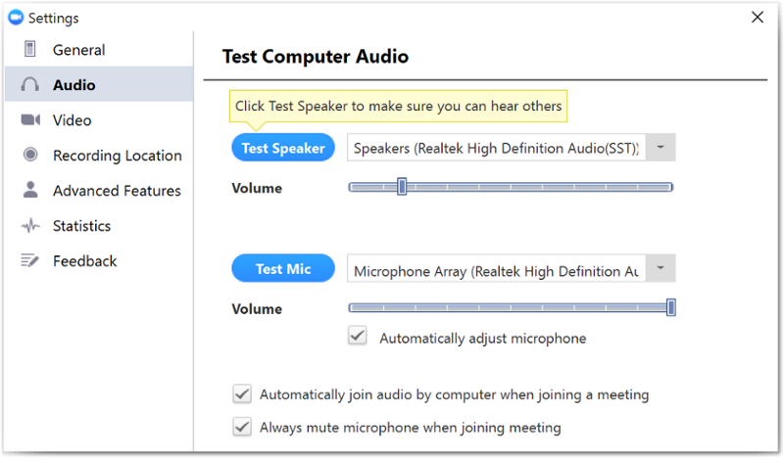
Audio Settings
Source: Zoom: Settings and Configuration
Last Updated: March 12, 2020 11:06:08 AM PDT

Slide 62
Audio Settings
Select the speakers you want to test from the list of your computer’s audio playback devices listed in the drop-down next to the Test Speaker button.
Click the Test Speaker button.
Adjust the volume of the selected playback device until you’re satisfied.
Select the microphone you want to test from the list of your computer’s audio recording devices listed in the drop-down next to the Test Mic button.
Click the Test Mic button.
Adjust the volume of the selected recording device until you’re satisfied.
Choose your audio preferences for meetings.
Zoom: Settings and Configuration
Last Updated: March 12, 2020 11:06:08 AM PDT

Slide 63
Video Settings
The Video Settings provide you the ability to determine your preferences during meeting participation.
Choose the camera you want to use from the “Camera” dropdown list.
Choose between widescreen and original aspect ratios.
Choose your video preferences for meetings.
Note: The widescreen aspect ratio presents black bars on both sides of the video playback.
Zoom: Settings and Configuration
Last Updated: March 12, 2020 11:06:08 AM PDT
UC San Diego 9500 Gilman Dr. La Jolla, CA 92093 (858) 534-2230

Slide 64
How do you select gallery view on Zoom?
To switch from active speaker view, tap Switch to Gallery View in the upper-left corner of the Zoom window.
If you do not see the controls, tap your screen to get them to appear.
This will switch into gallery view. You can view up to 9 people at a time.
2020 Guiding Media Pvt Ltd.

Slide 65
ADD VIRTUAL BACKGROUND TO ZOOM MEETINGS
You can either choose from the available virtual backgrounds or add your own.
To change your background, go to the Zoom settings. Click on Virtual Background from the left sidebar. Select a background. Click on the add icon to upload from your PC.
2020 Guiding Media Pvt Ltd.
Notes:
Many of us are concerned about our background when we are on a video call. Thankfully, you can deal with that. Pick Zoom's virtual background to make your video feed look distinct.

Slide 66
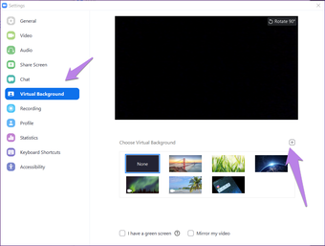
ADD VIRTUAL BACKGROUND TO ZOOM MEETINGS
2020 Guiding Media Pvt Ltd.

