Slide 1
Growth Deviations in the Fetus and Newborn
Maria Anna M. Tugano, MD
UP-PGH Division of Newborn Medicine

Slide 2
Objectives
At the end of this session, the participant should be able to:
Describe normal fetal growth
Understand and describe fetal growth deviations: causes, manifestations, complications and prevention
Compare fetal growth deviations vs weight-for-age standards

Slide 3
Fetal Growth
Appropriate fetal growth and development in utero is essential for newborn health and lifelong well being
Varies significantly by race, sex, parity, maternal size and other genetic and physiological factors
Best judged through serial measurements
Normal is defined by measurements of the head, abdomen and femur
Notes:
The use of ultrasound for routine biometry is done to establish or confirm gestational age.

Slide 4
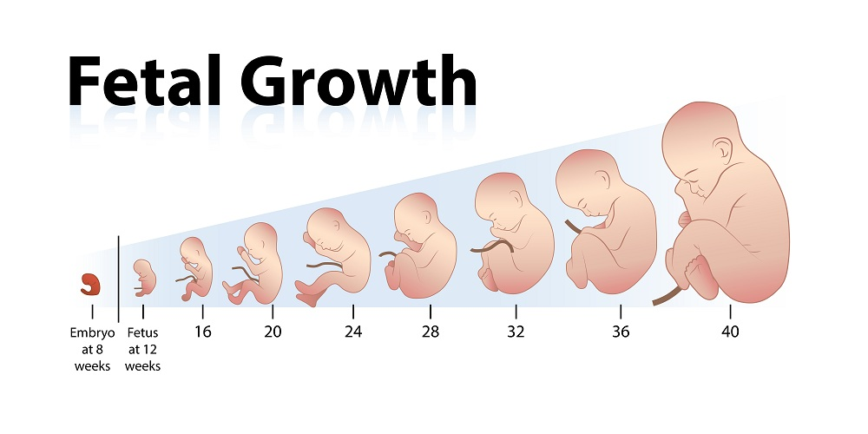
Fetal Growth
Stage 1 | Stage 2 | Stage 3
4-20 weeks | 20-28 weeks | 28-40 weeks
Hyperplasia | Hyperplasia/ hypertrophy | hypertrophy
Rapid mitosis | Declining mitosis | Rapid hypertrophy
Increasing DNA content | Increasing cell size | Rapid increasing cell size
symmetric | Mixed- asymmetric | asymmetric
Notes:
The use of ultrasound for routine biometry is done to establish or confirm gestational age.

Slide 5
Fetal Growth
Biometrics
Crown-rump length | Best parameter for early dating
Biparietal diameter | Obtained after parietal bone calcification (12 weeks AOG) Gives closest correlation with gestational age in 2nd trimester
Head circumference
Femoral length
Transcerebellar diameters
Humeral and pedal lengths

Slide 6
Fetal Growth Deviations
Abnormal fetal growth
Small for gestational age (SGA) vs Intrauterine Growth Restriction
Large for gestational Age vs Macrosomia
Notes:
Before the clinical onset of growth delay, there is a decrease in the UV volume flow and reduction in fetal cardiac output. Venous redistribution leads to downregulation of the glucose-insulin-IgF growth axis and to decreased glycogen storgae in the liver. Therefore, liver size is reduced with a fall in the AC before the EFW falls below the 10th percentile.

Slide 7
Fetal Growth Deviations
Sharma et al. Postnatal Complications of IUGR. J Neonatal Biol 5:232.
Notes:
Determined by 4 main factors
Mother
Ethnicity, height, weight, comorbidities
Placenta
Fetus
Environment

Slide 8
Fetal Growth Deviations
No universally accepted criteria for diagnosis of abnormal fetal growth
Findings on Doppler Studies | Associated Problems
High umbilical artery resistance | uteroplacental constraints on fetal growth
Persistent absence or reversal of end-diastolic flow | severe growth restriction, perinatal morbidity and mortality
Middle cerebral artery resistance (manifests later) | Compromised perfusion
Paradoxical ductus venosus | Indicator for morbidity

Slide 9
Fetal Growth Deviations
Abdominal circumference
Before clinical onset of growth delay, there is a decrease in umbilical venous volume flow → reduction in fetal cardiac output → downregulation of the glucose-insulin-IgF growth axis → decreased glycogen storage → liver size reduced
Notes:
Before the clinical onset of growth delay, there is a decrease in the UV volume flow and reduction in fetal cardiac output. Venous redistribution leads to downregulation of the glucose-insulin-IgF growth axis and to decreased glycogen storgae in the liver. Therefore, liver size is reduced with a fall in the AC before the EFW falls below the 10th percentile.

Slide 10
Fetal Growth Deviations
Abdominal circumference
Outer margin of the abdominal skin line at the level of the gastric bubble and the intrahepatic portion of the umbilical vein at the bifurcation of the portal veins
Best single predictor of growth aberrations
Better indicator of decreased perfusion or increased glycogen storage than cranial measures

Slide 11
Fetal Growth Restriction
Birth weight less than the:
Tenth percentile (ACOG)
Third percentile (WHO)
Intrauterine Growth Restriction (IUGR)
A type of FGR
Second top cause of perinatal morbidity and mortality worldwide
Failure of the fetus to reach in utero growth potential
Deviation form the normal or expected fetal growth pattern
About 7-9% of livebirths

Slide 12
Intrauterine Growth Restriction
COMMON ETIOLOGIES
Maternal Factors | Placental Factors
Age Parity Ethnicity/race Height Poor weight gain Short pregnancy intervals Nutrition Infection Pulmonary, cardiac, renal, liver, autoimmune diseases Diseases related to pregnancy Anemia/hemoglobinopathies thrombophilia | Placental insufficiency Multiple gestation
 | Environmental Factors
 | Medications Tobacco/alcohol Altitude Assisted reproductive technology Country of origin
 | Fetal Factors
 | Genetics Chromosomal disorders
Notes:
‘head sparing’ due to redistribution of fetal blood flow

Slide 13
Intrauterine Growth Restriction
Characteristics | Asymmetric IUGR (Type 1) | Symmetric IUGR (Type 2)
Incidence | 70-80% of cases | 20-30% of cases
Etiology | Uteroplacental insufficiency | Genetic disorder Infection intrinsic to fetus
Antenatal scan (HC, AC, BPD, FL) | Abdominal circumference is decreased | All are proportionally reduced
Cell number | Normal | Reduced
Cell size | Reduced | Normal
Sharma et al. Postnatal Complications of IUGR. J Neonatal Biol 5:232.
Notes:
‘head sparing’ due to redistribution of fetal blood flow

Slide 14
Intrauterine Growth Restriction
Characteristics | Asymmetric IUGR (Type 1) | Symmetric IUGR (Type 2)
Ponderal index | Low (less than 2) | Normal (more than 2)
Postnatal anthropometry (Wt, Lt, HC) | Reduction in weight, length and head circumference- normal | Reduction in all parameters
Difference between HC and CC in term IUGR | More than 3 cm | Less than 3 cm
Features of malnutrition | More pronounced | Less pronounced
Prognosis | Good | Poor
Sharma et al. Postnatal Complications of IUGR. J Neonatal Biol 5:232.
Notes:
Ponderal Index (PI=[weight (in gram) × 100] ÷ [length (in cm) 3])

Slide 15
Intrauterine Growth Restriction
Antenatal Diagnosis
⬆Umbilical artery resistance → diastolic flow decreases, disappears then reverses
Decreased middle cerebral flow is considered an ominous sign

Slide 16
Intrauterine Growth Restriction
Antenatal Diagnosis
Abdominal circumference
Specificity and negative predictive value close to 90%
Reflects a small liver, decreased hepatic glycogen stores and subcutaneous fat
Biophysical profile
Order of disappearance
Reactivity→Breathing→Movement→Tone→Amniotic fluid

Slide 17
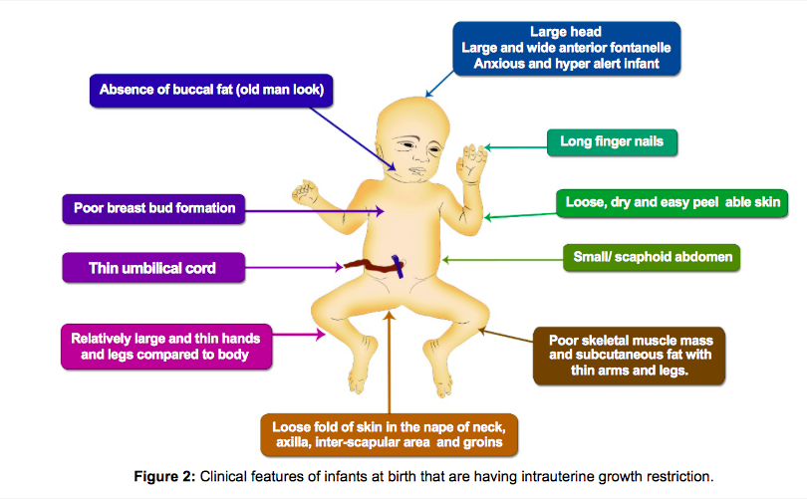
Intrauterine Growth Restriction
Clinical Features
Sharma et al. Postnatal Complications of IUGR. J Neonatal Biol 5:232.

Slide 18
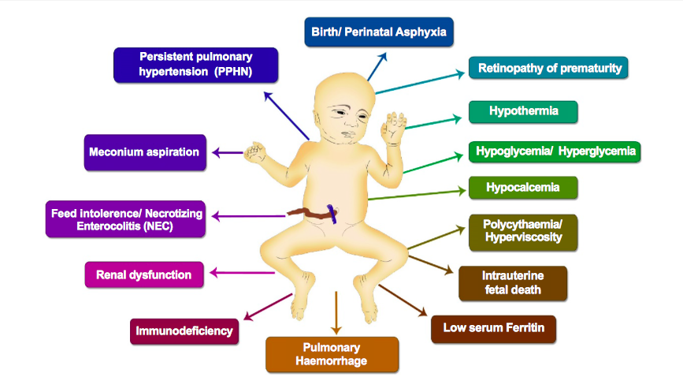
Intrauterine Growth Restriction
Short Term Complications
Sharma et al. Postnatal Complications of IUGR. J Neonatal Biol 5:232.

Slide 19
Intrauterine Growth Restriction
Complications in Childhood
Sharma et al. Postnatal Complications of IUGR. J Neonatal Biol 5:232.

Slide 20
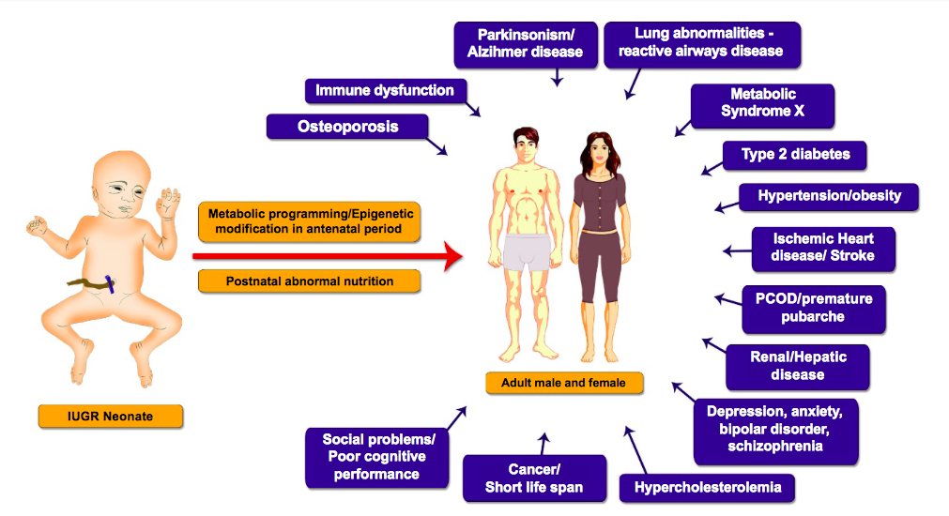
Intrauterine Growth Restriction
Complications in Adulthood
Sharma et al. Postnatal Complications of IUGR. J Neonatal Biol 5:232.

Slide 21
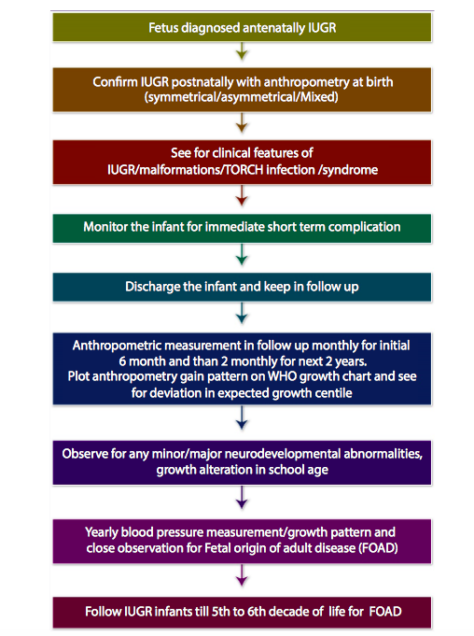
Intrauterine Growth Restriction
Treatment
Counseling regarding:
Diet and vices
Birth spacing
Nutrient supplementation
Low dose aspirin

Slide 22
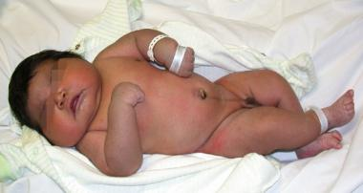
Macrosomia
“large body”
Multiple definitions exist
>90th OR >95th percentile
> 4000g OR >4500 g estimated weight
Implies growth beyond an absolute weight irrespective of gestational age
Predilection of fat to deposit in shoulders/chest, neck and face

Slide 23
Macrosomia
Risk factors
Maternal diabetes
High pre-pregnancy BMI
Excessive weight gain during pregnancy
Multiparity
Male sex
Parental height
Prolonged gestation

Slide 24
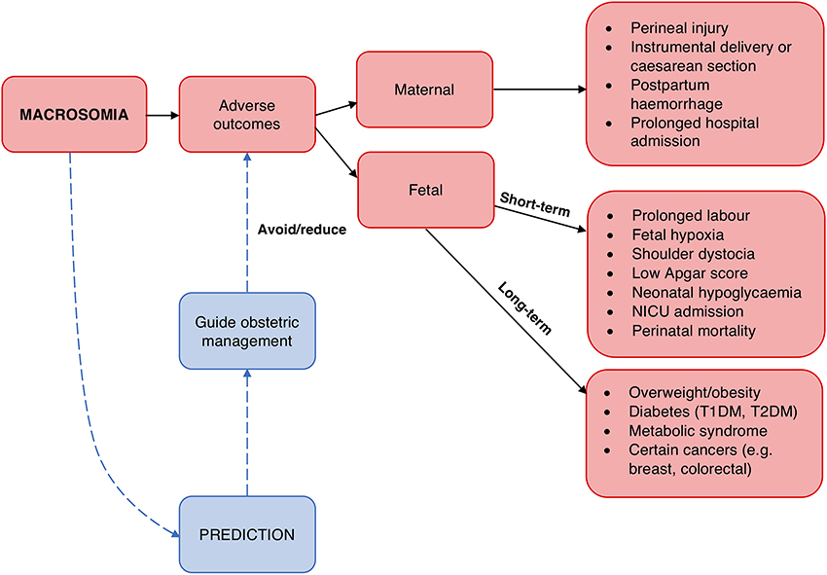
Macrosomia: Outcomes

Slide 25
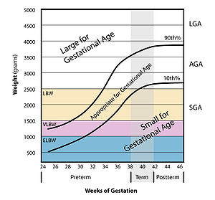
Weight-for-gestational-age Standards

Slide 27
Appropriate for Gestational Age (AGA)
Newborns whose birth weight was between the 10th and 90th percentile for gestational age
May include those newborns who have IUGR or macrosomia

Slide 28
Small for Gestational Age (SGA)
Size (weight and abdominal circumference) falls below a cut-off percentile (3rd or 10th) of size for gestational age
May imply fetal growth restriction but some are normal yet constitutionally small
May have the capacity to grow normally
Physical status: the use and interpretation of anthropometry. Report of a World Health Organization expert committee. World Health Organ Tech Rep Ser 1995;854:1-452.

Slide 29
IUGR vs SGA
Intrauterine Growth Restriction | Small for Gestational Age
Fail to reach in utero growth potential Growth of some organs are sacrificed for the vital organs May have long short and long term consequences | Born less than a prespecified weight percentile regardless of etiology Less than 2 standard deviations below the mean OR Less than 10th percentile May be a reflection of genetics, race, ethnicity or sex
Notes:
IUGR is not to be confused with SGA. These two terms are often used interchangeably but are not synonymous. Not all infants with IUGR are SGA at birth, and conversely, not all SGAs had IUGR.
Small for gestational age (SGA) is defined as birth weight being less than two standard deviations (2SD) below the mean or less than 10th percentile as per specific population and gestational age norms.
This survival mechanism may result in metabolic changes, which set the stage for later neonatal, pediatric and adult onset diseases.

Slide 30
Large for Gestational Age (LGA)
If size (weight and abdominal circumference) is above the (90th or 97^{th)} percentile of size for gestational age
May imply excessive fetal growth but some are normal yet constitutionally large

Slide 31
Macrosomia vs LGA
Terms for excessive fetal growth
Macrosomia | LGA
Have more total body fat, larger shoulder and upper extremity circumferences, higher upper extremity skin-fold measurements and smaller head to abdominal circumference ratios Predilection of fat deposits in the shoulders/trunk | All proportions are large
Irrespective of gestational age | Weight with regards to gestational age

Slide 32
Classification of Size based on Birthweight
Normal birthweight | > 2,500 grams
Low birthweight | < 2,500 grams
Very low birthweight | < 1,500 grams
Extremely low birthweight | < 1,000 grams
Does not indicate the cause of such weight nor the rate of fetal growth

