Slide 1



Cholestatic Jaundice In Infancy
Germana Emerita V. Gregorio, MD, PhD
Department of Pediatrics
University of the Philippines Manila
College of Medicine Philippine General Hospital

Slide 2
Objectives
Define and recognize the clinical features of jaundice
Differentiate the two types and causes of hyperbilirubinemia
Differentiate between obstructive and non-obstructive jaundice in terms of clinical and histological features and imaging studies
Identify the disorders causing cholestasis that requires urgent surgical intervention
Discuss the consequences when there is impairment in bile flow

Slide 3
Jaundice
Yellow discoloration of the skin, sclerae and other tissues
Positive sign affecting the hepatobiliary / hematologic system
Appears if serum bilirubin is ≥ 2 mg/dl

Slide 4
Approach to A Jaundice Infant
Onset of Jaundice
  Within 1st 24 hours of life: Never Physiologic
  Within 1st 2 weeks of life : Normal or Exaggerated Physiologic Jaundice
  After 2 weeks of life: Consider Possible Liver Disease
II. Type of Jaundice
  Unconjugated/Indirect Hyperbilirubinemia
  Conjugated/Direct Hyperbilirubinemia
III. Cause(s) of Jaundice Depending on Type

Slide 5
Bilirubin Metabolism
Increased production
Decreased conjugation
Heme
(RBC)
Urobilin (Kidney)
Stercobilin (biliary tract & SI)
Bilirubin + glucoronide (Liver)
Biliverdin (RES)
Bilirubin (Albumin)
Decreased or Impaired Excretion

Slide 6
WHAT ARE THE TWO TYPES OF JAUNDICE ?

Slide 7
Type of Jaundice
Unconjugated or Indirect Hyperbilirubinemia | Conjugated or Direct Hyperbilirubinemia
Increase in total bilirubin ≤20% as direct bilirubin Jaundice, yellow stools, colorless urine Frequently due to a hematologic cause | Increase in total bilirubin >20% as direct bilirubin Jaundice, pale/acholic stools, dark urine Consider possible liver pathology

Slide 8
I. Causes of UNCONJUGATED Hyperbilirubinemia
A. Increased Production of Bilirubin
Hemolytic | Non-hemolytic
ABO and Rh Incompatibility | Physiologic Jaundice
Abnormality in RBC membrane (spherocytosis) | Maternal Diabetes Mellitus
RBC enzyme defect (G6PD deficiency, pyruvate kinase) | Birth Trauma (Intraventricular Hemorrhage; Cephalohematoma)
Abnormality in RBC (thalassemia & other hemoglobinopathies) | Polycythemia (Fetal-maternal transfusion; twin-twin transfusion; delayed cord clamp)
Notes:
G6PD protects RBC from harmful substances

Slide 9
I. Causes of UNCONJUGATED Hyperbilirubinemia
B. Decreased Conjugation
Common Causes | Uncommon Causes
Prematurity | Crigler-Najjar Syndrome (Type 1 and type 2)
Breast Milk Jaundice | Gilbert's Disease (Gilbert Syndrome)
 | Hypothyroidism
Notes:
Gilbert’s disease, a variant of Crigler Najjar wherein the UDPG transferase promoter is present. In all causes of unconjugated hyperbilirubinemia, the treatment is directed on the cause. AND in unconjugated hyperbilirubinemia, sunshine exposure will help

Slide 10
II. Causes of CONJUGATED Hyperbilirubinemia
A. Decreased Excretion (Intrahepatic Disease)
 | Causes
I. Infection | TORCH Sepsis, UTI, Tuberculosis, Malaria, Syphilis
2. Metabolic | TPN-induced cholestasis Inborn Errors of Metabolism: galactosemia, tyrosinemia, glycogen storage disease Maternal Diabetes Mellitus Hypopituitarism
3. Genetic | Turner's Syndrome Trisomy 18/Trisomy 21 (Down’s Syndrome) Alpha one antitrypsin deficiency
4. Drug Induced | Antibiotics Acetaminophen, Corticosteroids
Notes:
The second group are the causes of conjugated hyperbilirubinemia which may either be due to a decreased excretion or impaired excretion. Causes of decreased excretion includes: (1) Infection. It is important to remember that with TORCH syndrome representing Toxoplasmosis, Rubella, Cytomegalovirus and Hepatitis , this is mainly a systemic illness and therefore it is rare that the sole manifestation of the patient is jaundice. These patients may have other signs and symptoms including cranial, ophthalmic, cardiac, skin lesions. It is also important to rule out any infection, esp the treatable causes of infection like TB, malaria and syphilis. A second consideration are the metabolic causes. TPN induced cholestasis is actually a misnomer as this is usually in a setting of a premature, placed on NPO, started on TPN and being treated with antibiotics for sepsis. All these factors could cause insult to an immature liver. Thus, it is now sometimes known as Neonatal cholestasis multifactorial causes. Another important metabolic cause is galactosemia which is a congenital absence of the galactose 1 phosphate uridyl transferase. The sugar found in milk is lactose, which is metabolized to glucose and galactose. The absence of this enzyme leads to the deposition of the metabolite in the liver, kidney, eyes and brain. Once a presumptive diagnosis is made, the patient should be shifted to a lactose free milk formula.

Slide 11
II. Causes of CONJUGATED Hyperbilirubinemia
B. Impaired Excretion (Extrahepatic ± Intrahepatic Disease)
Causes
Extrahepatic Biliary Atresia
Choledochal Cyst
Neonatal Sclerosing Cholangitis
Paucity of Intrahepatic Bile Ducts (Alagille’s )
Bile Duct Stenosis
Inspissated Bile/Mucus Plug
Extrinsic Compression of Bile Ducts
Spontaneous Perforation of Bile Ducts

Slide 12
Jaundiced Infant
History, PE, Stool color, Total and Direct Bilirubin
Unconjugated
Hyperbilirubinemia
Conjugated Hyperbilirubinemia
Decreased Excretion
Impaired Excretion
Increased Production
Decreased Conjugation

Slide 13
Conjugated Hyperbilirubinemia
Urgent Investigations
Prothrombin time
Blood Glucose
Specific tests for non-viral infections
Urine test for reducing sugars
Blood and urine cultures
Notes:
The PT is a measure of extrinsic pathway (clotting factors 2, 7, 9, 10) and these factors are dependent on Vit K. In liver disease, there is malabsorption of Vit K. If the PT is prolonged and it improves after Vit K administration, then we know that it is just deficiency of VitK that caused the prolonged PT. If the PT does not improve, then it means that the liver is unable to convert VitK from inactive to active form and therefore, there is severe liver disease.
Blood glucose: liver is the site of carbohydrate metabolism.
Specific tests for non-viral infections: toxoplasmosis, malaria, syphilis, tuberculosis
Urine test for reducing sugar: If positive, consider galactosemia and change milk formula until results of NBS available
Urine and blood cultures to rule out infection/sepsis

Slide 14
Conjugated Hyperbilirubinemia
Subsequent Investigations
Stool appearance
Urine color
Ultrasound of the hepatobiliary tree
Liver biopsy
+/- ⁹⁹Tc hepatobiliary scan

Slide 15
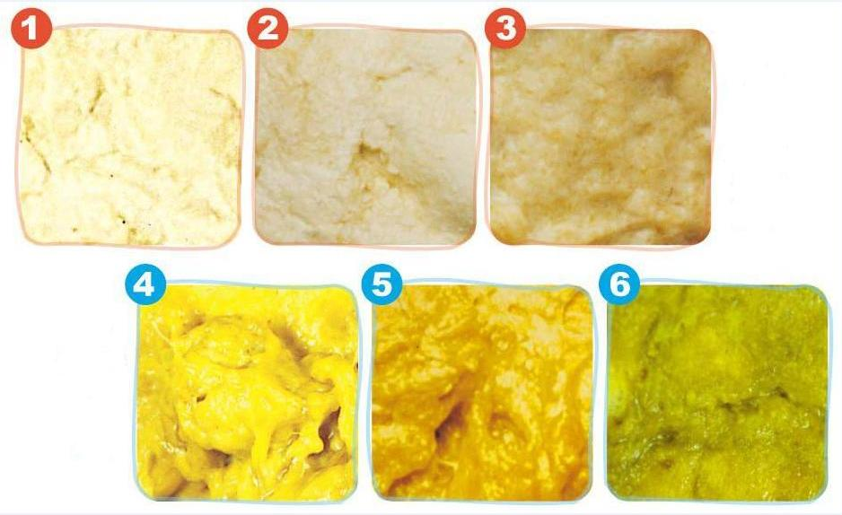

Slide 16
Diagnostic tests for possible obstructive jaundice
 | Sensitivity (%) | Specificity (%) | LR
Ultrasound | 73-100 | 67-100 | 2.2 – α
Radionuclide scan | 83-100 | 33-100 | 1.3 – α
Duodenal aspirate | 91-100 | 43-100 | 1.6 - α
Percutaneous liver biopsy | 89-99 | 82-98 | 5 - 50
LR – likelihood ratio for obstruction
Moyer et al, JPGN, 2004

Slide 17
Liver biopsy results of 376 cholestatic jaundice
Section of Pediatric Gastroenterology,
UP-Philippine General Hospital, 2004-2010
 | n (%)
Neonatal hepatitis | 231 (61)
Extrahepatic biliary atresia | 136 (36)
Miscellaneous | 9 (7)
Vitug JD, Avila JMC, Gregorio GV. Acta Medica Philippina 2015; 49:4

Slide 18
Extrahepatic Biliary Atresia
Definition
Complete obliteration or destruction of the hepatic or common bile duct
Disorder unique to infancy

Slide 19
Extrahepatic Biliary Atresia
Age (? birth) related
Normal birthweight distribution
10% prematurity
Male : female ratio of 0.8
20 -25% anomalies in other organs

Slide 20
Extrahepatic Biliary Atresia
Factors Influencing Prognosis
1. Age at surgery - persistence of bile ducts at porta hepatis
2. Experience of surgeon and perioperative team
3. Ascending cholangitis following surgery
4. Severity of liver damage at the time of surgery

Slide 21
Extrahepatic Biliary Atresia
349 children - 1985 to 2002
Age at surgery & survival with native liver
Survival rate
Age at operation (days) | n | 2-yr | 10-yr
≤ 30 | 24 | 65 | 49
31-90 | 276 | 40 | 25
>90 | 49 | 30 | 15
Schreiber et al, J Pediatrics, 2007

Slide 22
Cholestatic jaundice
Clinical consequences
1. Failure of excretion of bilirubin, bile salts and cholesterol
2. Malabsorption of fats and fat soluble vitamins
3. Hepatocellular dysfunction

Slide 23
Treatment of Cholestasis
Jaundice, Pruritus, Xanthelasma
 | Daily Dose
Cholestyramine | 4 to 16 grams
Phenobarbital | 5 to 10 mg/kg
Ursodeoxycholic Acid | 15 to 45 mg/kg
Rifampicin | 5 to 10 mg/kg

Slide 24
Treatment of Cholestasis
Vitamin Supplementation
Vitamin | Daily Doses
A | 2500 to 25,000 IU
D | 400 to 1200 IU
E | 15 mg to 200mg/kg
K | 1 to 5 mg

Slide 25
Treatment of Cholestasis
Hepatocellular Dysfunction
Ascites - diuretics, albumin transfusion
Variceal bleeding - endosclerosis, beta blockers, vasopressin/somatostatin
End stage liver disease – liver transplantation

Slide 26
Summary
There are two types of hyperbilirubinemia
The cause and treatment depends on the type
Jaundiced infants beyond 2 weeks with a direct bilirubin at least 20% of the total warrants further investigation
Biliary atresia should be recognized early to maximize survival with the native liver
Consequences of cholestasis include persistence of jaundice, pruritus, xanthelasma and hepatocellular dysfunction

