Slide 1
A tool for BPS Case Analysis (learning how to be an integrated family physician)
Patient- centered, Family Focused, Community Oriented Care Matrix

Slide 2
Framework are based from the work of Prof Zorayda Leopando in developing teaching strategies on biopsychosocial approach to care.
Slides are from Prof ZEL

Slide 3
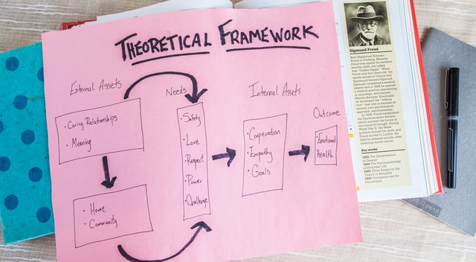
The Theoretical Framework of the PFC Matrix

Slide 4
PATIENT CENTEREDNESS and outcome of GP consultation
Predictors of satisfaction | Communication Partnership Positive MD approach
Predictors of enablement | MD’s interest on patient’s problem Health promotion Positive approach
Use of health service | Personal relationship-> less referral
Little et al 2001
DOH FMRTP
Z E Leopando
DOH FMRTP

Slide 5
FAMILY ORIENTED PRIMARY CARE
Learning to “think family”
The importance of genogram
The family within a larger system – use an ecomap
Chronic illness and disability- supporting family caregivers
Working with family members – the family conference
Identifying the family at risk
Graham Bresick, 2006
DOH FMRTP
Z E Leopando
DOH FMRTP
Notes:
In FOPC
Learning to “think family”
The importance of genogram
The family within a larger system – use an ecomap
Chronic illness and disability- supporting family caregivers
Working with family members – the family conference
Identifying the family at risk

Slide 6
SYSTEMS APPROACH
“the family operating as an interactive unit, in which what affects one member affects all members.”
Seligman & Darling, 2009

Slide 7
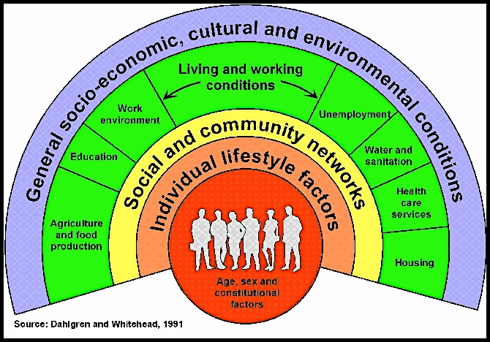
SOCIAL DETERMINANTS OF HEALTH
DOH FMRTP
DOH FMRTP
Z E Leopando

Slide 8
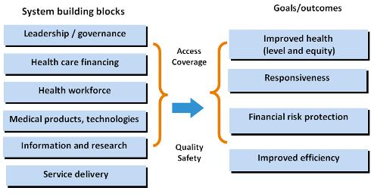
WHO BUILDING BLOCKS OF HEALTH

Slide 9
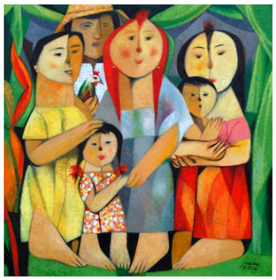
The PFC Matrix (Leopando, 200?)
DOH FMRTP
Z E Leopando
DOH FMRTP

Slide 10
PFC Matrix by Leopando
Z. E. Leopando, 2000
 | Patient Centered | Family Focused | Community Oriented to Community based
History and physical examination
Analysis , including differential diagnosis
Plan of management

Slide 11
Z. E. Leopando, 2000
 | Patient Centered | Family Focused | Community Oriented to Community based
History and physical examination | Cc, HPI, ROS, Past Med Hx, PSH, Feelings, fears concern, doubt, predicament, PE, | Family History, family determinants and resources, caregiver issues Family Life Cycle Stage | Place of origin and residence: endemicity Place of work and hazard Environmental sanitation Health center & other resources Social determinants of health
Analysis , including differential diagnosis | Differential diagnosis Stage of illness, Impact of illness, Compliance issues Bioethics CPG/ EBM | Tools for family assessment Impact of illness, Compliance issues Family lifecycle stage Bioethics | Community: effect on patient’s illness Vice versa Compare with epidemiological picture Legislation and ordinances and policies Social determinants of health
Plan of management | Diagnostics Therapeutics Supportive Alternatives Follow-up/ referral Biopsychosocial apprpoach | Capability building of caregivers Health education for family Reassurance | Networking, Linkages, referral, shared care, Health Education

Slide 12
Z. E. Leopando, 2000
 | Patient Centered | Family Focused | Community Oriented to Community based
History and physical examination | Cc, HPI, ROS, Past Med Hx, PSH, Feelings, fears concern, doubt, predicament, PE, | Family History, family determinants and resources, caregiver issues Family Life Cycle Stage | Place of origin and residence: endemicity Place of work and hazard Environmental sanitation Health center & other resources Social determinants of health
Analysis , including differential diagnosis | Differential diagnosis Stage of illness, Impact of illness, Compliance issues Bioethics CPG/ EBM | Tools for family assessment Impact of illness, Compliance issues Family lifecycle stage Bioethics | Community: effect on patient’s illness Vice versa Compare with epidemiological picture Legislation and ordinances and policies Social determinants of health
Plan of management | Diagnostics Therapeutics Supportive Alternatives Follow-up/ referral Biopsychosocial apprpoach | Capability building of caregivers Health education for family Reassurance | Networking, Linkages, referral, shared care, Health Education

Slide 13
 | Patient Centered | Family Focused | Community Oriented to Community based
History and physical examination | Cc, HPI, ROS, Past Med Hx, PSH, Feelings, fears concern, doubt, predicament, PE, | Family History, family determinants and resources, caregiver issues Family Life Cycle Stage | Place of origin and residence: endemicity Place of work and hazard Environmental sanitation Health center & other resources Social determinants of health
Analysis , including differential diagnosis | Differential diagnosis Stage of illness, Impact of illness, Compliance issues Bioethics CPG/ EBM | Tools for family assessment Impact of illness, Compliance issues Family lifecycle stage Bioethics | Community: effect on patient’s illness Vice versa Compare with epidemiological picture Legislation and ordinances and policies Social determinants of health
Plan of management | Diagnostics Therapeutics Supportive Alternatives Follow-up/ referral Biopsychosocial apprpoach | Capability building of caregivers Health education for family Reassurance | Networking, Linkages, referral, shared care, Health Education

Slide 14
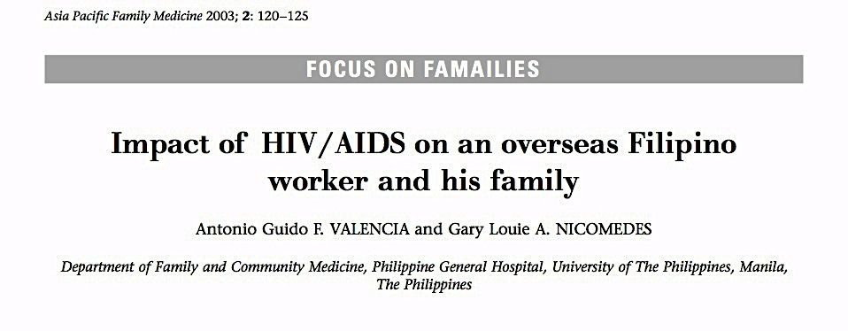
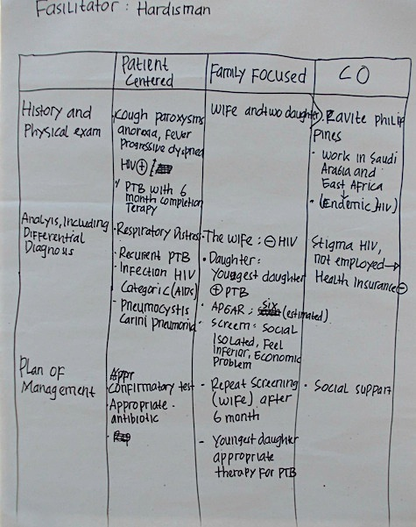

Slide 15
Guidelines for the PFC Discussion during the 2 week rotation at FM
Choose a case seen at FMC or AMBU per group
Analyze the case using the PFC matrix
To be presented on the 2nd Wednesday of your rotation.

Slide 16
Family from Community Rotation
Ba able to present a family seen and managed during your community rotation
Family presented should have PFC matrix

Slide 17
THANK YOU

